Slide 1
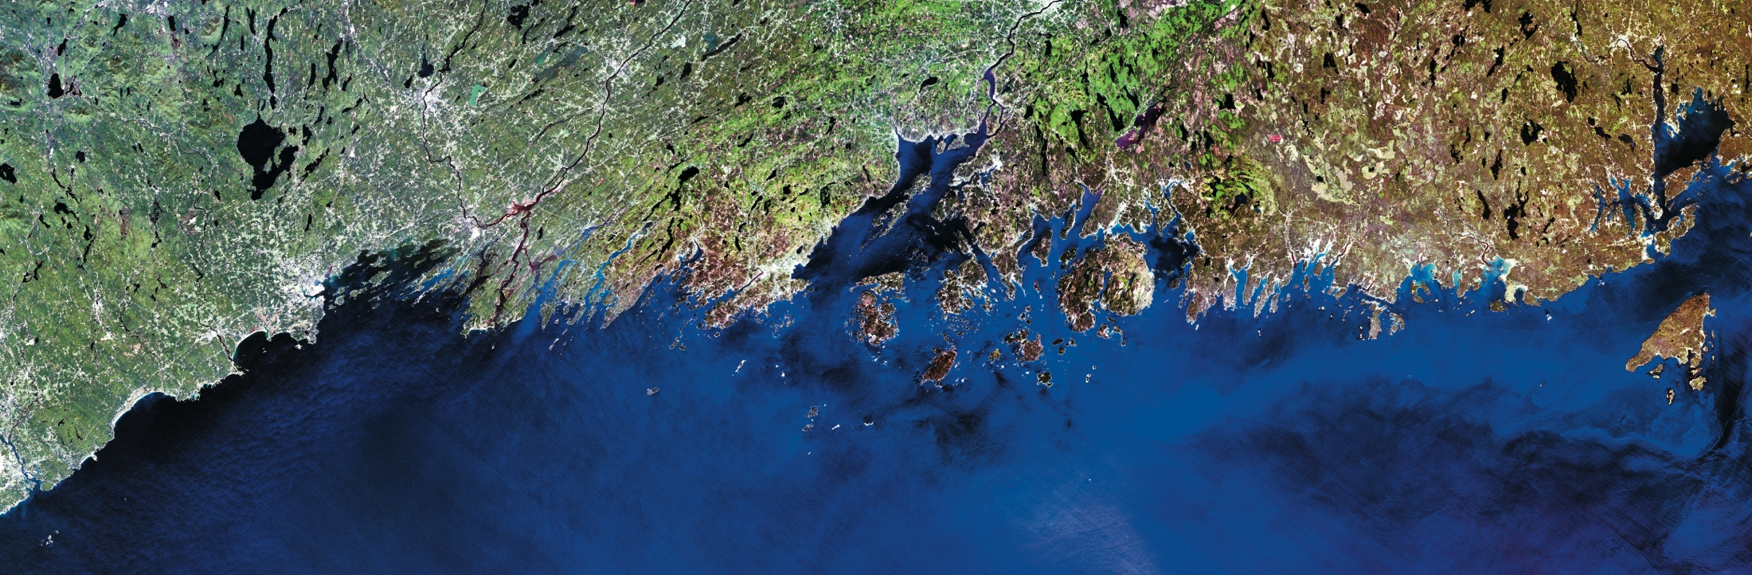
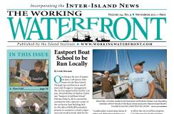
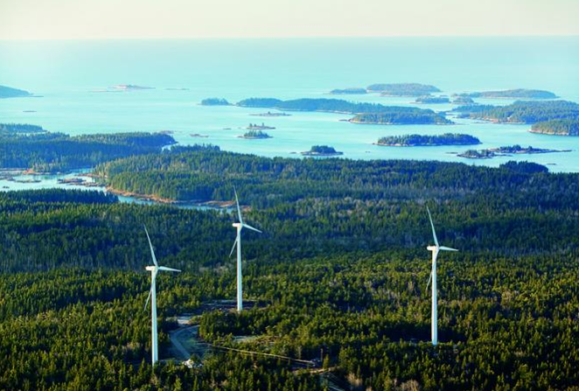
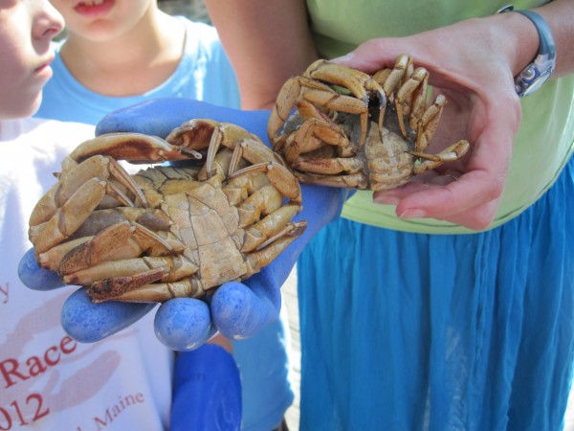
Community Development | Economic Development | Marine Programs | Education Programs | Community Energy | Media
Notes:
The Island Institute works to sustain Maine’s island and remote coastal communities, and exchanges ideas and experiences to further the sustainability of communities here and elsewhere. Similar natural resource-dependent communities elsewhere
Why is the II involved in marine resources? Fishing is critical to these communities.
15% of islanders have lobster licenses, compared to 1% of Mainers overall, suggesting the value of the lobster fishery to the islands.
For example, Islesford – 70 year round residents (including kids and elderly), 21 fishermen – almost every family is directly dependent on the fishery ($1.2 m in landings)

Slide 2
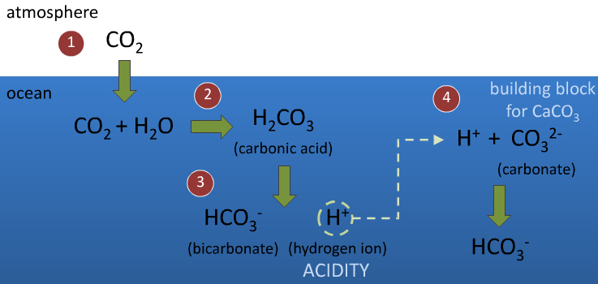
Ocean Acidification

Slide 3
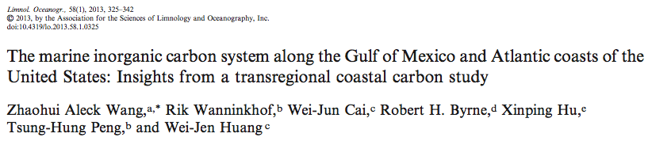
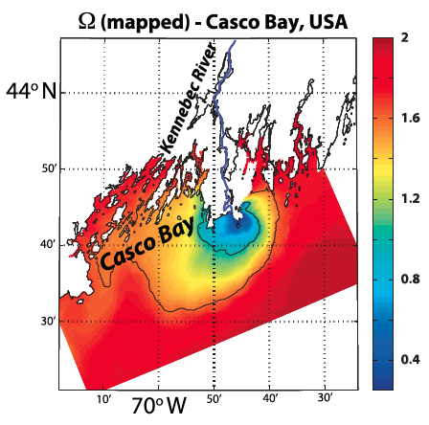
The Gulf of Maine is uniquely susceptible
Cold water absorbs CO₂ more readily
Colder, fresher water entering GoM from Canada has a lower pH
(Salisbury and Hunt, unpublished)
Fresh water coming in from many rivers is more acidic
Semi-enclosed shape may increase residence time
(Salisbury et al. EOS 2008)

Slide 4
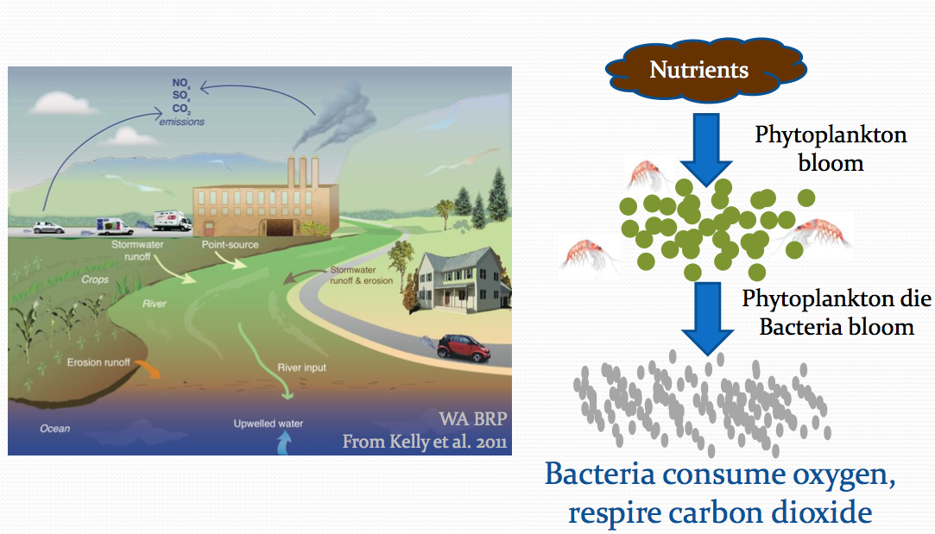
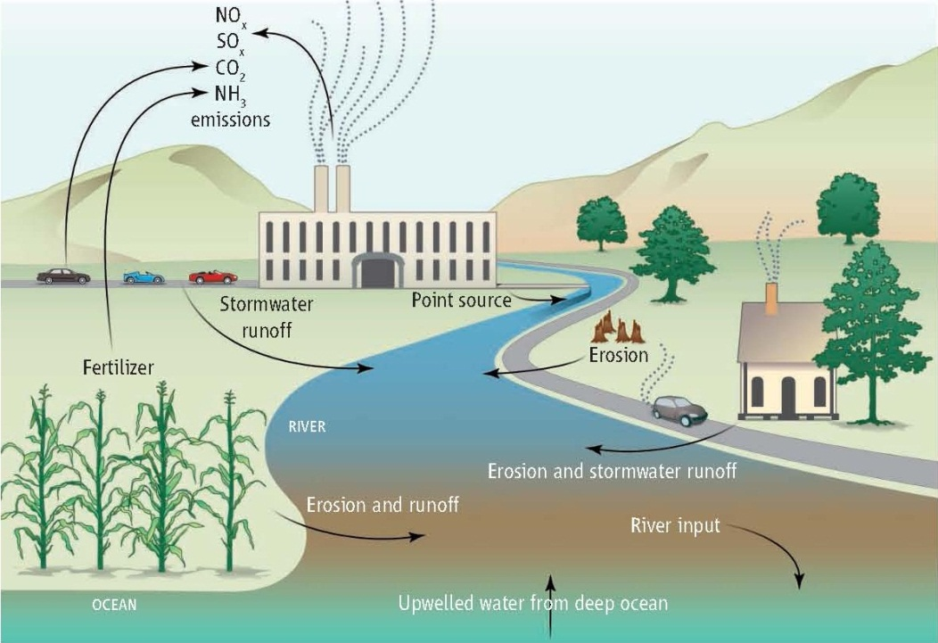
Input of nutrients can cause acidification of coastal waters- “coastal acidification”
From Kelly et al. 2011. Science.

Slide 5
Ocean Acidification Is Already Happening
Past, present and future impacts
on hard clams-
Larval clam survival
Two week survival (%)
Next century Mid Century Present Pre-Industrial
Pre-Industrial
250 ppm
Current
390 ppm
Mid-century
750 ppm
Next-century
1500 ppm
50
24 C
29 C
40
Larval clam survival-
CO₂ & temp
20 day survival (%)
30
20
10
0
~250
~380
~750
Juvenile clam growth
CO₂ level
(Talmage and Gobler, 2010, 2011)
Notes:
Not a future problem

Slide 6
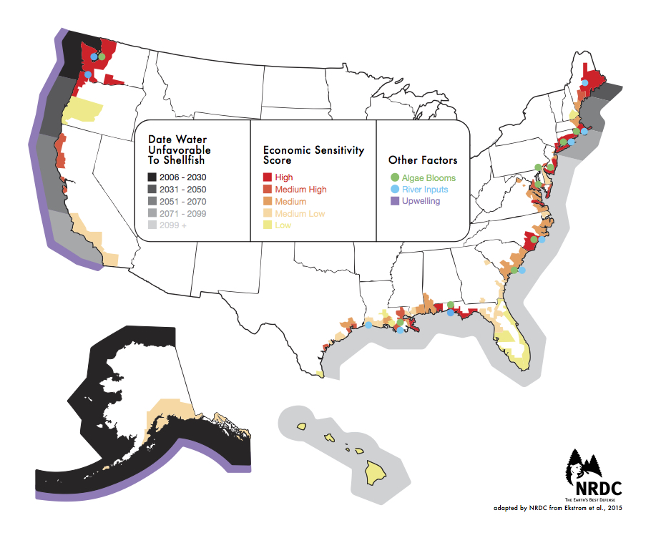

Slide 7
Preliminary 2014 Commercial Maine Landings by Ex-vessel Value
Total $585,348,370 as of 2/25/15
$464 million (including coop bonuses of ~8 million)
over 85% of Maine’s fisheries (by landings value) are shell producing species, including lobster, clams, urchins, scallops, oysters, and mussels
~7,700 active harvesters targeted shell-building species in 2014
Notes:
Why Maine has a stake is very obvious when you look at the breakdown of the value of our commercial fisheries landings.

Slide 8
