Slide 1
Living with a Changing Bay:
State of the Bay and the New Casco Bay Plan
Curtis C. Bohlen
Director, Casco Bay Estuary Partnership

Slide 2
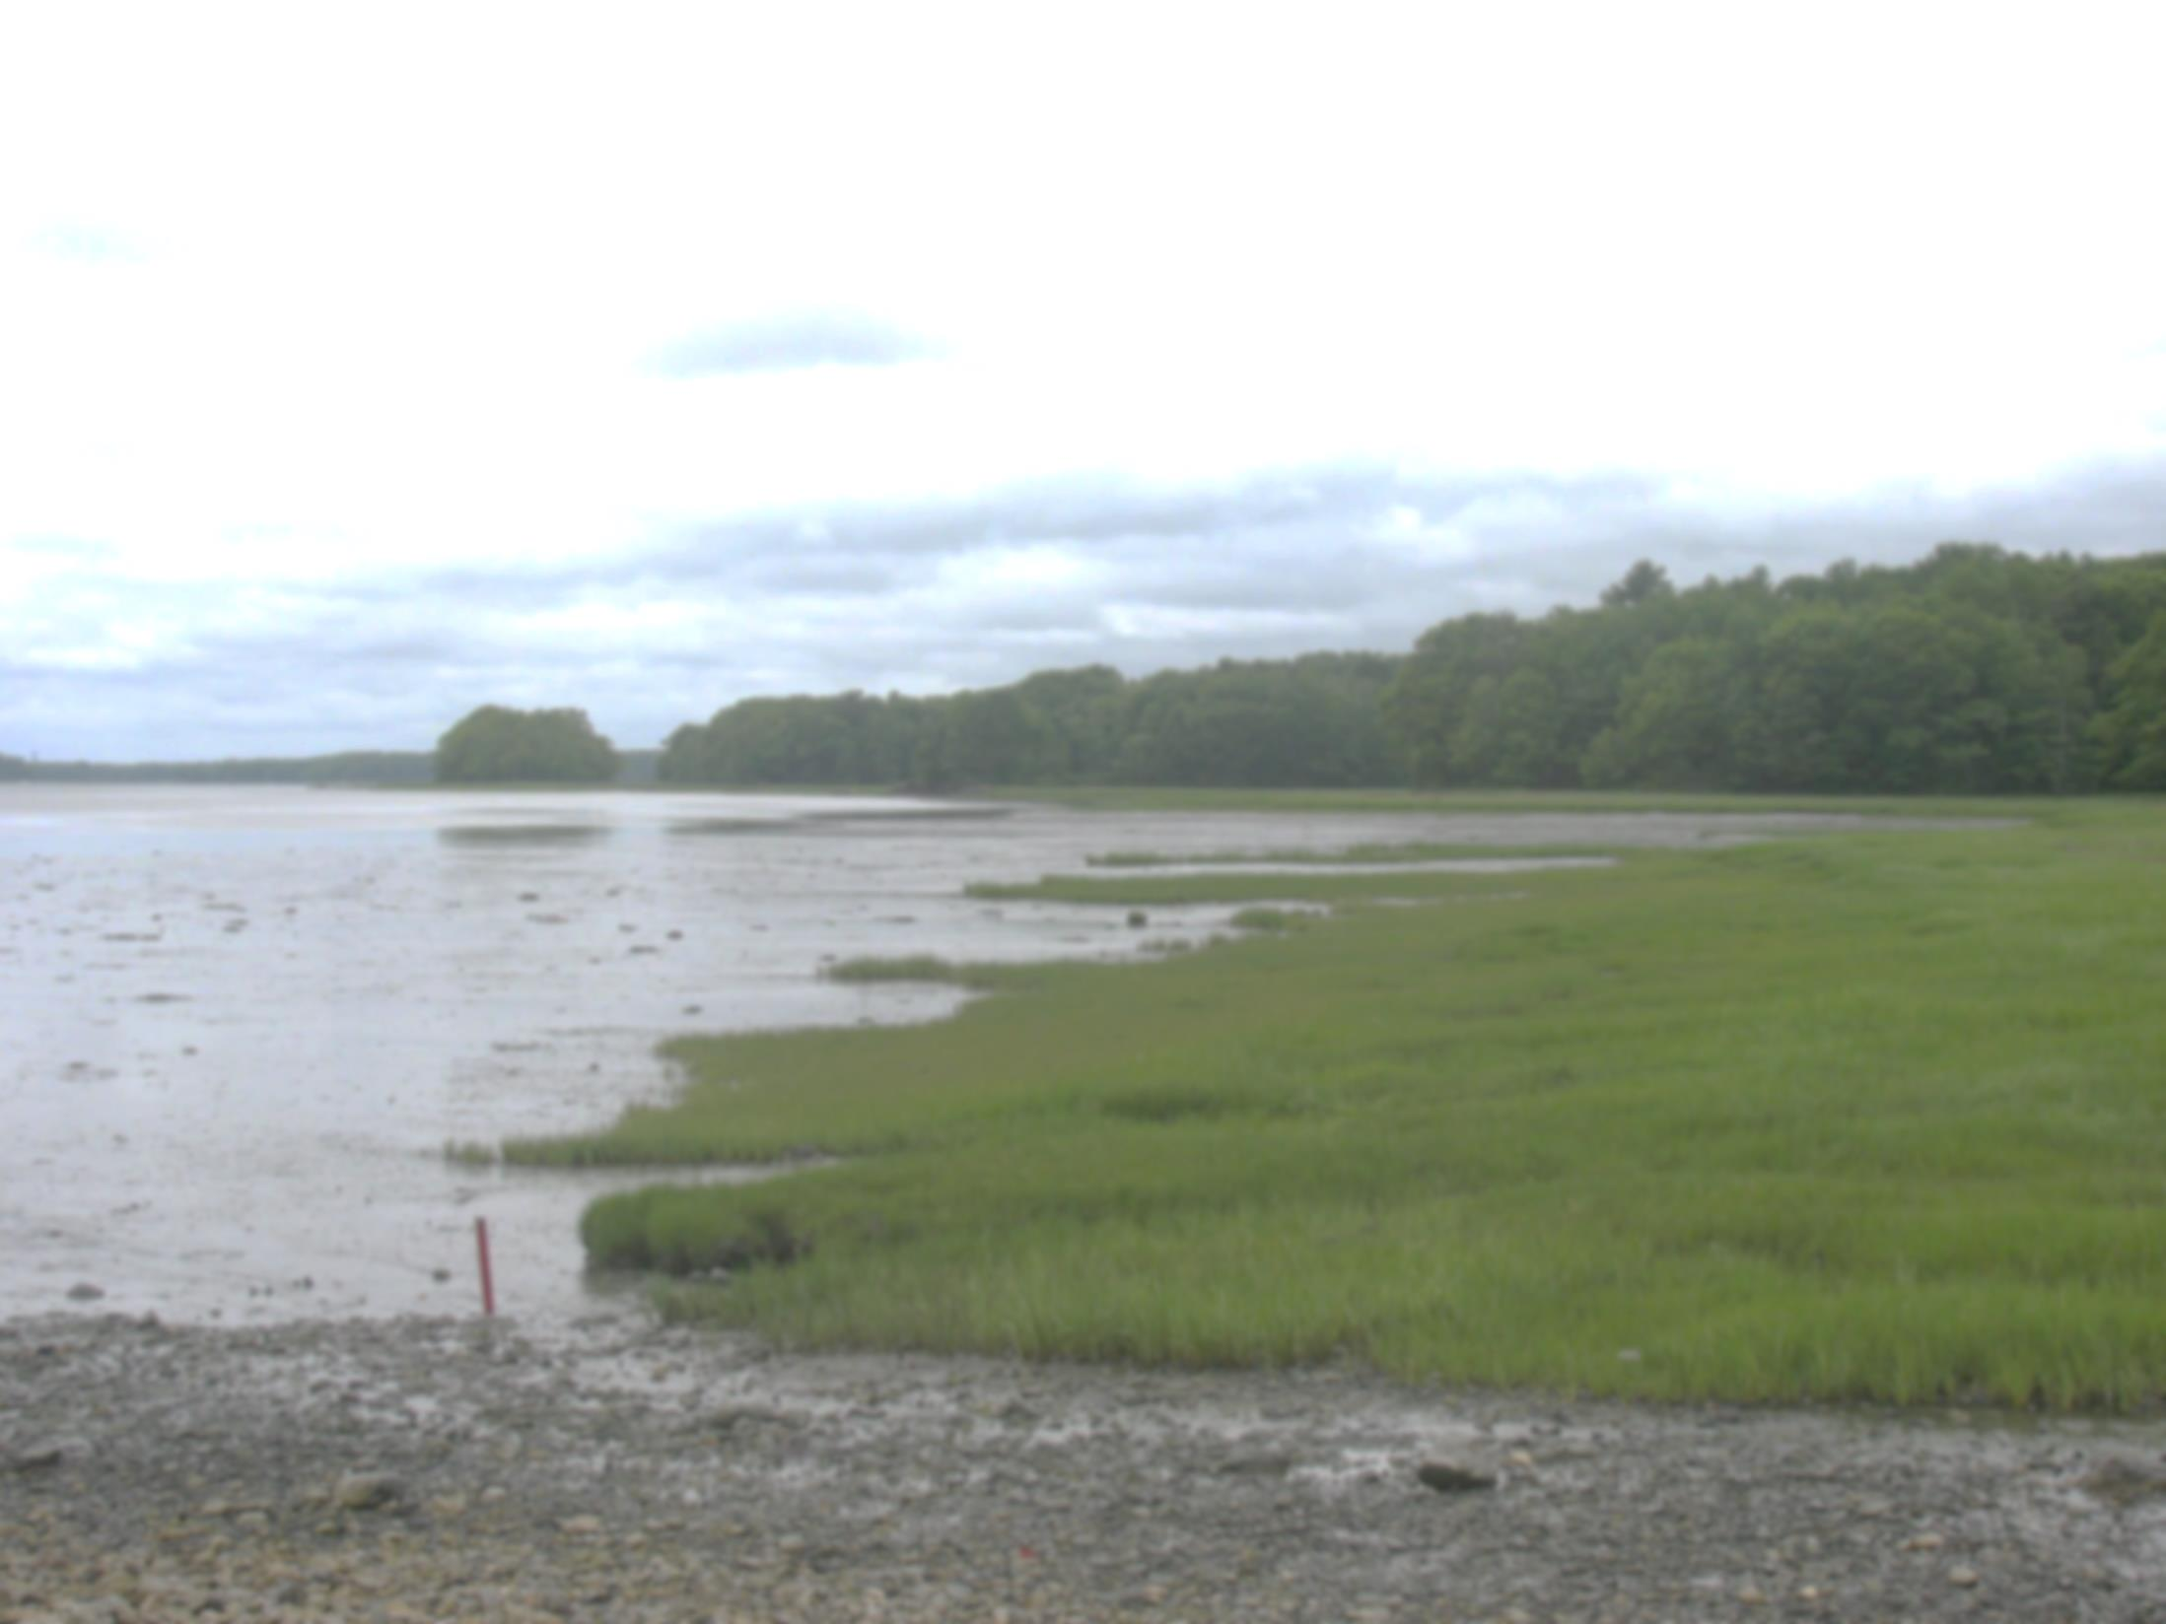
Welcome
State of the Bay 2015
What can we do today to build the Bay we will want in 2050? In 2100?
Notes:
Announcements
Not going to talk about agenda -- you have that in your hands.
Want to focus on what the day is really about.

Slide 3
Looking Back, Looking Forward
State of the Bay 2015
Draft Casco Bay Plan
Portland Community Rowing Association Regatta, 2011

Slide 4
A Changing Bay
We are in an unprecedented period of change
Climate
Invasive species
Coastal development
Coastal Acidification
Altered marine food webs
Notes:
Large scale drivers of coastal change are not being effectively controlled by existing institutions.

Slide 5
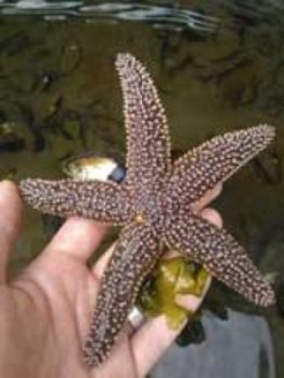
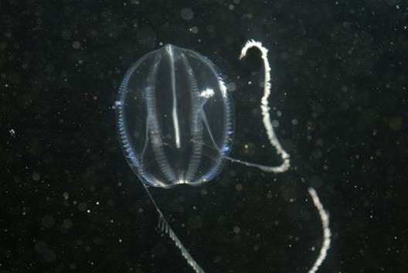
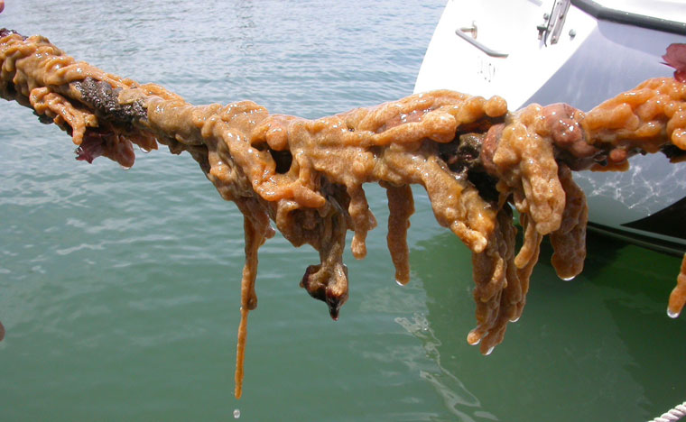
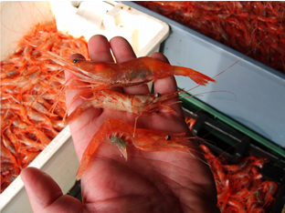
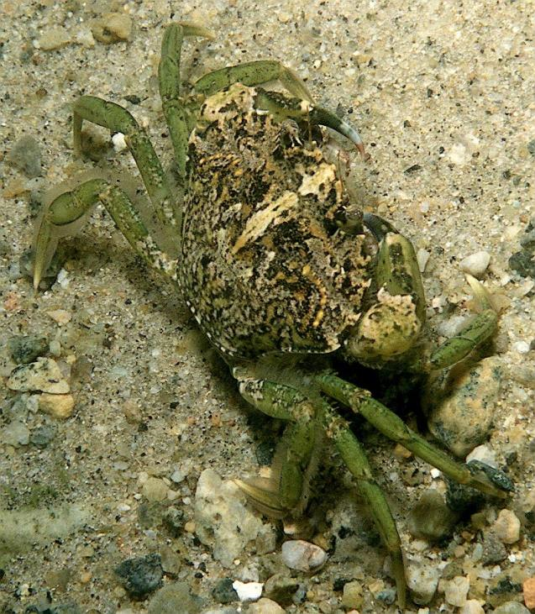
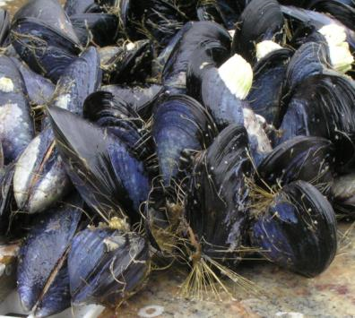
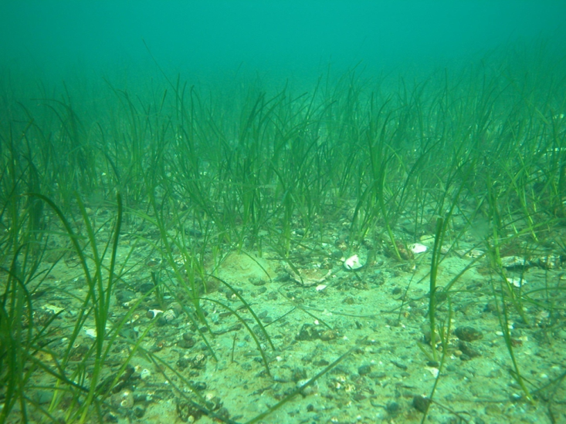
Shifting Abundance of Marine Species
Notes:
No indicators on these changes, because until recently, no systematic data collection efforts

Slide 6
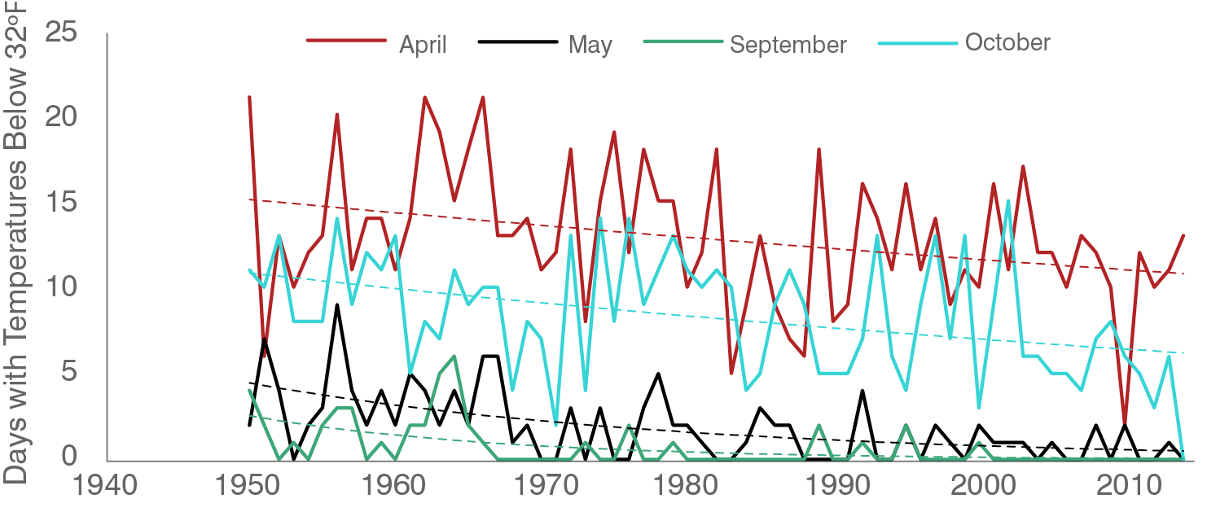
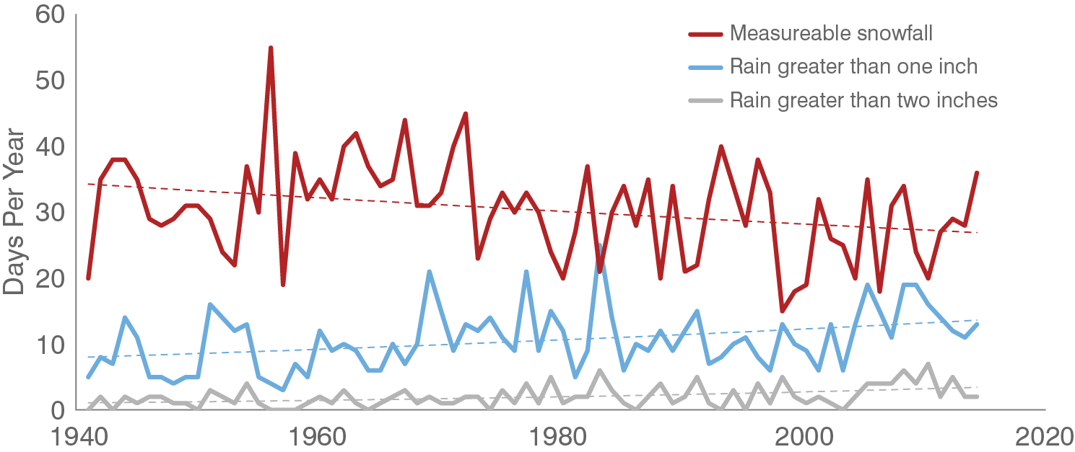
Yes It’s Warmer….
Climate has been warming for decades
Annual minimum temperatures up more than 8°F In 65 years
Freezes less common in spring and fall
Fewer days with snow, but more large rain storms
Bay ~ 3.5°F warmer in 20 years

Slide 7
But it’s not just climate
Climate will interact with other forces
Invasive species
Demographic forces
Nutrients and Water Quality
Acidification
Habitat loss
(See all 16 SotB Indicators)
P. Erickson for MIT Sea Grant College Program (from NEANS website)
Eurasian Green Crab

Slide 8
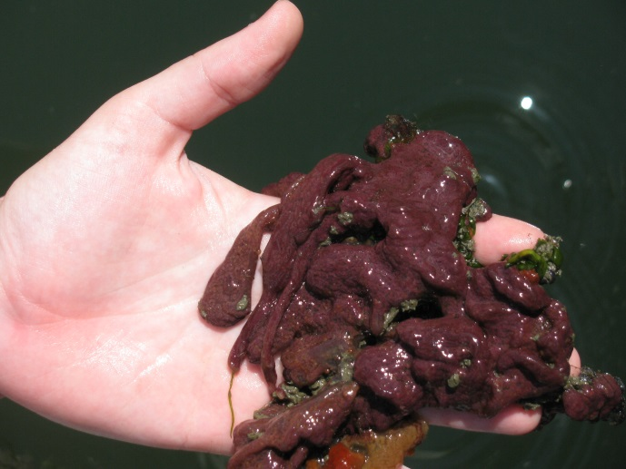
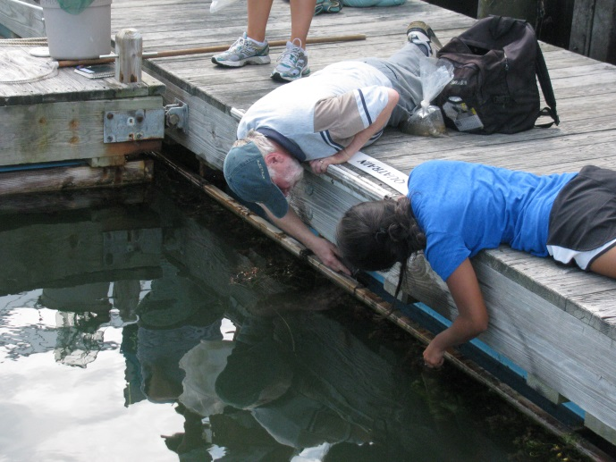
Marine Invasives
About one sixth of species at two Casco Bay
sites are introduced, with nearly as many of
uncertain origin.
18
Botryllus schlosseri
Notes:
Y moving marine species around the globe, we are creating novel combinations of species, making it doubly hard to predict how marine ecosystems will adjust in the face of other changes.

Slide 9
Demographics
Cumberland County Population
Up 8.5% since 2000
Annual Growth ~ 0.5%
~ 22% more people in the watersheds by 2050
22% more sewage
Urban areas growing, but a majority of growth continues to be suburban
Increased construction
Increased runoff

Slide 10
Interacting Changes
Multiple sources of change make prediction and understanding harder
We will be surprised

Slide 11
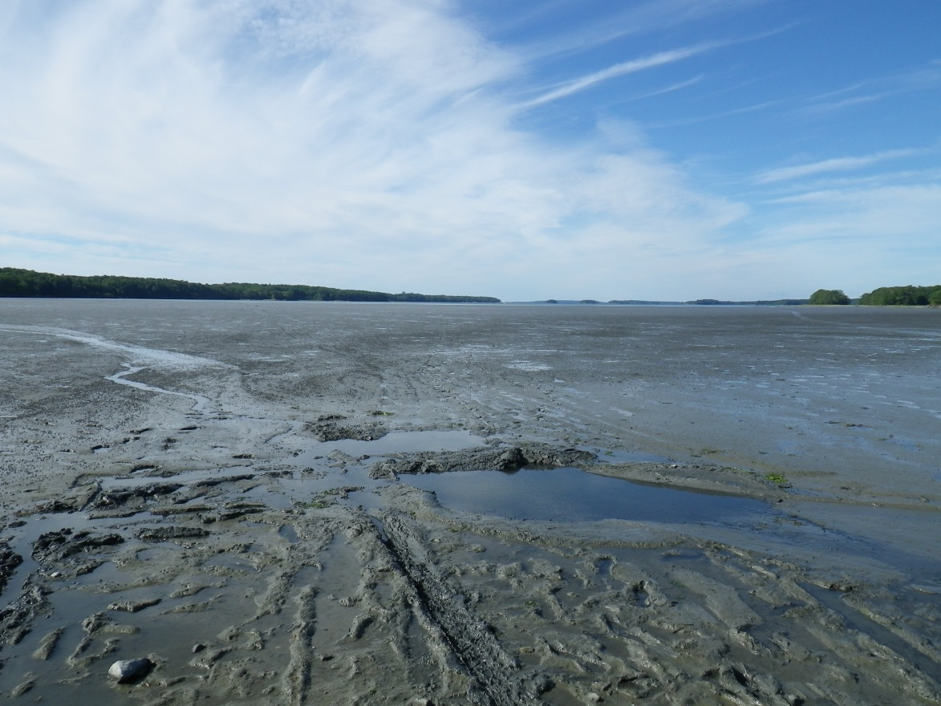
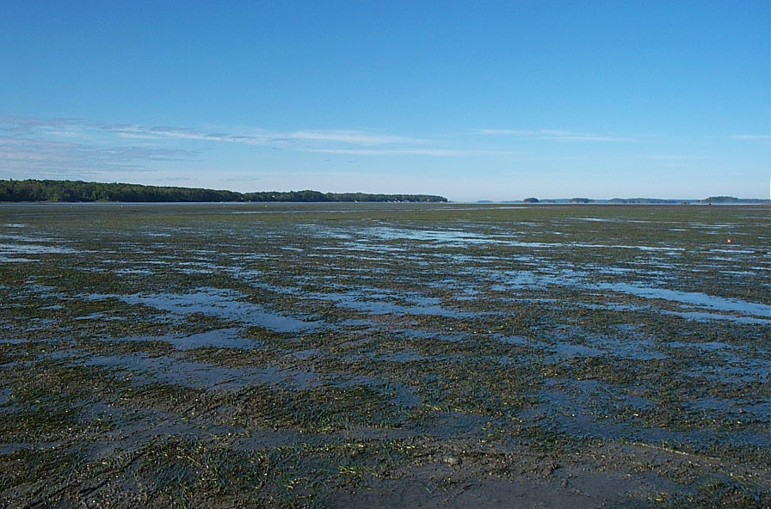
2013
2001
Photos: Hillary Neckles USGS
Notes:
Hillary Neckles
Let me give one example of the difficulties we face

Slide 12
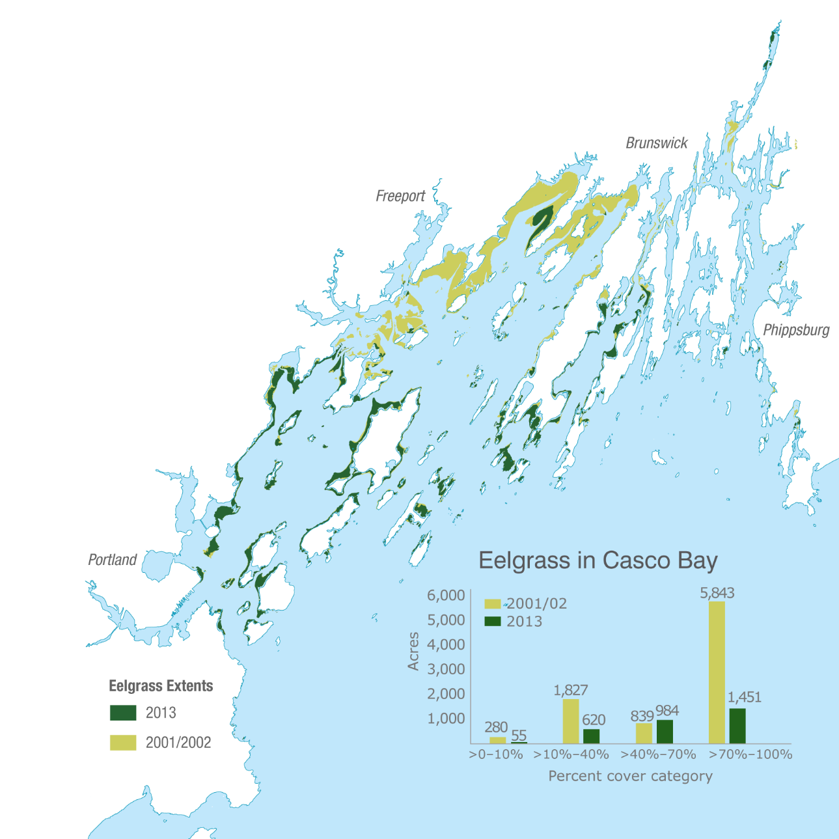
Eelgrass Coverage ca. 2002-2014
58% decline in eelgrass area
75% decline in area of dense eelgrass
Most losses occurred in 2012-2013

Slide 13
The New Casco Bay Plan
The world is changing
The future is uncertain
What can we do today to build the Bay we want in 2050? In 2100?

Slide 14
Thinking about the Future
Focus on major long-term threats to health of the Bay
Increase resilience of the Bay and our communities
Improve understanding of how the Bay provides benefits to local communities
Develop better science and more robust monitoring
Detect change
Understand change
Engage the public and communities with the Bay
Portland Waterfront, “King Tide”
Notes:
The future of the Bay will be shaped by our choices.
We need those choices to be made with the best understanding

Slide 15
The New Casco Bay Plan
Goal 1: Protect, restore and enhance key habitats that sustain ecological health
Goal 2: Reduce nutrient pollution and its impacts, including coastal acidification
Goal 3: Foster resilient communities and their connections to Casco Bay
Goal 4: Mobilize collective knowledge and resources to support Casco Bay
Hear more and join the discussion 1:00, Breakwater Room

Slide 16
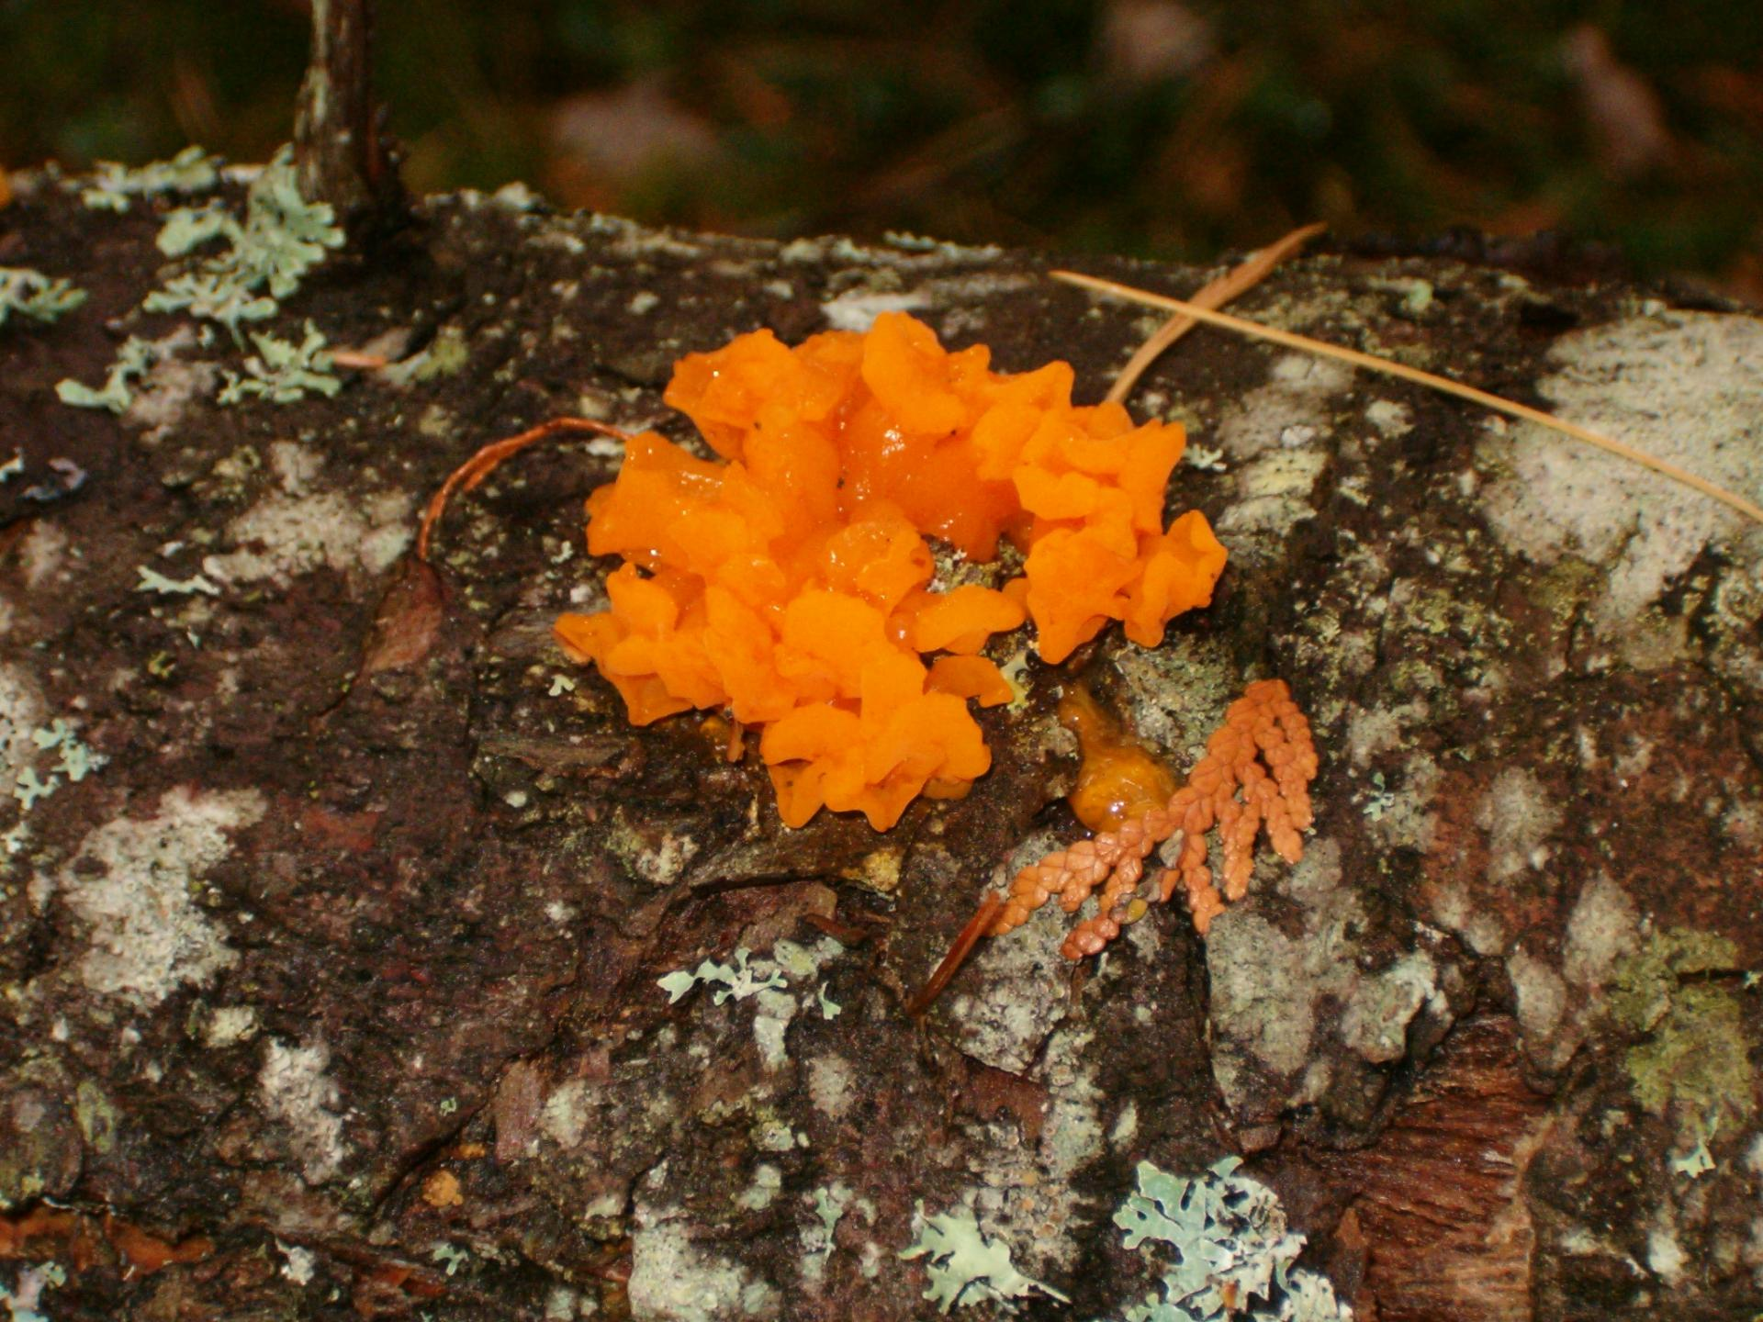
Thank you.
Curtis Bohlen
Director, Casco Bay Estuary Partnership
cascobayestuary.org
cbohlen@usm.maine.edu

