Slide 1
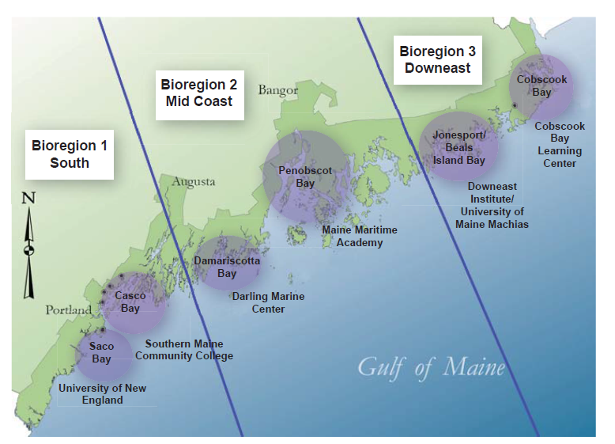
Modeling and Monitoring Approach
Place-Based and Idea-Based (organism-based)
Salmon: hydrodynamics (sea lice transport)
Oysters: hydrodynamics, nutrient, light, and productivity dynamics
Sea weed: hydrodynamics, light, and nutrient dynamics

Slide 2
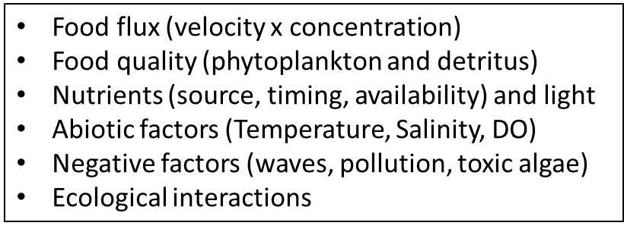
Theme 1: Growing Areas – What do we want to know and what do we want to model?
Newell, Brady, and Mayer

Slide 3
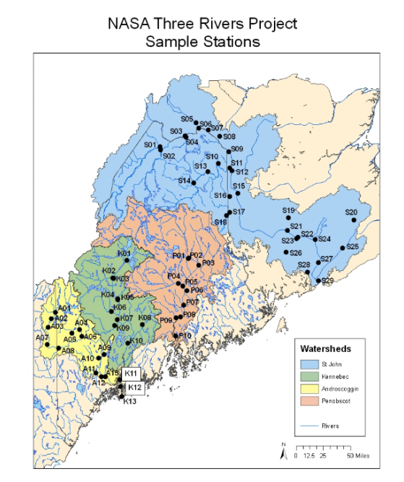
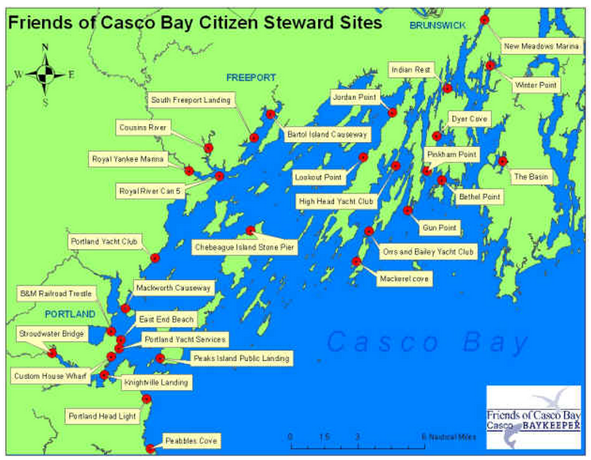
Compile Existing Data with the help of Stakeholders
Roessler
(Bowdoin)
2017

Slide 4
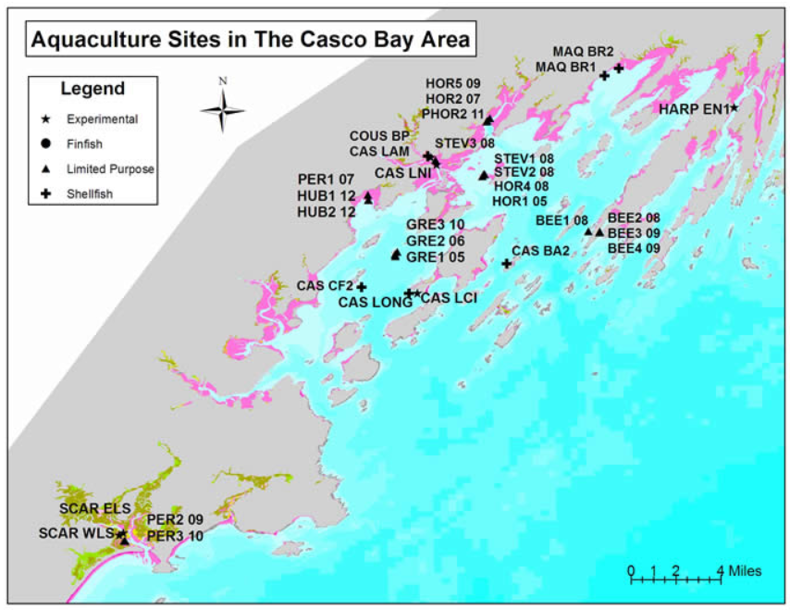
Aquaculture will inform site selection

Slide 5
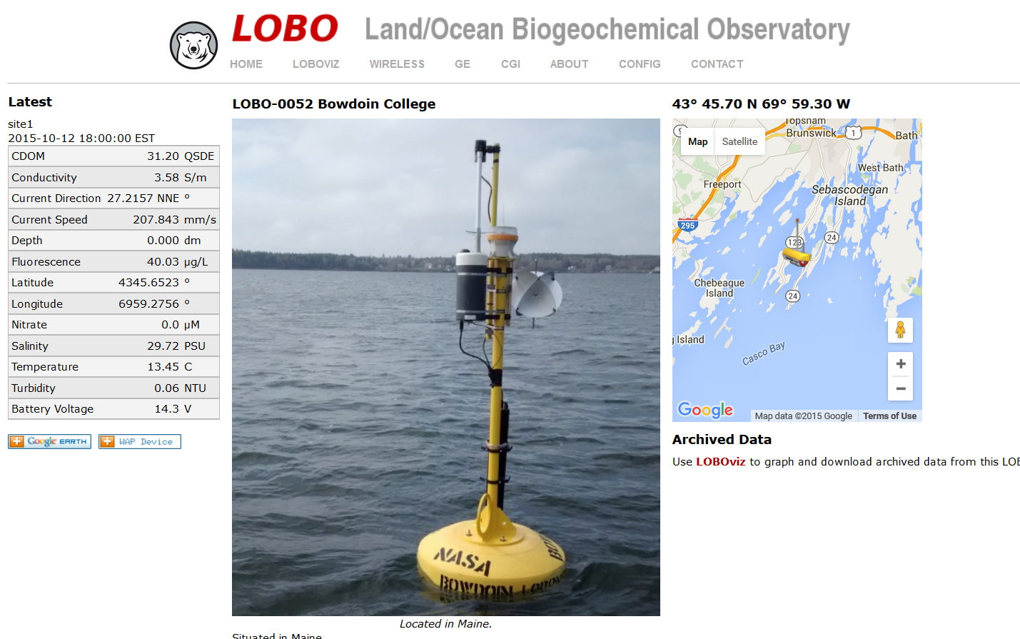

Slide 6
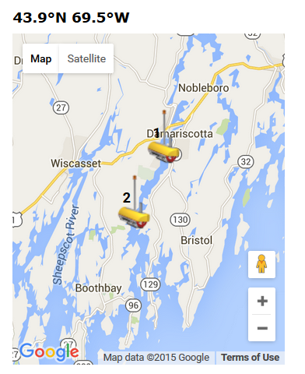
Damariscotta
Sampling along the Estuarine Gradient
Growing Area
Darling Center
Boothbay

Slide 7
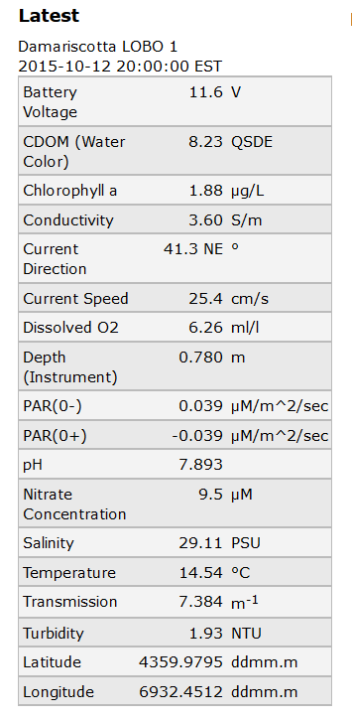
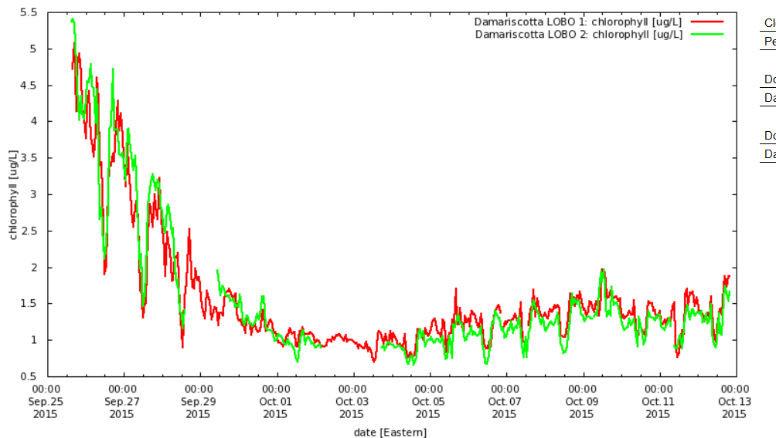
What we will be monitoring

Slide 8
Storm in Late September

Slide 9
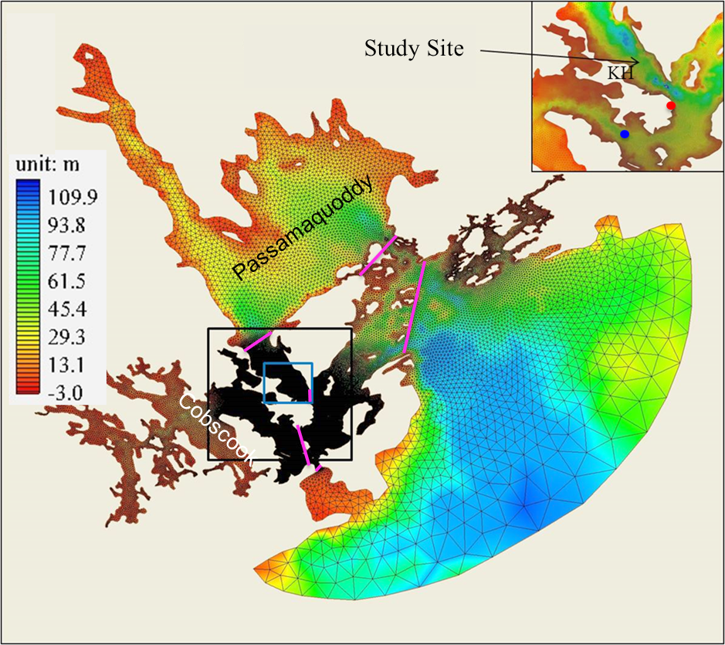
Building Modeling Capacity – INTEGRATION
COBSCOOK
CASCO and SACO
Hydrodynamics
Waves
Biogeochemical
Aquaculture Productivity
Ecosystem
5 of 6 Regions with Existing Common Hydrodynamic Model Framework! (Xue)

Slide 10
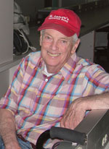
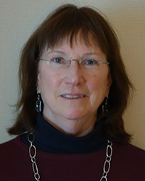
The times (and estuaries) are a changin’
Bernie McAlice took temperature (and other measurements) from the Darling Marine Center dock for approximately 10 years (1967-1977)
Mary Jane Perry (current Director) has been collecting CHL and temperature for the last 14 years

Slide 11
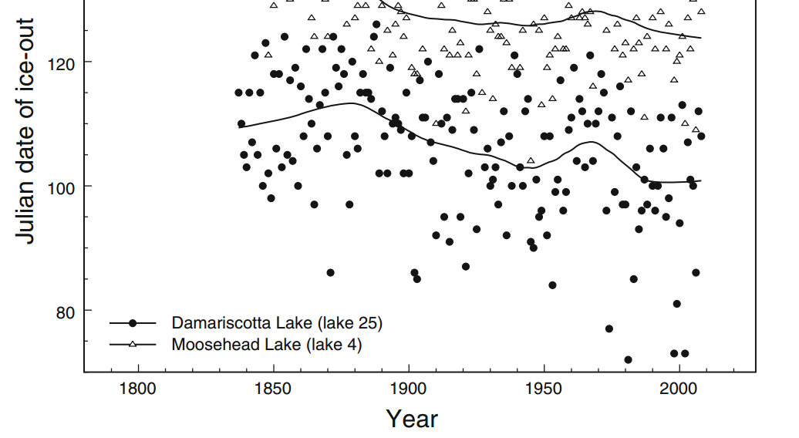
Lake Ice Out Dates in the Damariscotta River
April 10th

Slide 12
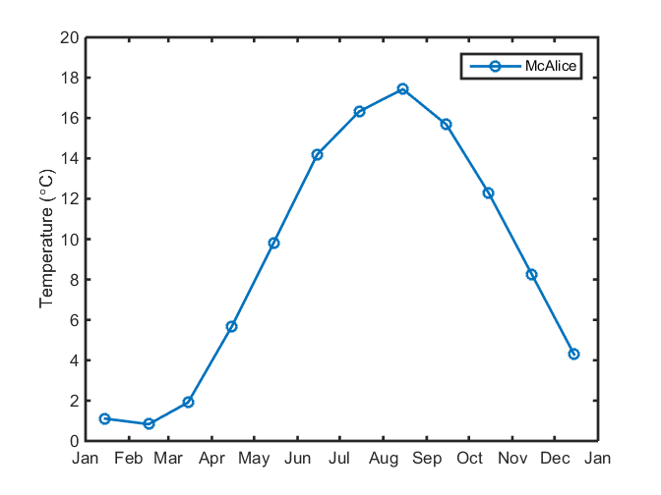

Slide 13
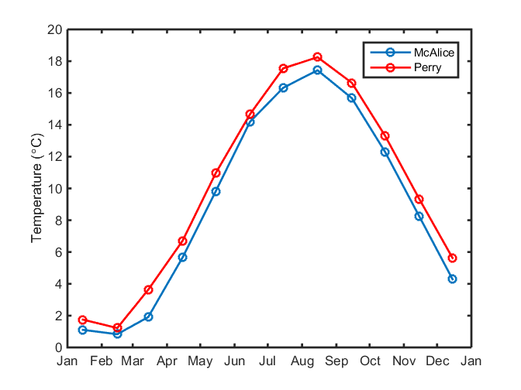

Slide 14
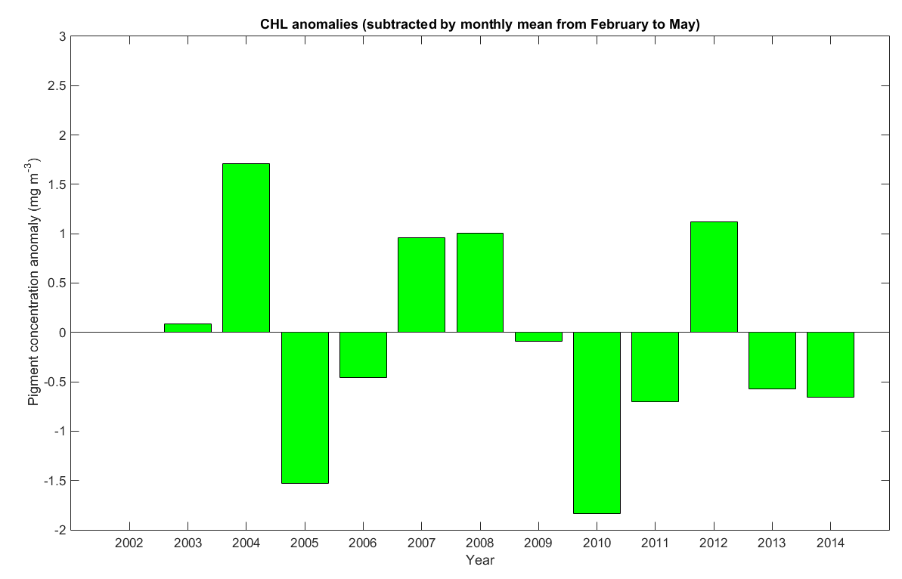
Spring
Spring Bloom?

Slide 15
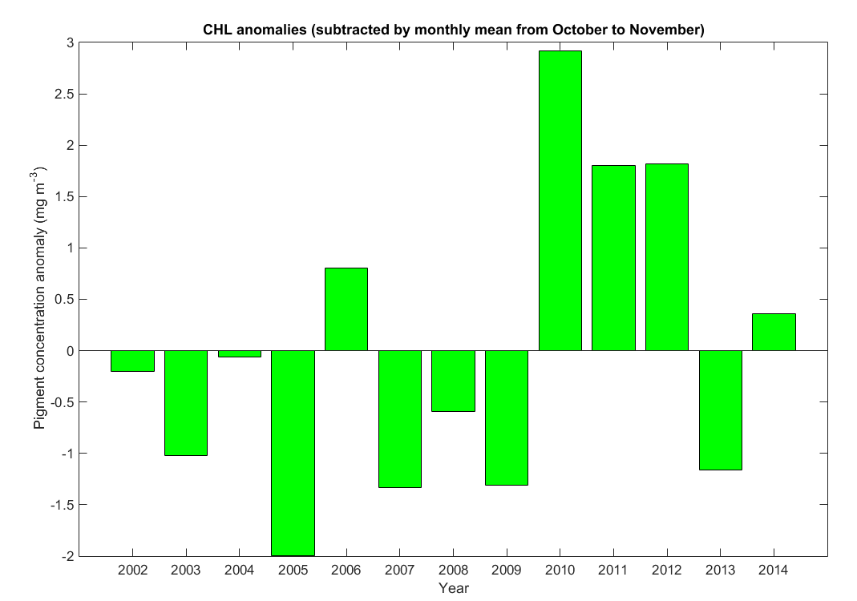
Bigger Fall Blooms

