Slide 1
Interpreting water quality standards in light of ecosystem change
Angela Brewer, Division of Environmental Assessment, Bureau of Water Quality
MAINE DEPARTMENT OF ENVIRONMENTAL PROTECTION
Protecting Maine’s Air, Land and Water

Slide 2
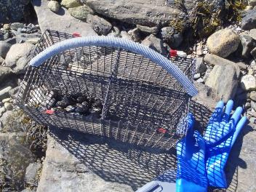
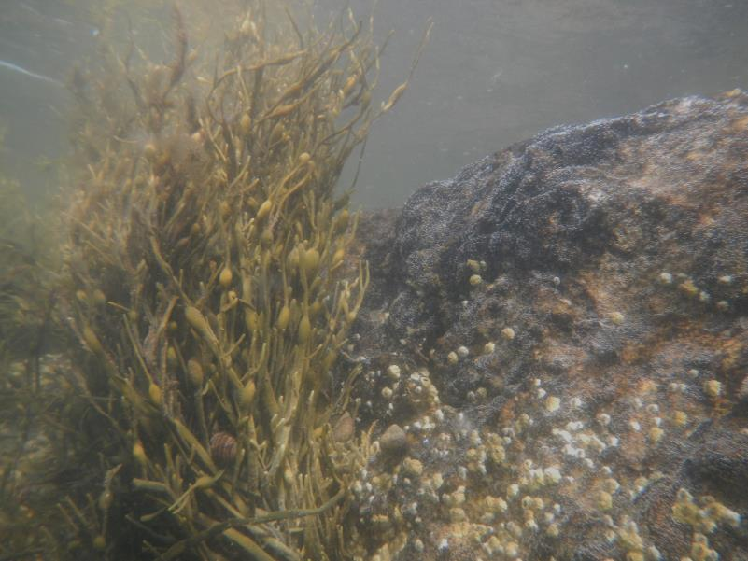
Water Quality Standards (WQS) set water quality goals for a waterbody and provide a regulatory basis for pollution controls
WQS = designated uses + water quality criteria + antidegradation policy
MAINE DEPARTMENT OF ENVIRONMENTAL PROTECTION www.maine.gov/dep

Slide 3
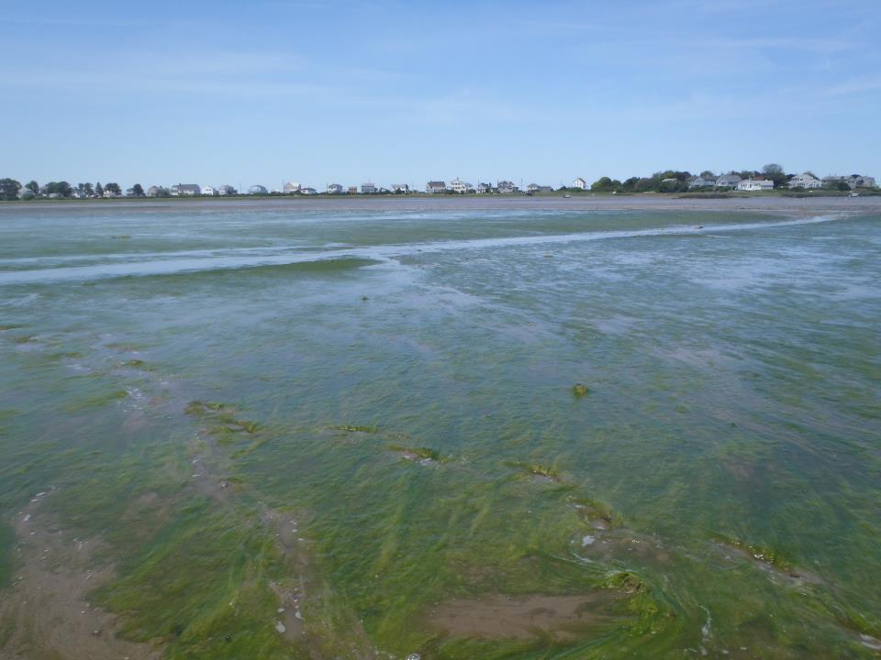
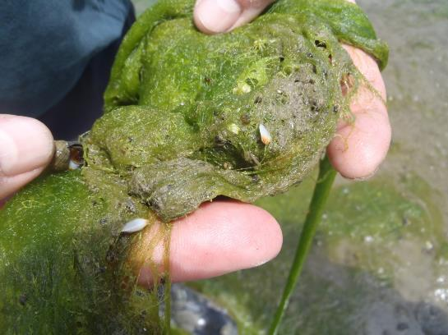
MAINE DEPARTMENT OF ENVIRONMENTAL PROTECTION www.maine.gov/dep

Slide 4
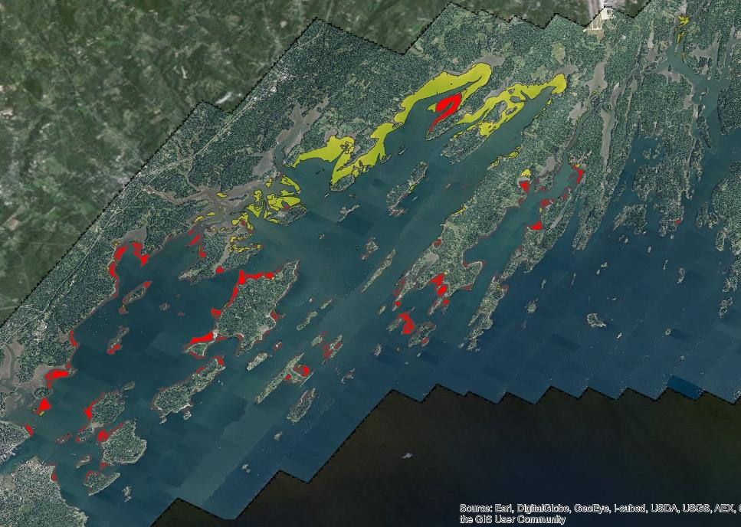
2013 vs. 2001/02 coverage
*58% reduction in area from 2001/02 (8,789 acres) to 2013 (3,651 acres)
MAINE DEPARTMENT OF ENVIRONMENTAL PROTECTION www.maine.gov/dep
Notes:
Total Casco Bay eelgrass acreage declined from 8,789 acres in 2001/02 to 3,651 acres in 2013, or a 58% reduction. Eelgrass distribution was similar to that observed in 1993/94 and 2001/02, with the exception of the area extending from mouth of the Royal River through Middle Bay, where 4,392 acres of dense subtidal beds (>70 to 100% cover) were almost completely lost between 2001 and 2013.

Slide 5
MAINE DEPARTMENT OF ENVIRONMENTAL PROTECTION www.maine.gov/dep

Slide 6
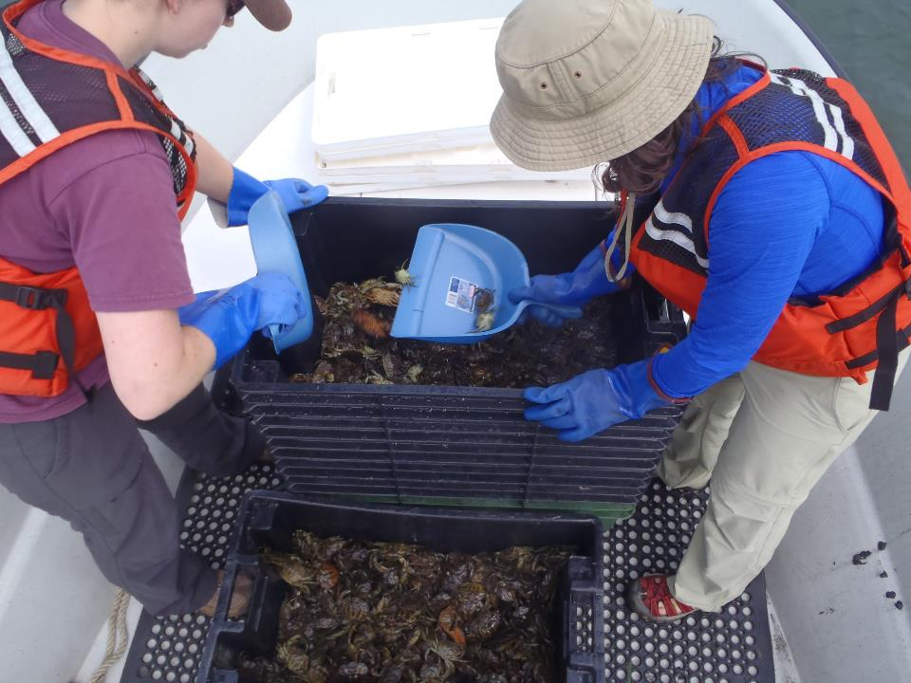
MAINE DEPARTMENT OF ENVIRONMENTAL PROTECTION www.maine.gov/dep

Slide 7
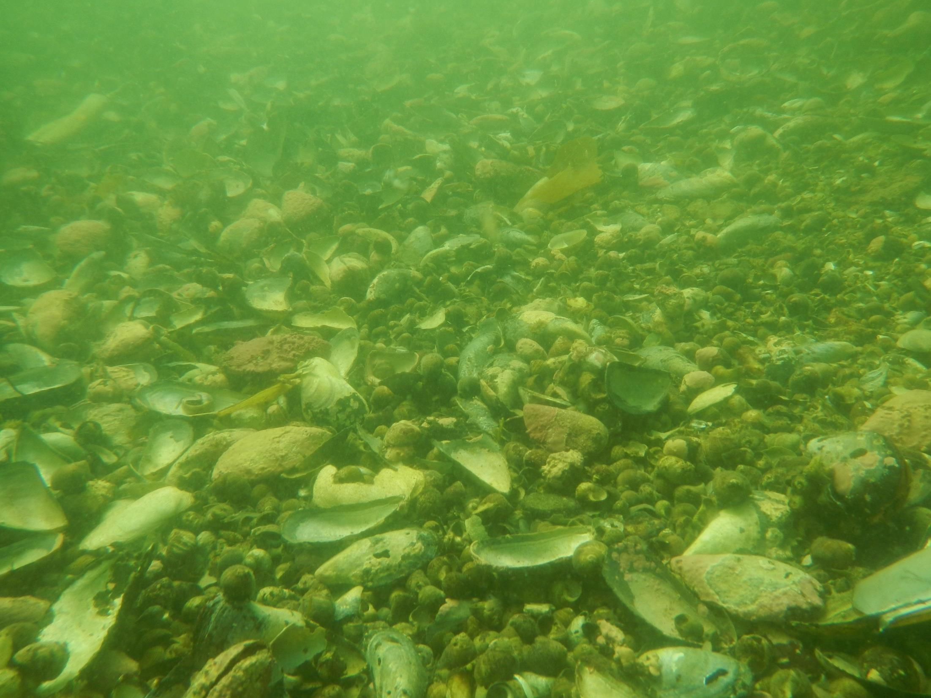
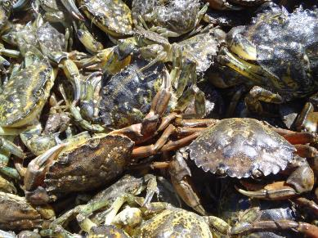
???
MAINE DEPARTMENT OF ENVIRONMENTAL PROTECTION www.maine.gov/dep

Slide 8
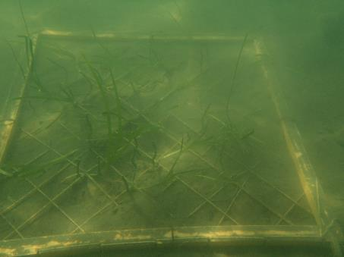
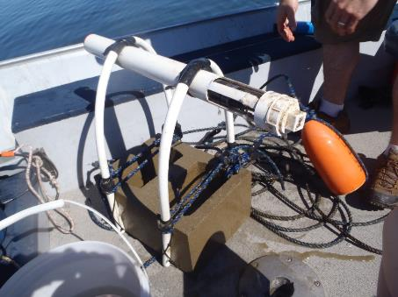
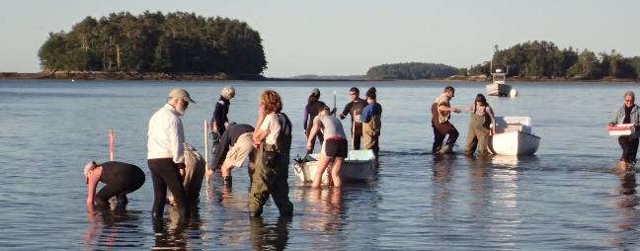
MAINE DEPARTMENT OF ENVIRONMENTAL PROTECTION www.maine.gov/dep

