Slide 1
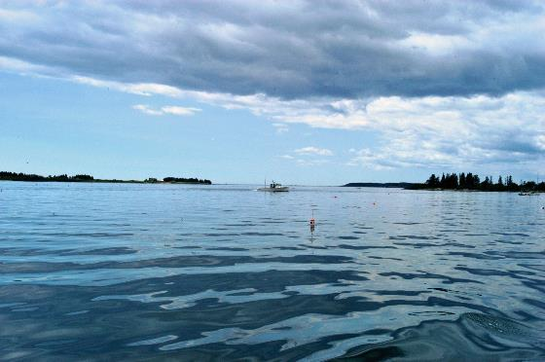
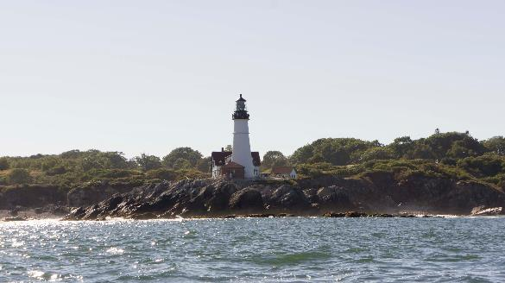
A Changing Casco Bay:
Onshore
Offshore
New Shores
Charles S. Colgan PhD
Center for the Blue Economy
Middlebury Institute of
International Studies
Professor Emeritus
Muskie School
University of Southern Maine

Slide 2
Maine 2012 Ocean Economy Employment

Slide 3
Maine Ocean Economy GDP ($Millions) 2012

Slide 4
Cumberland County Ocean Economy Employment 2012

Slide 5
Cumberland County Ocean Economy GDP ($ Millions) 2012

Slide 6
Casco Bay Accounts for about a third of Maine’s Ocean Economy, but nearly half or more in most of the sectors

Slide 7
Except in Marine Construction, Cumberland County’s Ocean Economy Outperformed Maine in employment growth 2005-2012

Slide 8
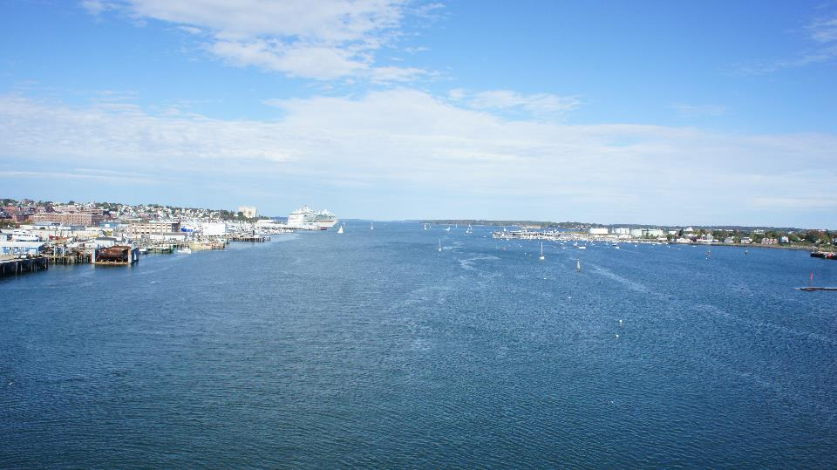

Slide 9
Bulk/Break Bulk Value in Portland

Slide 10
Bulk/Brea Bulk Metric Tons in Portland

Slide 11
Casco Bay and Petroleum

Slide 12
The Changing Role of Petroleum

Slide 13
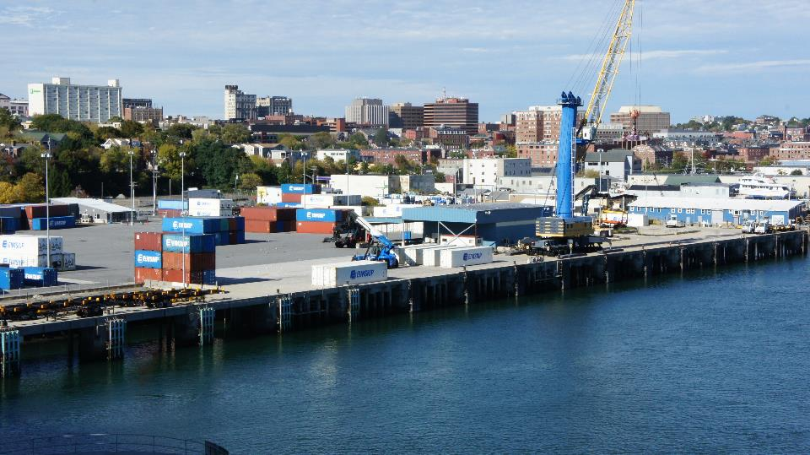

Slide 14
Container Value

Slide 15
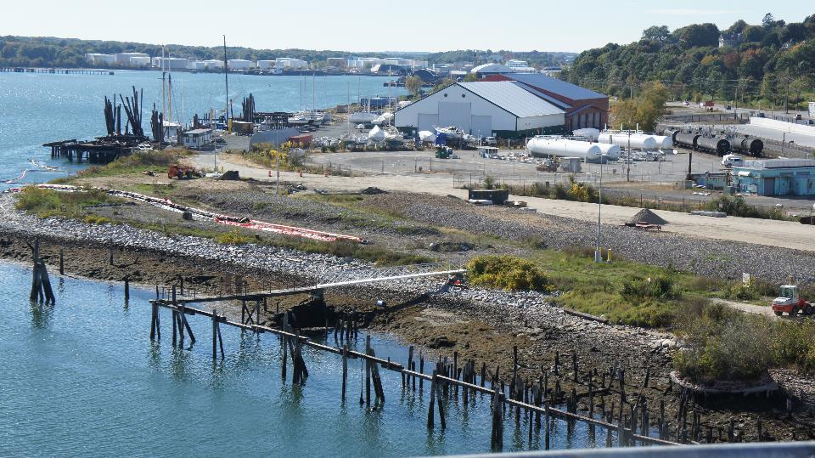
A long time coming…

Slide 16
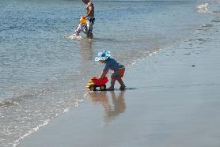
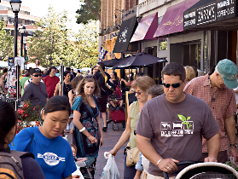
A Changing Population

Slide 17
Slowing population growth in Cumberland County- and it all depends on in-migration

Slide 18
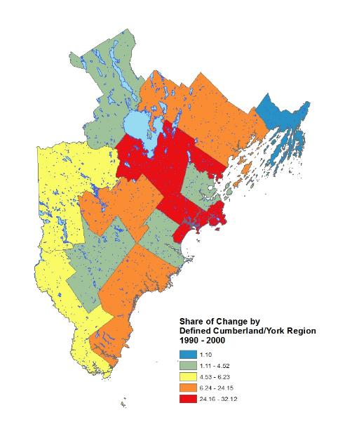
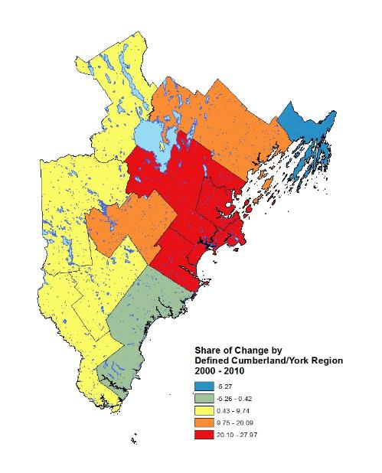

Slide 19
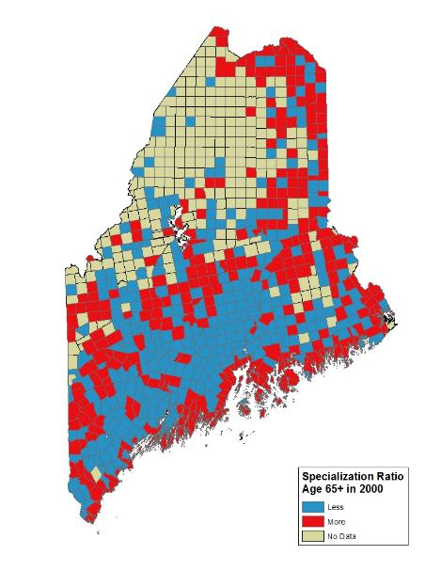
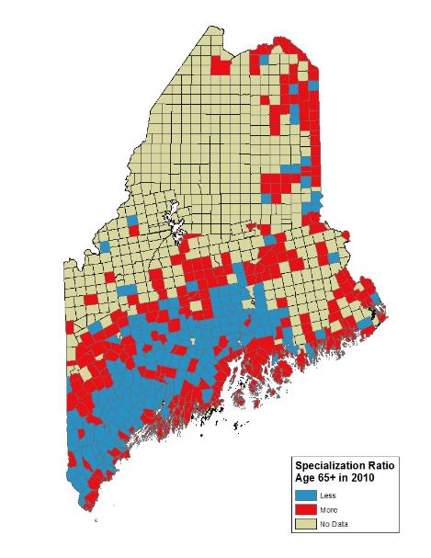

Slide 20
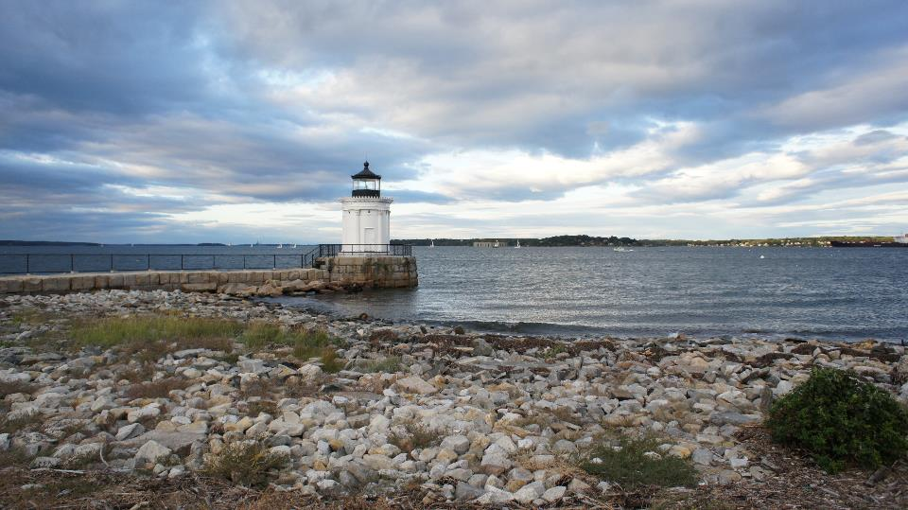

Slide 21
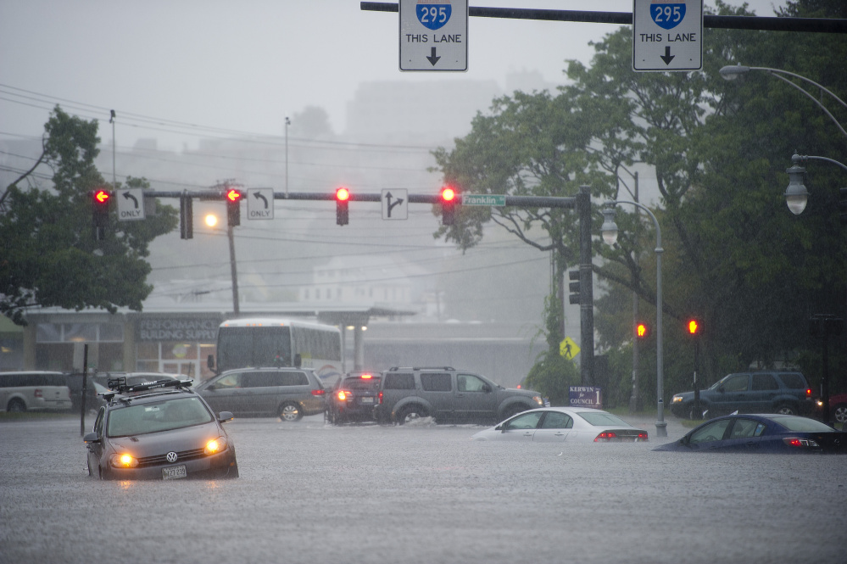

Slide 22
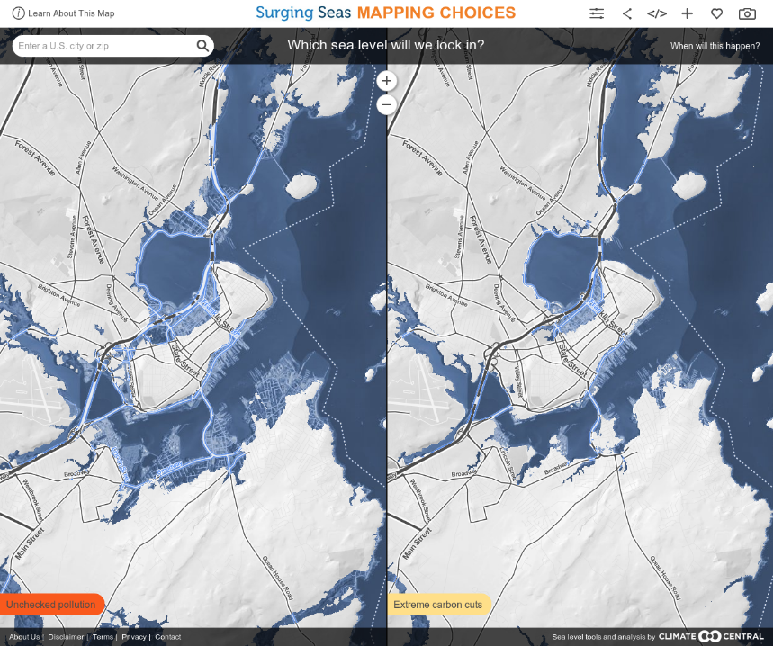

Slide 23
Choices
No action
Fortify
Hard v. Soft Armoring
Accommodate
Elevate – flood proof
Changing Temperatures and Chemistry
Retreat
Anticipate v. respond

Slide 24
Who will pay?
Adaptation in existing investment streams
Insurance
Self insurance
Flood Insurance
Disaster Relief
Innovative Approaches
TIF’s
Green Bonds

Slide 25
Next Steps for CBEP
Restoration = soft armoring
Conserving shoreland for buffer, upland for retreat
Managing a wetter environment in the urban core
Continuing demand for recreation
Define “health” in the context of a changing bay- and a changing population and economy that depends on the bay

