Slide 1
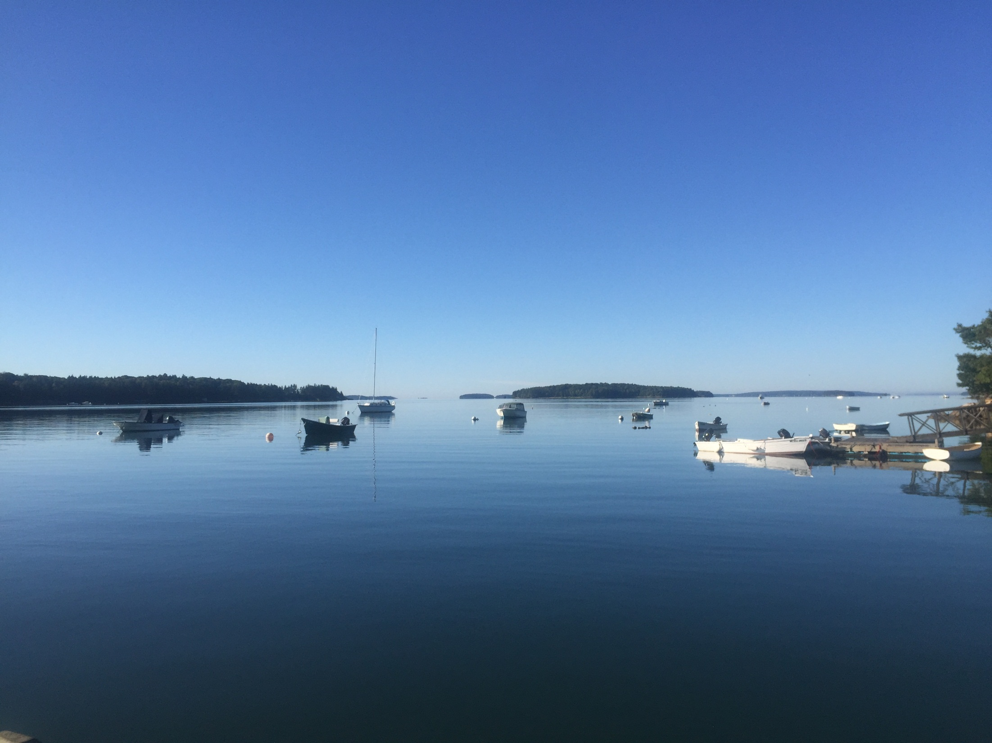
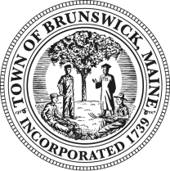
Community Shellfish Aquaculture Education and Awareness Projects In Brunswick
Brunswick Marine Resources Committee
Prepared By:
Brunswick Police Marine Resources & Harbor Management Division

Slide 2
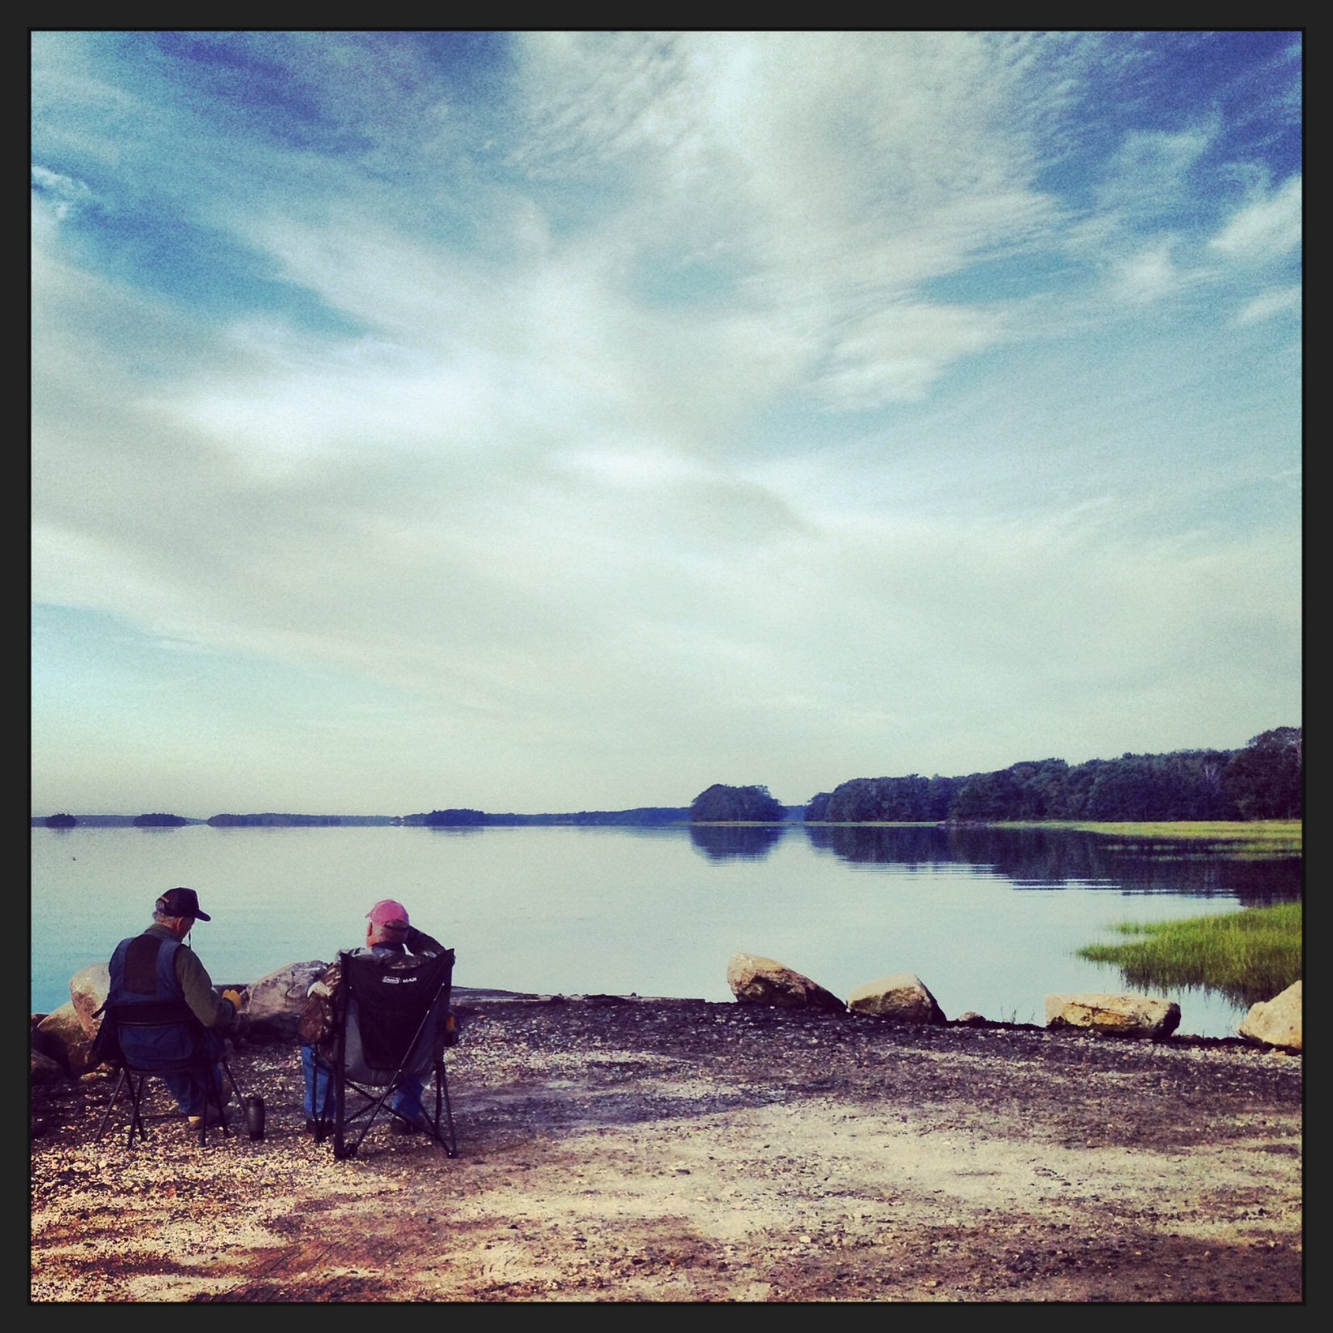
Garnering Community Support for Conservation initiatives through balanced multi use approach of our near shore coastal waters with the health of the eco system driving our DECISIONS!!!

Slide 3
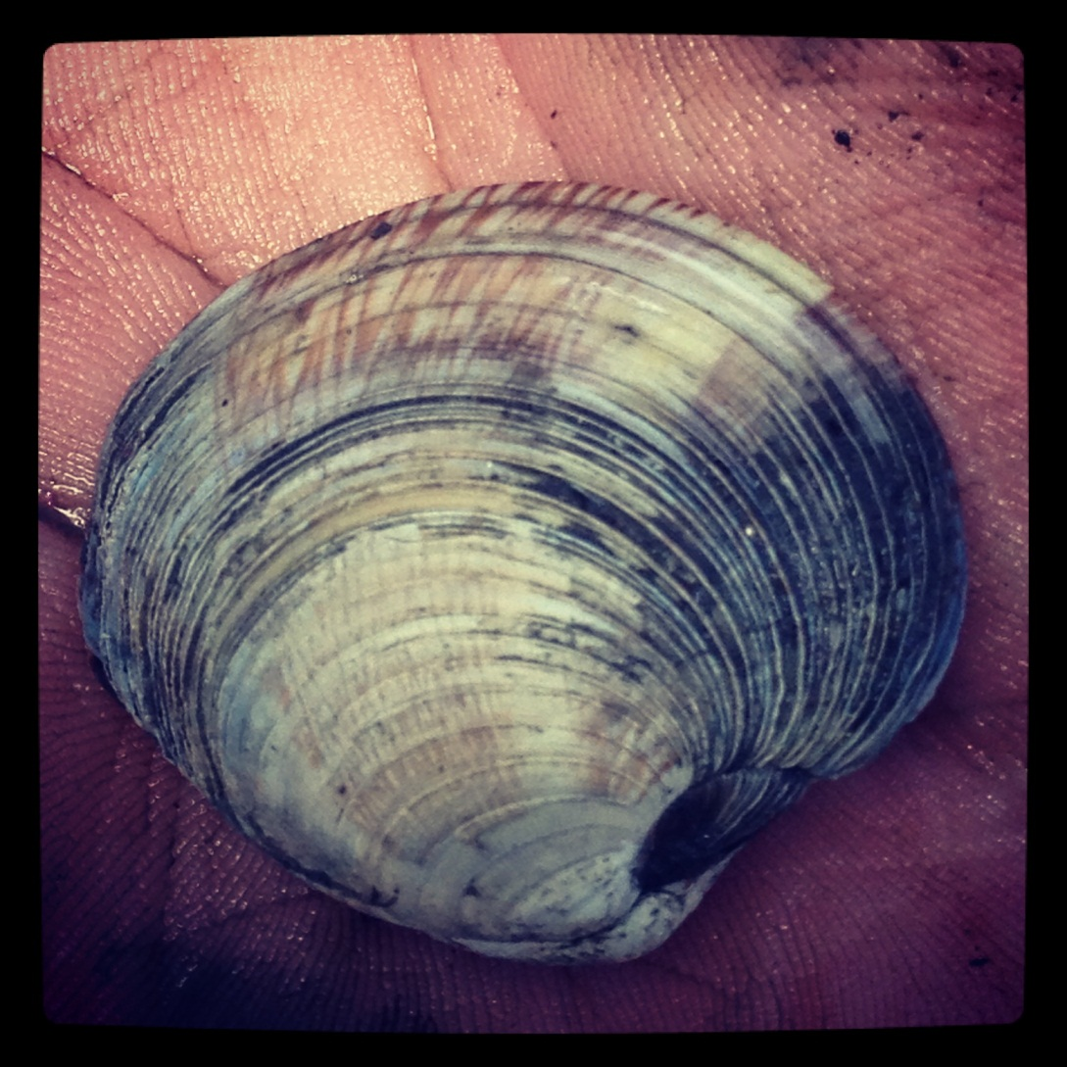
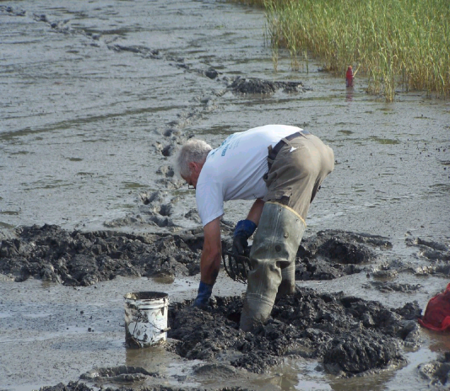
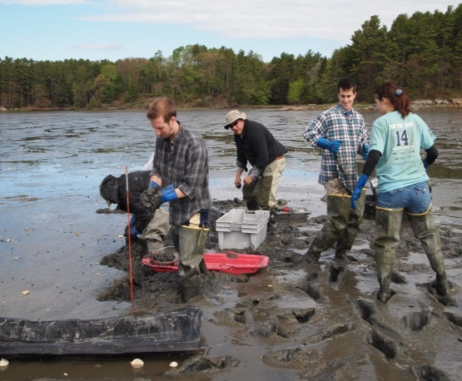
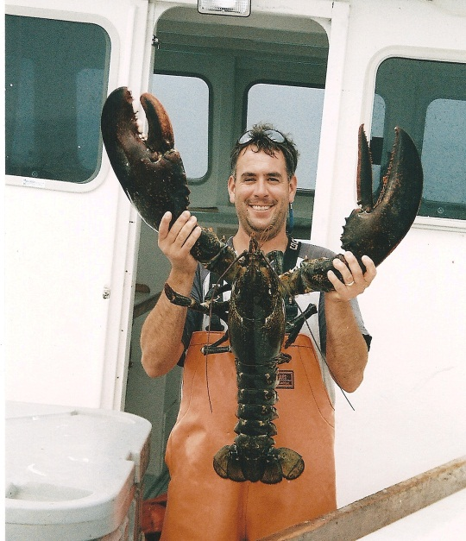
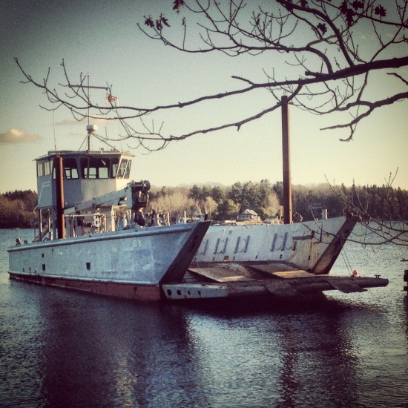
A healthy eco-system supports many different local jobs and provides millions of dollars toward our coastal economies!!!
Shellfishermen
Aquaculturist
Lobstermen
Sport fishermen
Recreational Guides
Wildlife Outfitters
Boat Dealers
Construction workers
Boat mechanics
Landscapers
ETC………

Slide 4
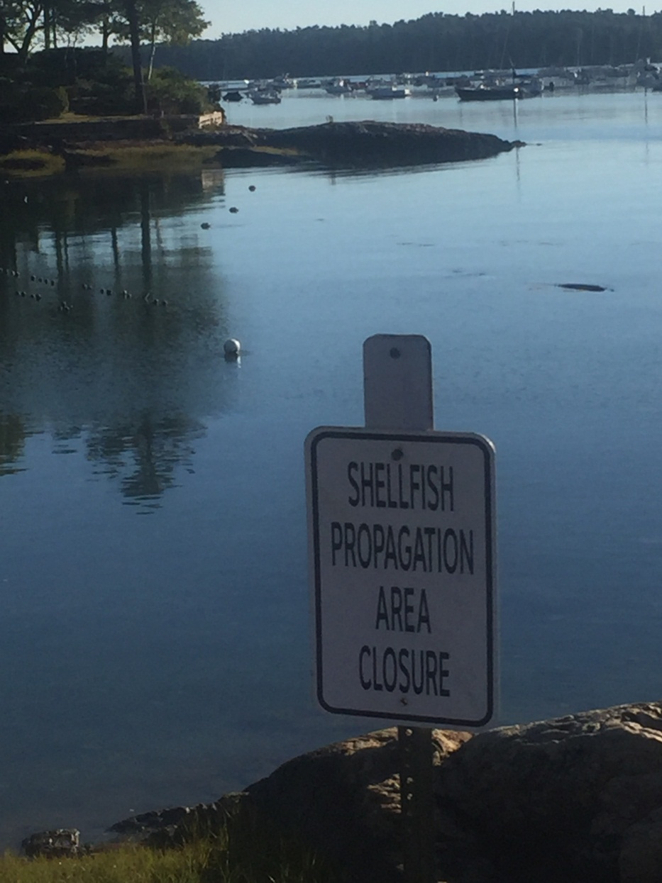
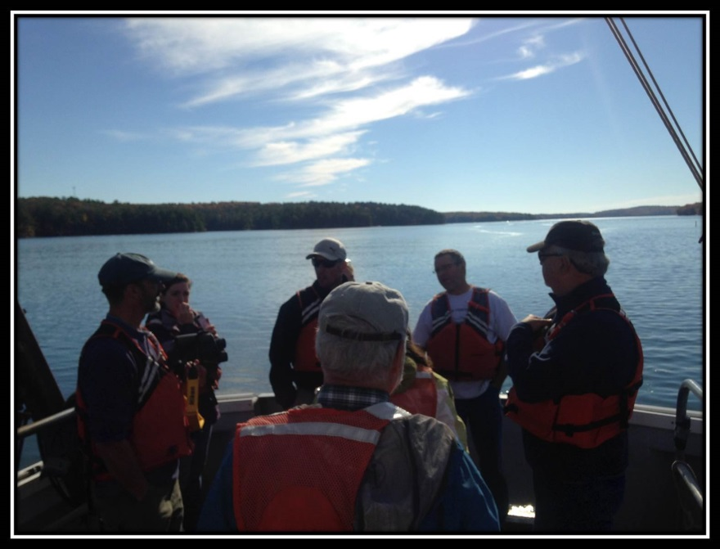
Shellfish Education Class
Maine Seagrant
Island Institute
Maine Aquaculture Innovation Center
Coastal Economics Inc.
Fair Winds Inc.
Harpswell & Brunswick
Local Residents and Fishermen

Slide 5
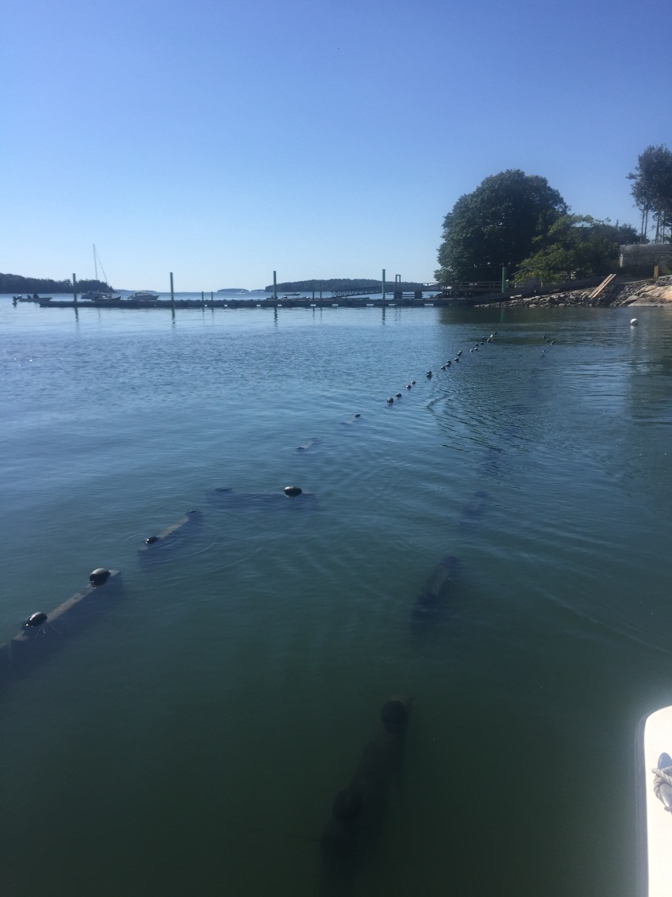
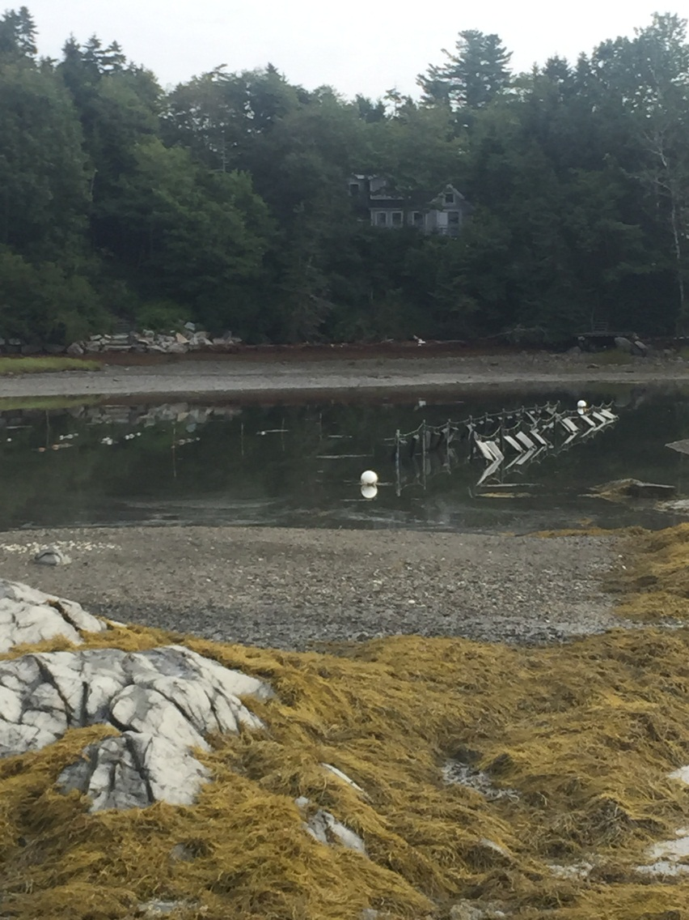
Oyster Flip Bag System

Slide 6
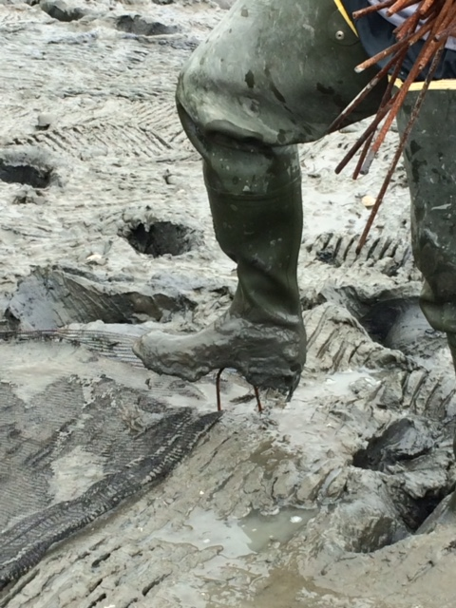
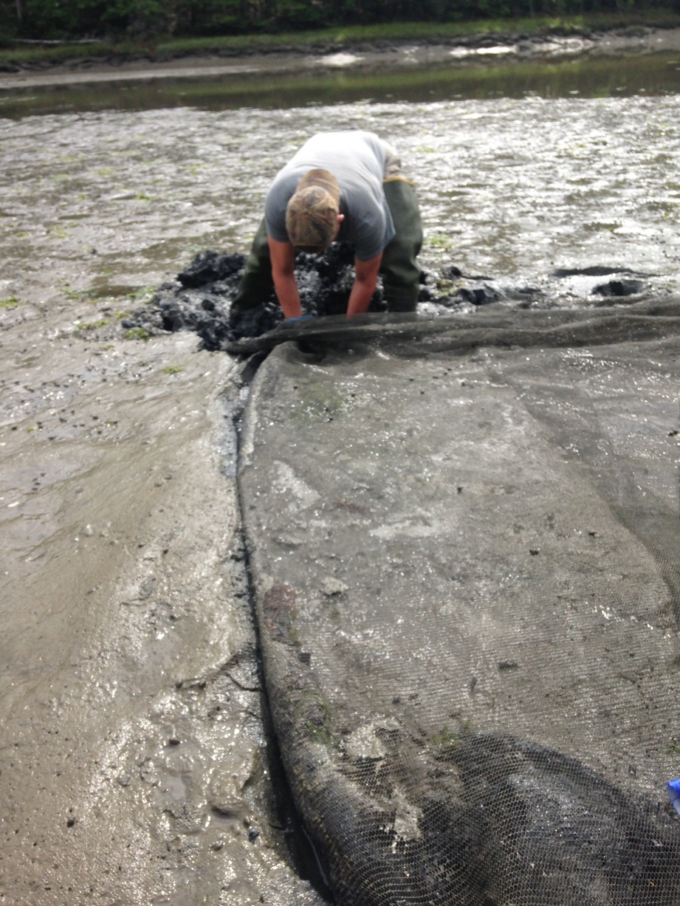
Shellfish Predation Netting

Slide 7
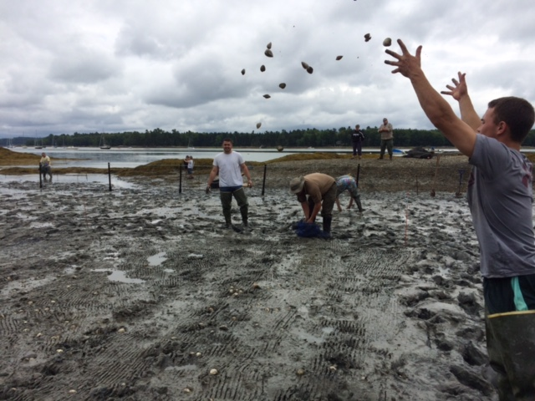
Volunteer Deployment of Projects

Slide 8
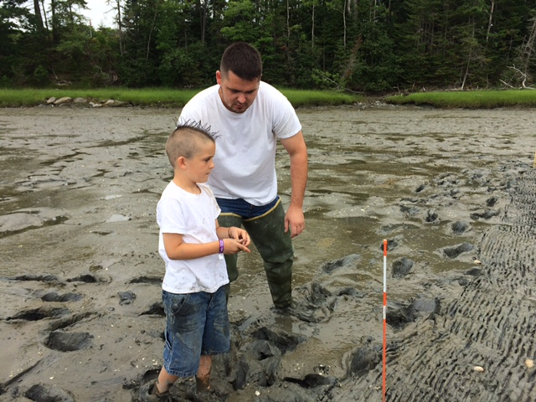
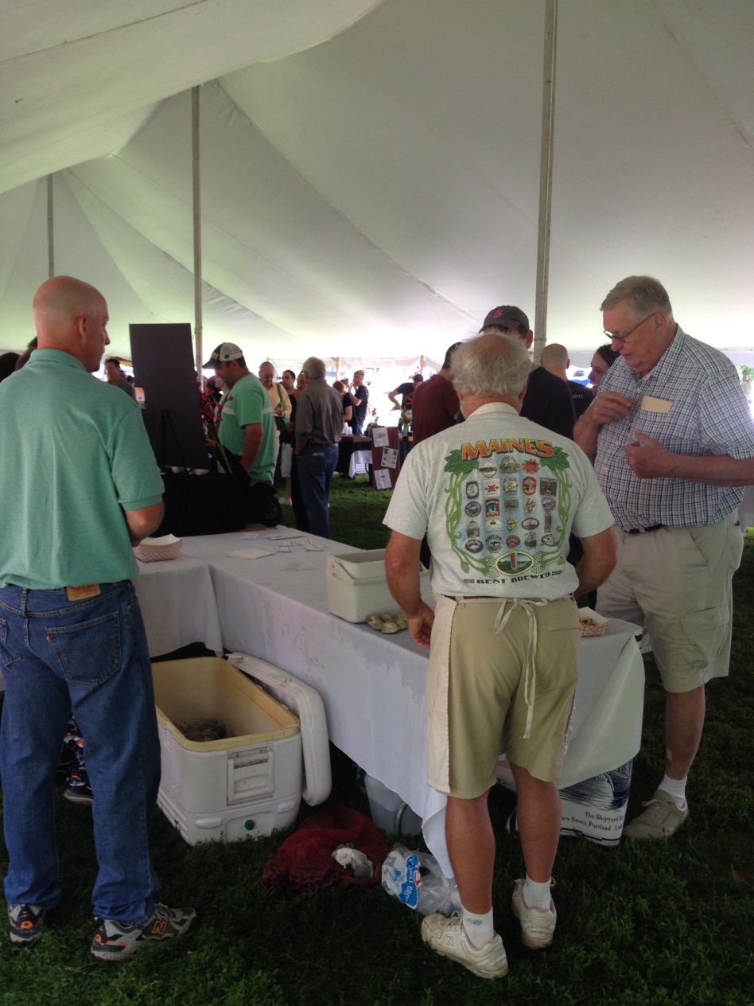
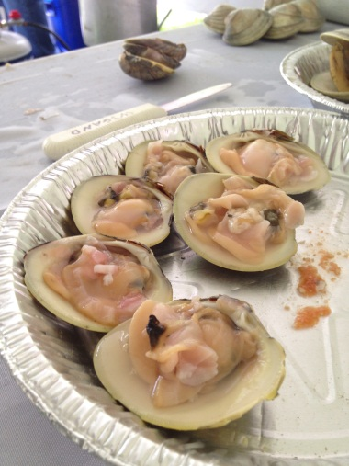
Community Involvement

Slide 9
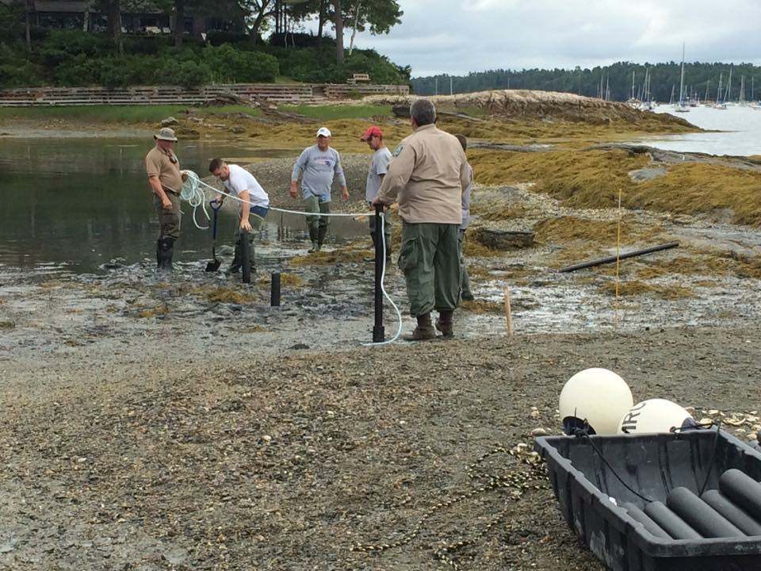
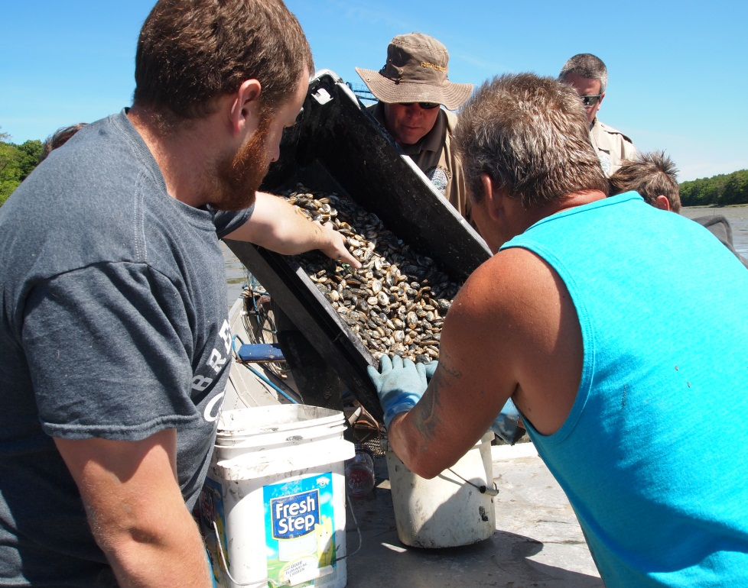
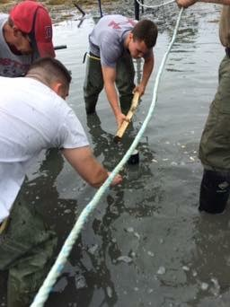
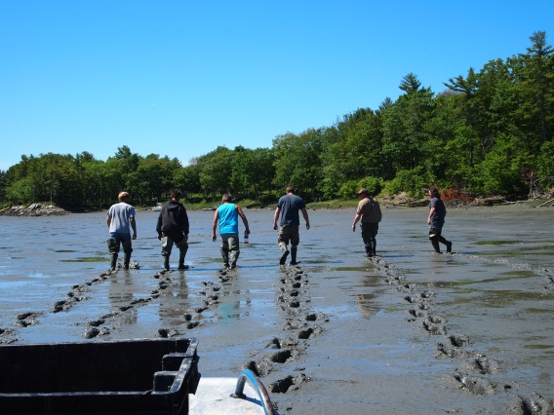
Fishermen Involvement

Slide 10
Other Projects supported by community volunteers
Shoreline Pollution Surveys
Shellfish Reseeding Projects
Roughing
Fencing
Netting
Junior High and High School Field Trips

Slide 11
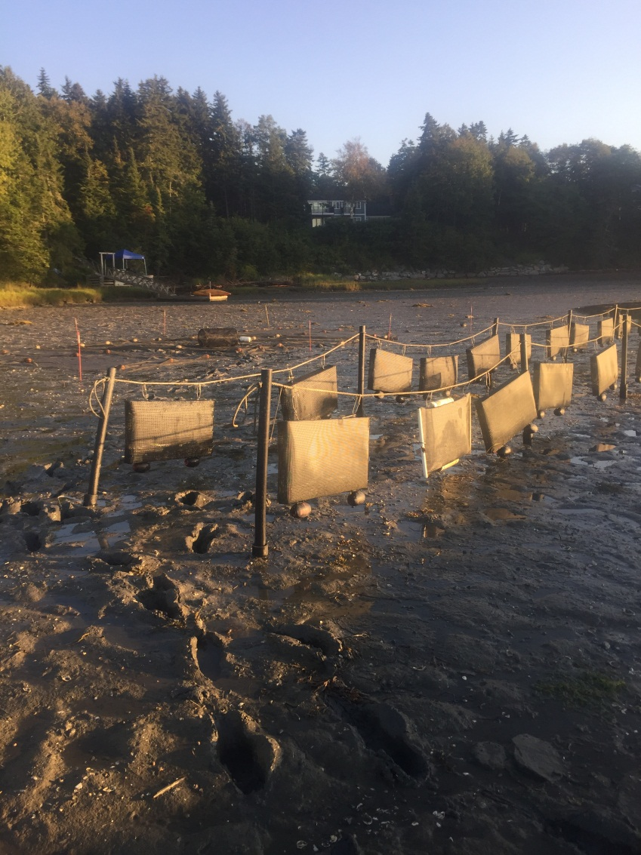
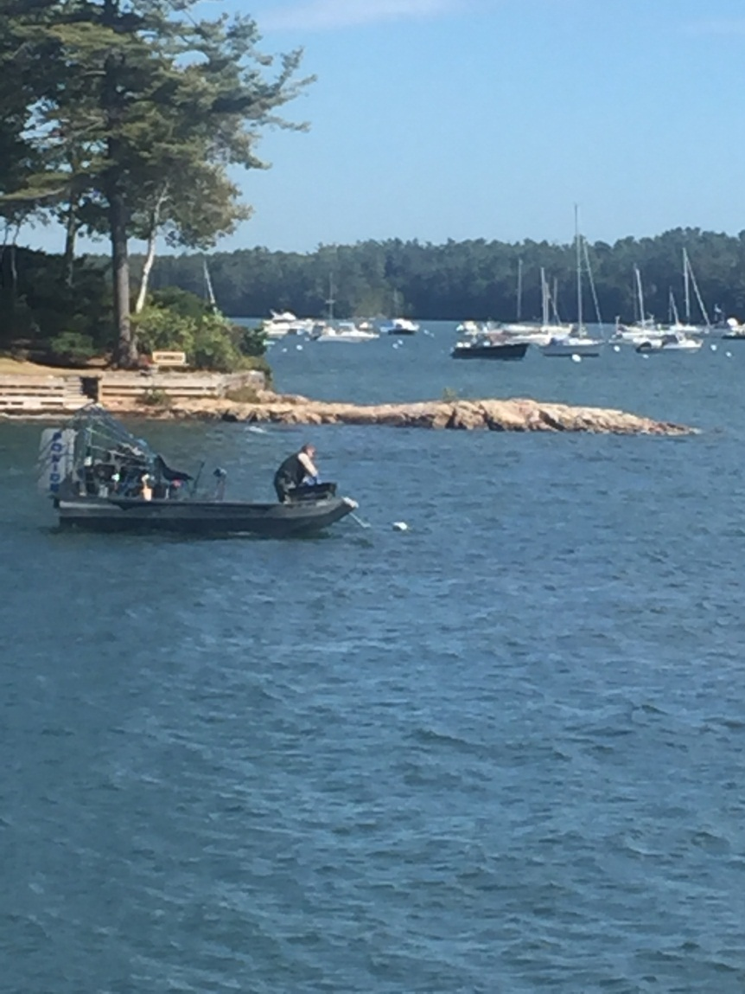
Predation Control

Slide 12
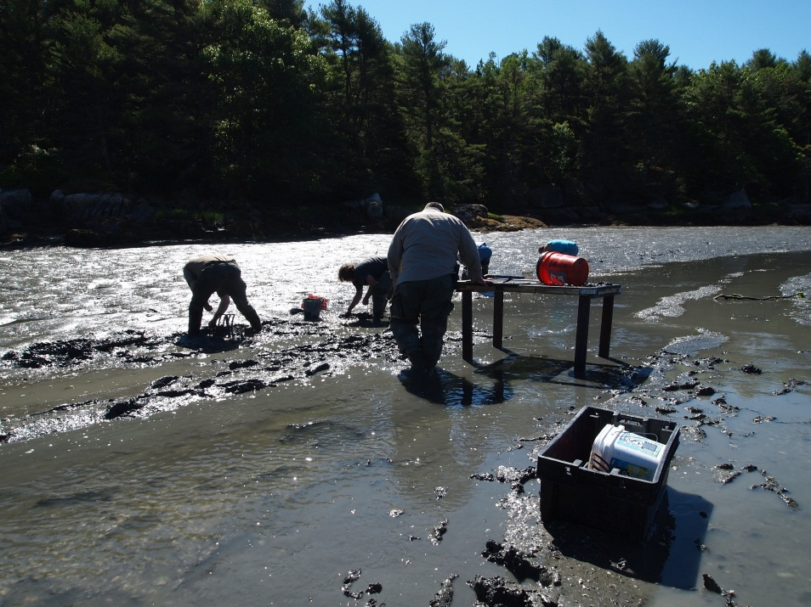
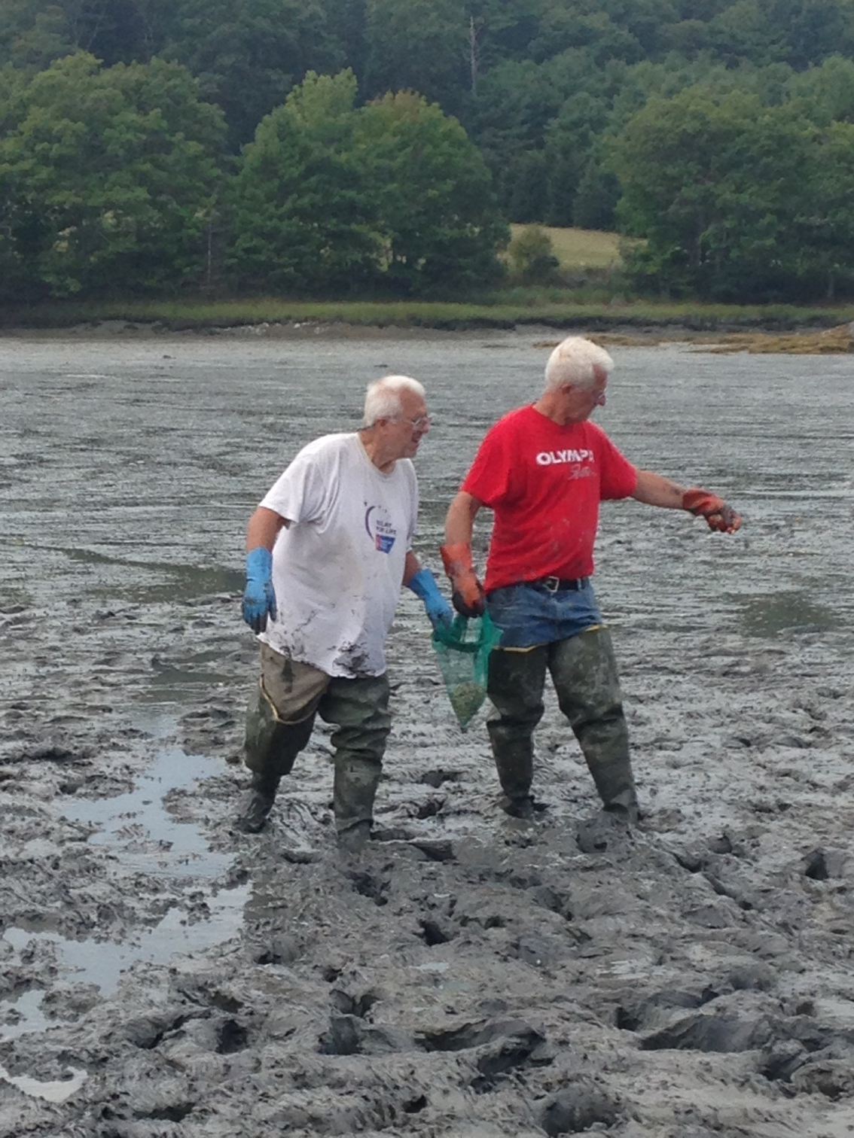
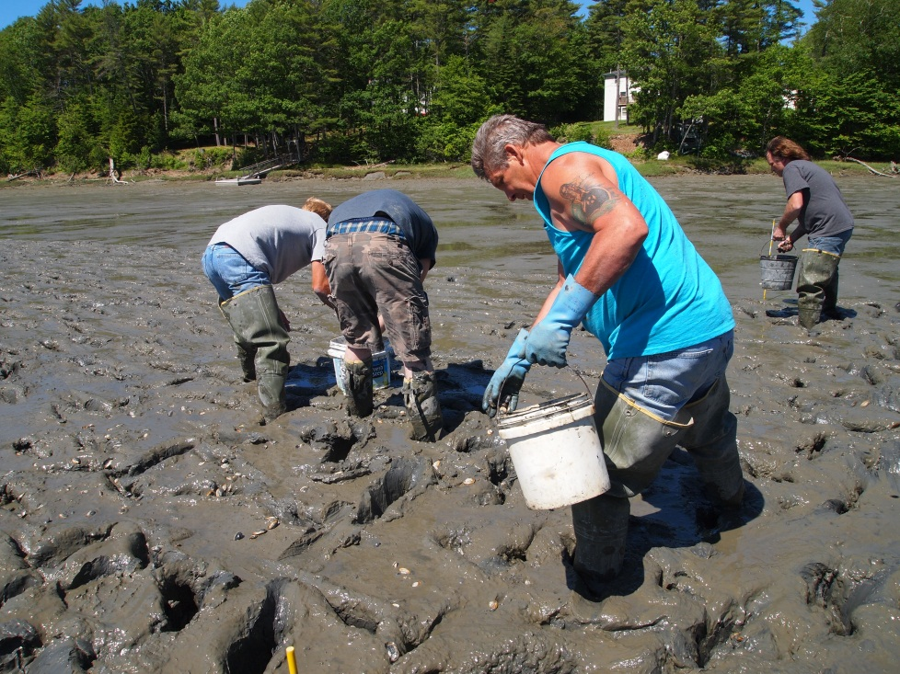

Slide 13
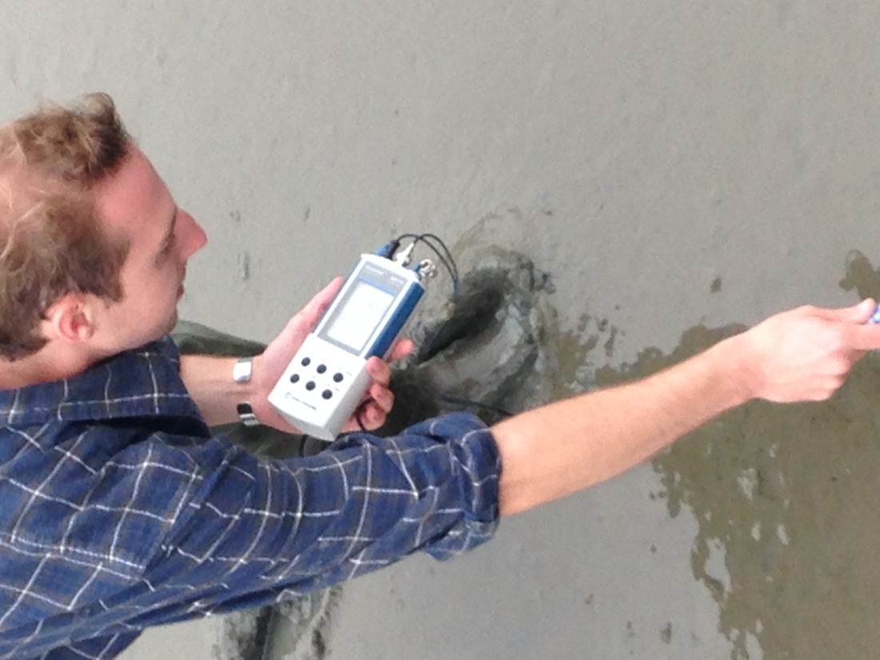
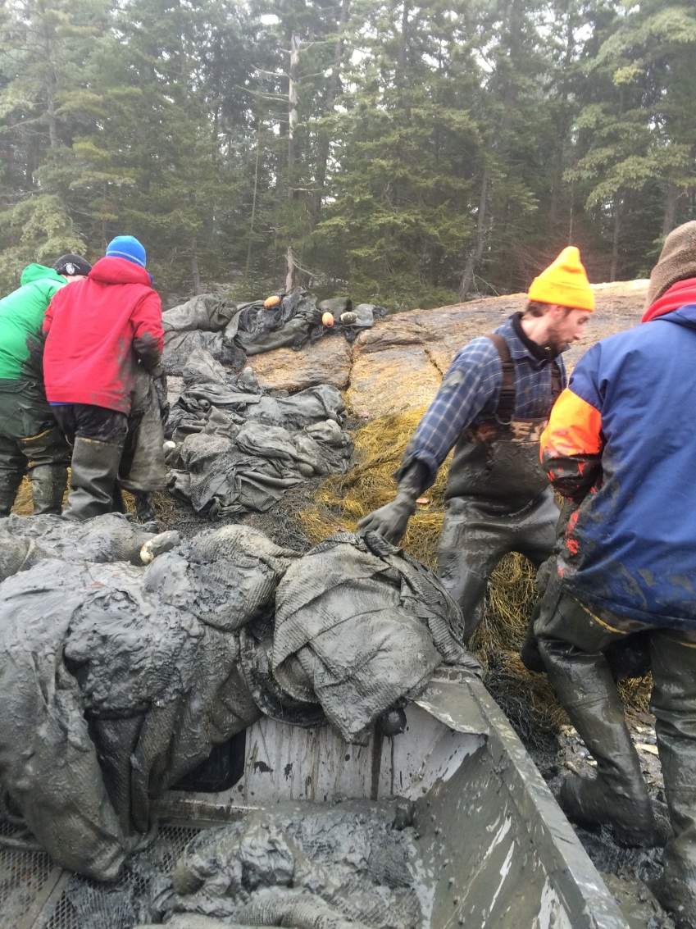
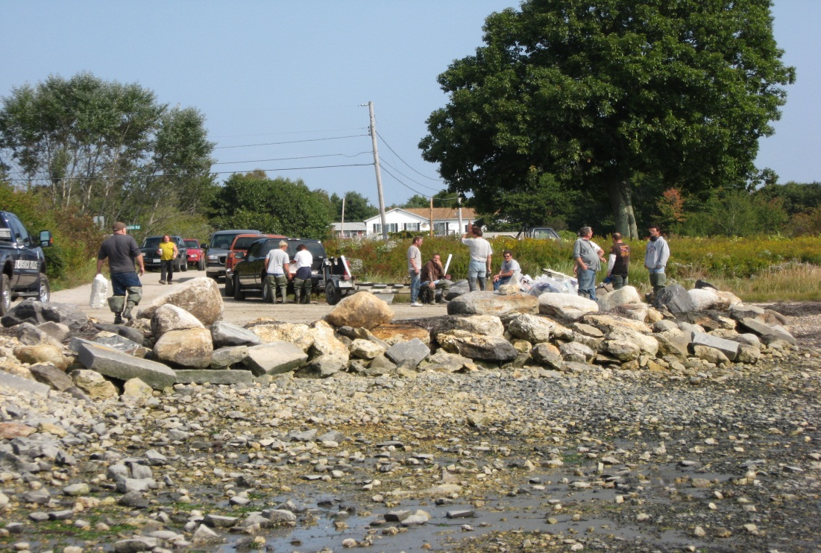

Slide 14
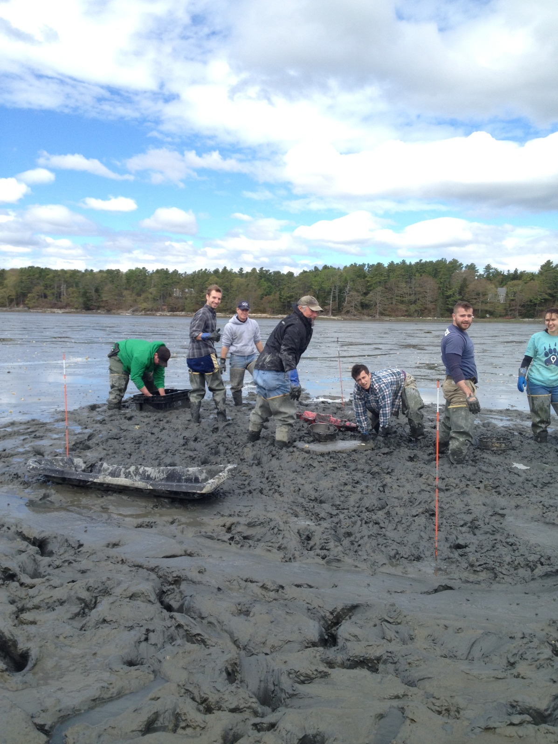
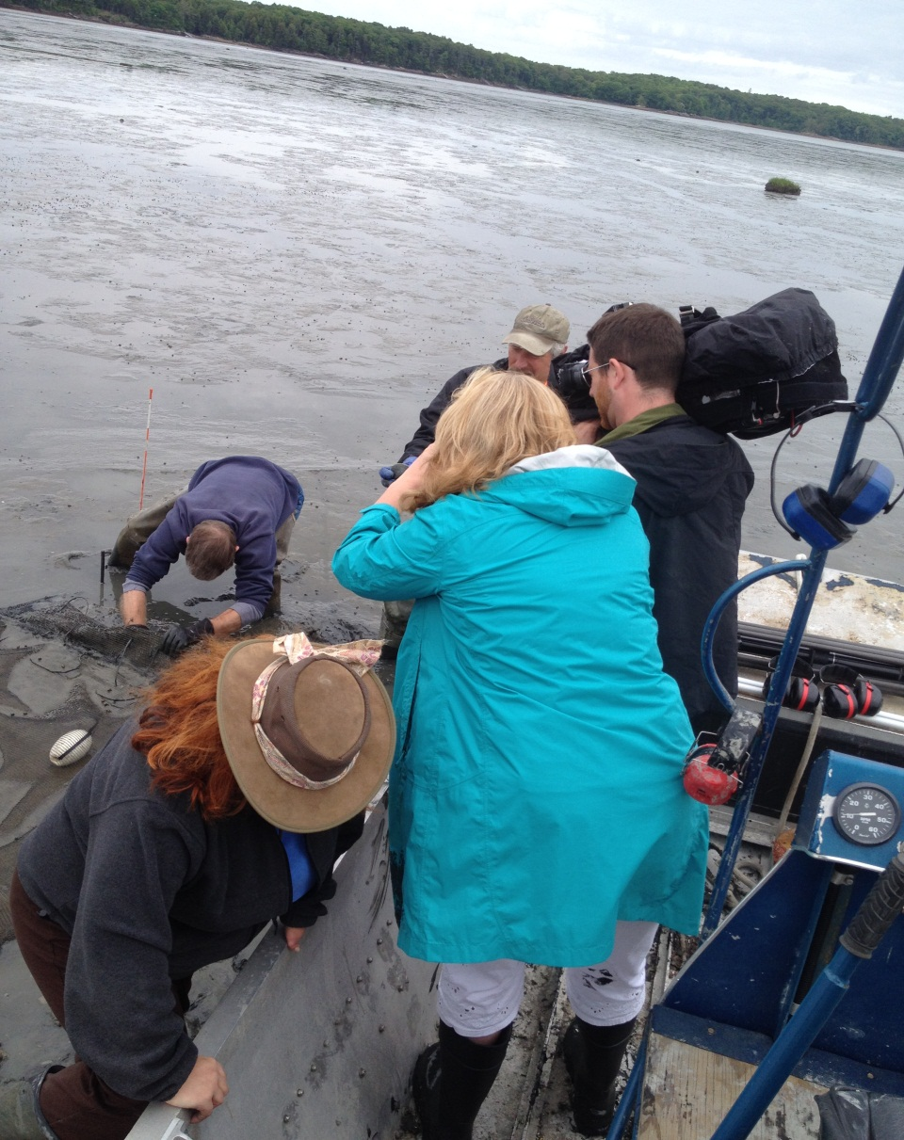

Slide 15
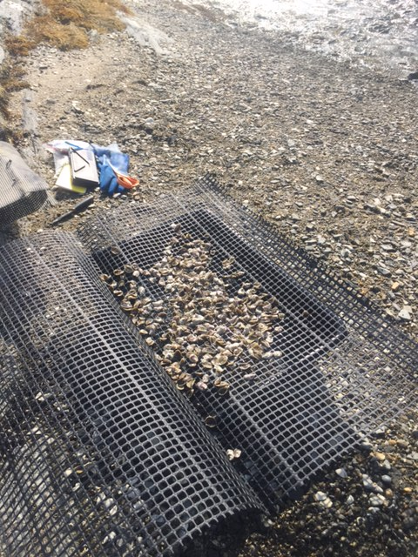
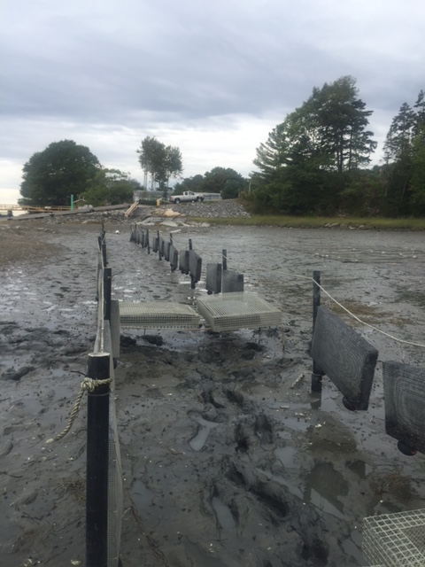

Slide 16
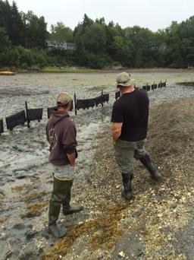
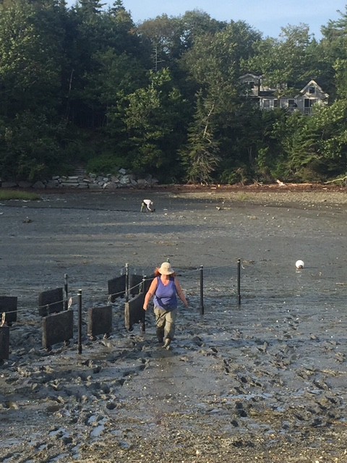
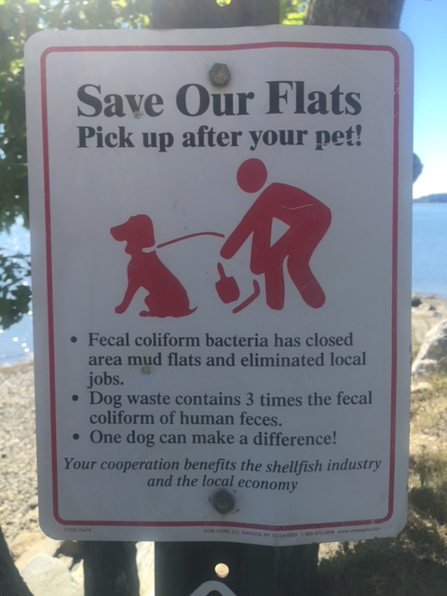
Education, Awareness and Action

Slide 17
MPBL Project Particulars
Deployed for three to four years. Beginning in 2015
Deployed to help educate the public about the importance of shellfish aquaculture as it pertains to our coastal economy and environments.
Deployed to help educate the public about the importance of the shared commercial and recreational uses of these sensitive intertidal areas.
Deployed in one of our more high traffic coastal areas to help ensure public visibility of the project.
Deployed to help educate and involve local shellfishermen in a project.

