Slide 1
Mobilizing Community Support for Casco Bay
Fred Dillon – City of South Portland
Dan Devereaux – Town of Brunswick
Kate McDonald – Cumberland County SWCD
Peter Slovinsky – Maine Geologic Survey
Doug Roncarati – City of Portland

Slide 2
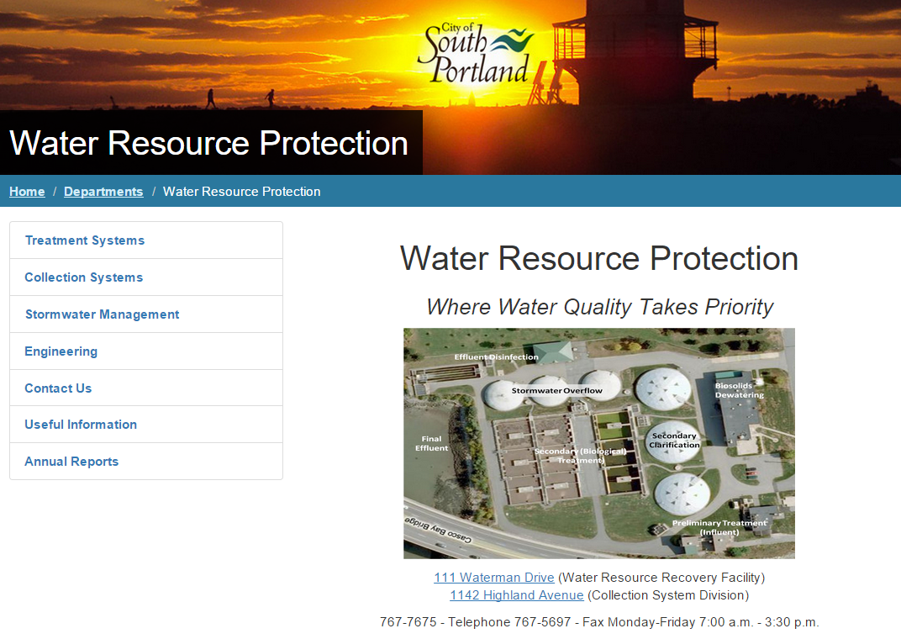

Slide 3
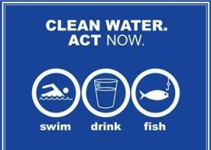


Basic Regulatory Framework
CWA
Wastewater
NPDES
Stormwater

Slide 4
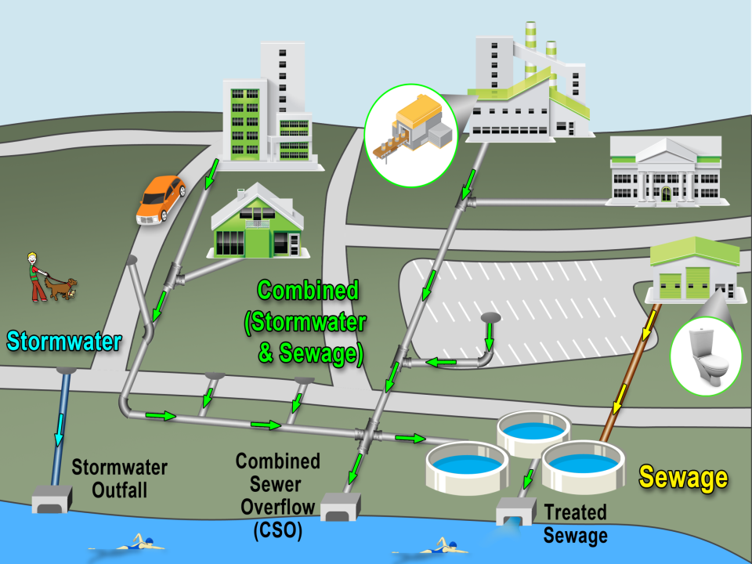
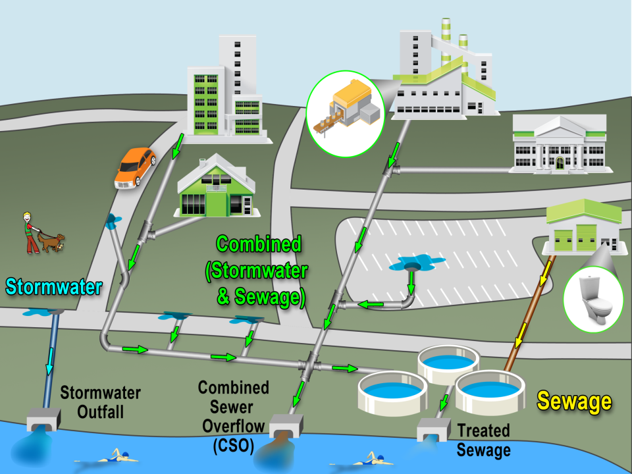


Municipal Piped Infrastructure

Slide 5
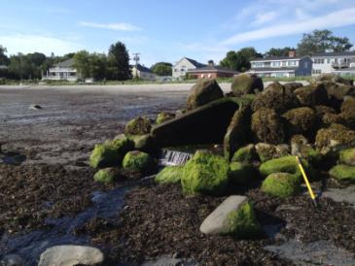
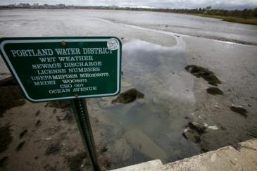
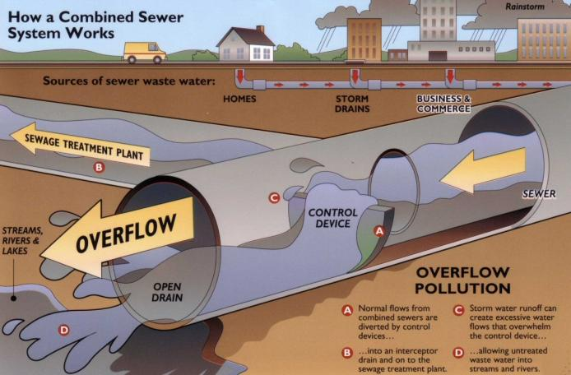
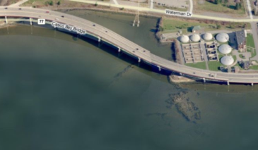
Municipal Piped Infrastructure
Stormwater outfall
Combined sewer
WWTP effluent

Slide 6
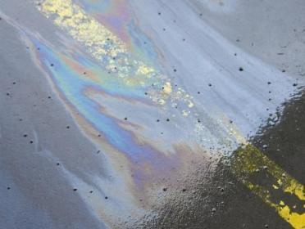
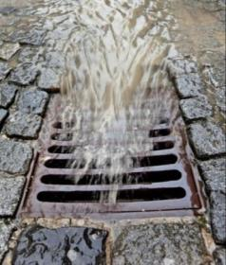
Polluted Stormwater
  Drainage systems carry pollutants like sediment, oil, fertilizers, salt, pet waste and trash.
  Rainwater that falls on paved streets, lawns, parking lots and sidewalks becomes polluted stormwater.

Slide 7
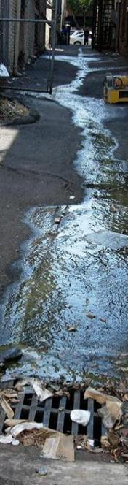
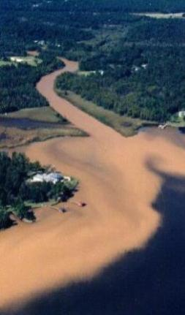
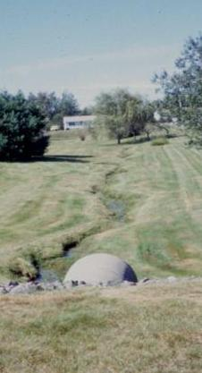
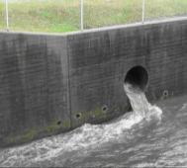
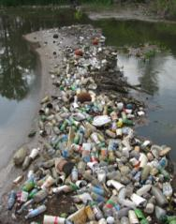
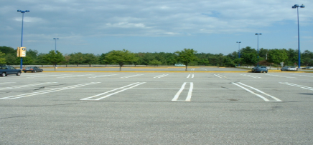
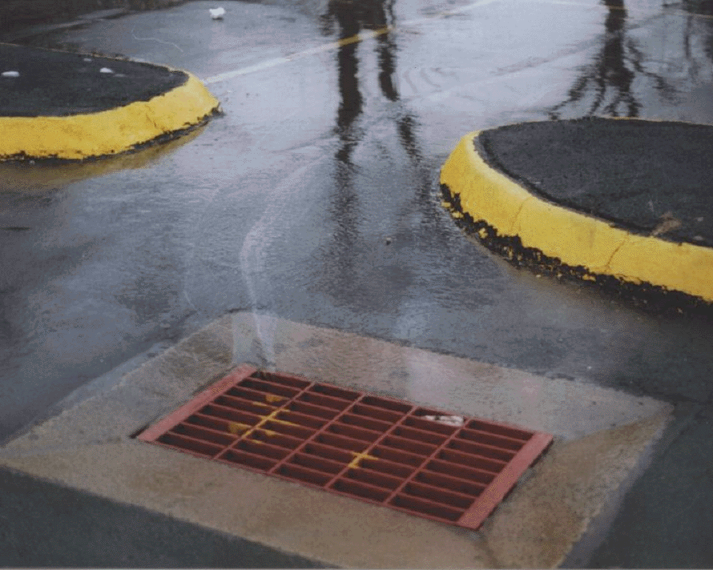

Slide 8

Why it Matters
  Polluted stormwater is one of the largest remaining sources of pollution for the Nation’s waters (“…one of the great challenges of modern water pollution control”)
  Polluted stormwater is “only increasing source of water pollution in many watersheds” – Seth Brown, WEF Stormwater Program Director
Notes:
1 mg/L TKN and 0.15 TP

Slide 9
Municipal Permit
  CWA requires regulation of stormwater discharges
  5 year permit cycles
  1st permit issued in 2003 – next permit due in 2018
  Additional regulations required with each new permit cycle
  DEP administers Maine’s permit
  Each regulated community must develop and submit a Stormwater Plan consistent with the permit

Slide 10
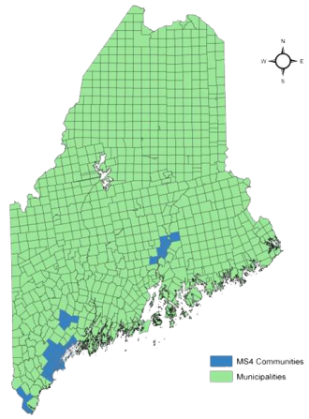
Permit Requirements / Implications
Full compliance with 6 “minimum control measures”
Improvement & protection of priority water bodies
Added scrutiny from DEP, EPA & environmental groups
Higher costs than non-regulated municipalities

Slide 11


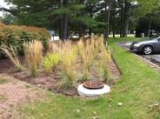

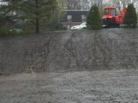
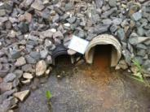
Stormwater Program Elements
MS4
6 Minimum Control Measures
MCM6
MCM2
MCM3
MCM4
MCM5
MCM1

Slide 12
Interdepartmental Coordination is Key
Council
Manager
Assessing
Comm. & Econ Dev.
Fire & Police
Info Tech
Parks & Rec
Planning & Code Enf.
Public Works
Water Resources
Finance
Need to work outside of “silos” to collectively meet permit requirements & promote local water resource protection efforts
Stormwater Permit
Permit affects most aspects of local government and highlights importance of interdepartmental collaboration for shared compliance responsibilities

Slide 13
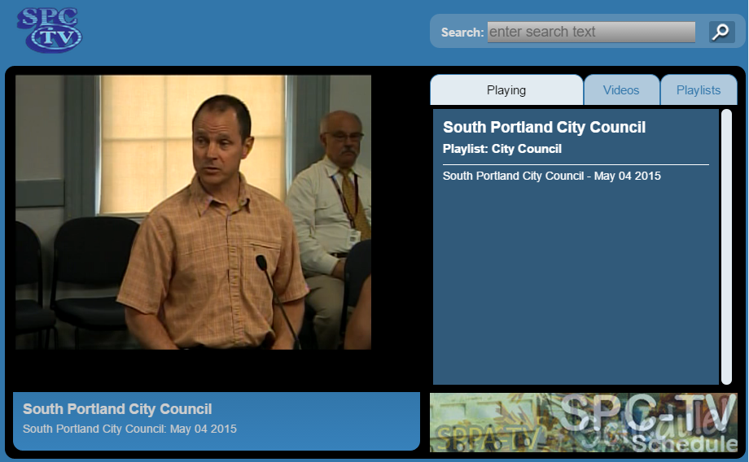

Slide 14
Thornton Heights Stormwater Separation

Slide 15
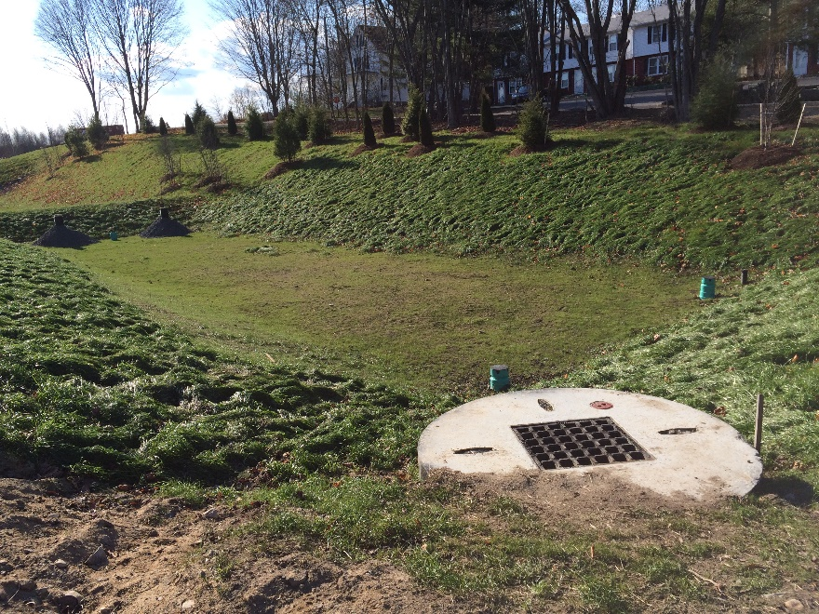
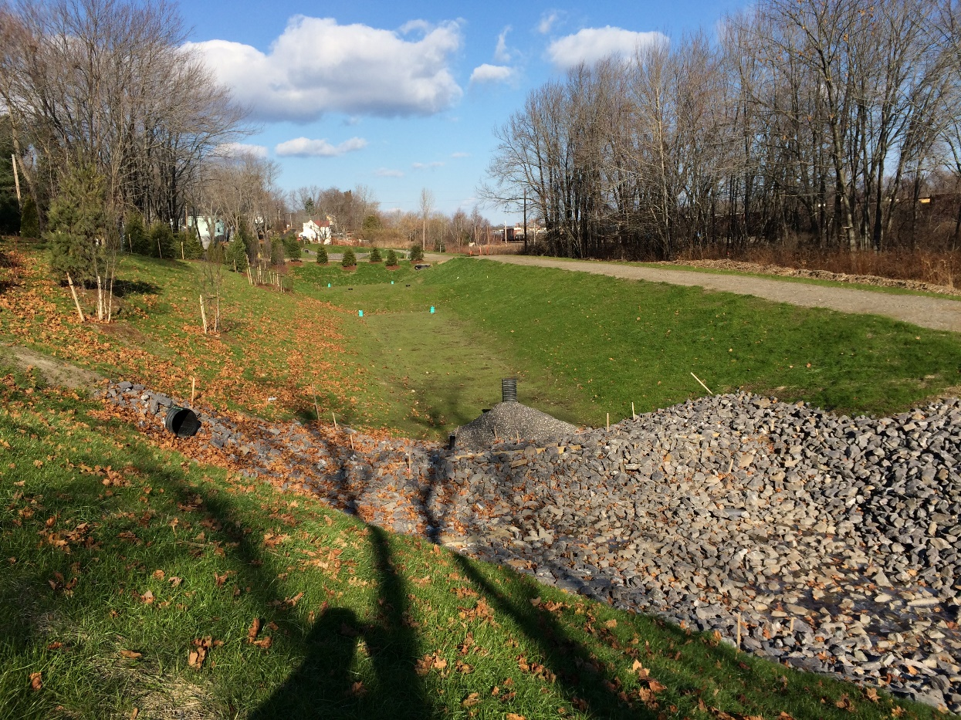
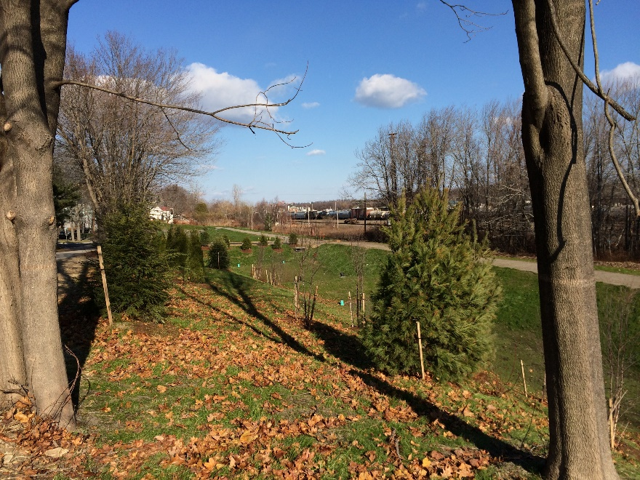
Thornton Heights Stormwater Separation

Slide 16
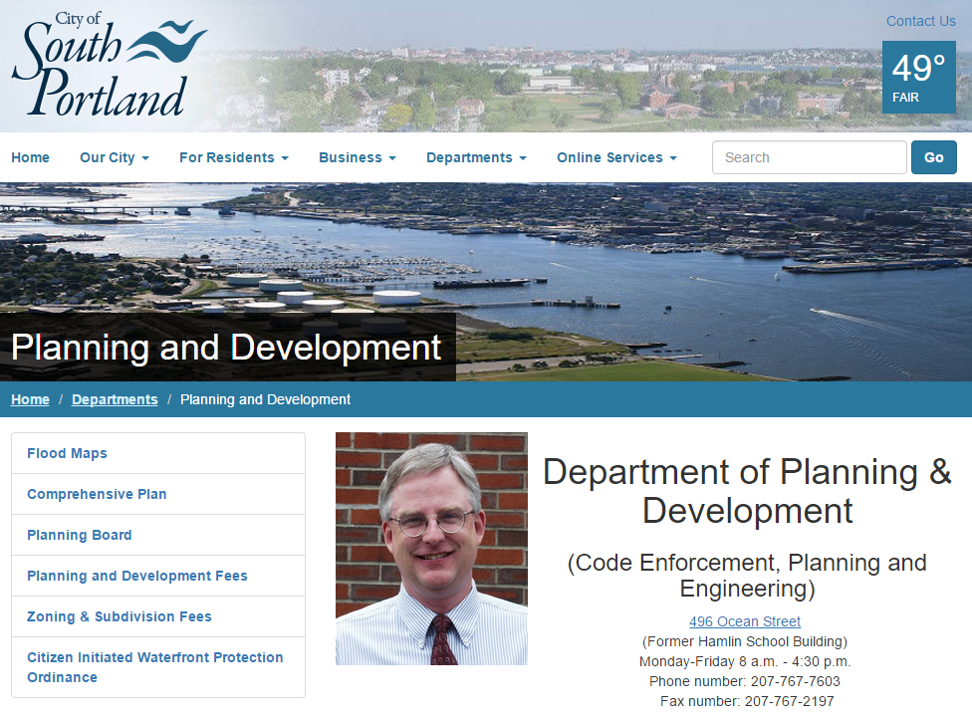

Slide 17
WETLAND ORDINANCE
  In addition to wetland protection, 25’ upland buffer
  Applies to all site plan / subdivision projects & building permits in NWI wetland / hydric soils
SHORELAND ZONING STREAM PROTECTION
  In addition to streams under State’s model ordinance, also includes Long Creek tribs
ANTI-SPRAWL DEVELOPMENT
  Comp plan & ordinances support small lot infill to reduce greenfield development
CLIMATE ACTION PLAN (see next 2 slides)

Slide 18
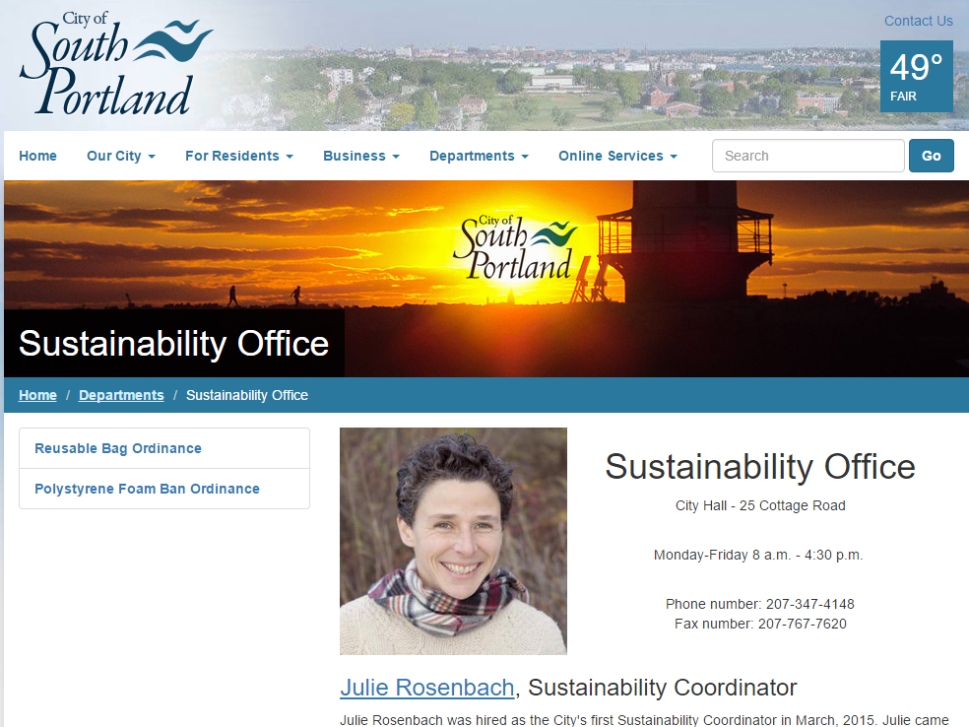

Slide 19
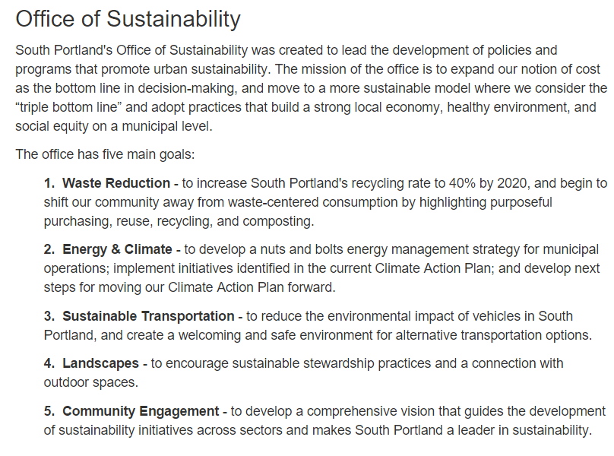

Slide 20


Slide 21
















Slide 22

Questions / Discussion

