Slide 1

State of the Bay Conference
Monitoring Change in Casco Bay October 13, 2015

Slide 2
What I am going to talk about…
Water Quality Monitoring
  What kinds of data we collect
  What we are seeing, and what we are not seeing, in the data
  How we are adjusting as the Bay changes
    More frequent data collection
    Sediment pH work

Slide 3
Water Quality Parameters:
  Water temperature
  Salinity
  Dissolved oxygen
  Secchi depth
  Total and dissolved nutrients
  In-situ fluoresence
  pH and Total Alkalinity
Issues of concern
  Nitrogen Pollution
  Ocean and Coastal Acidification

Slide 4
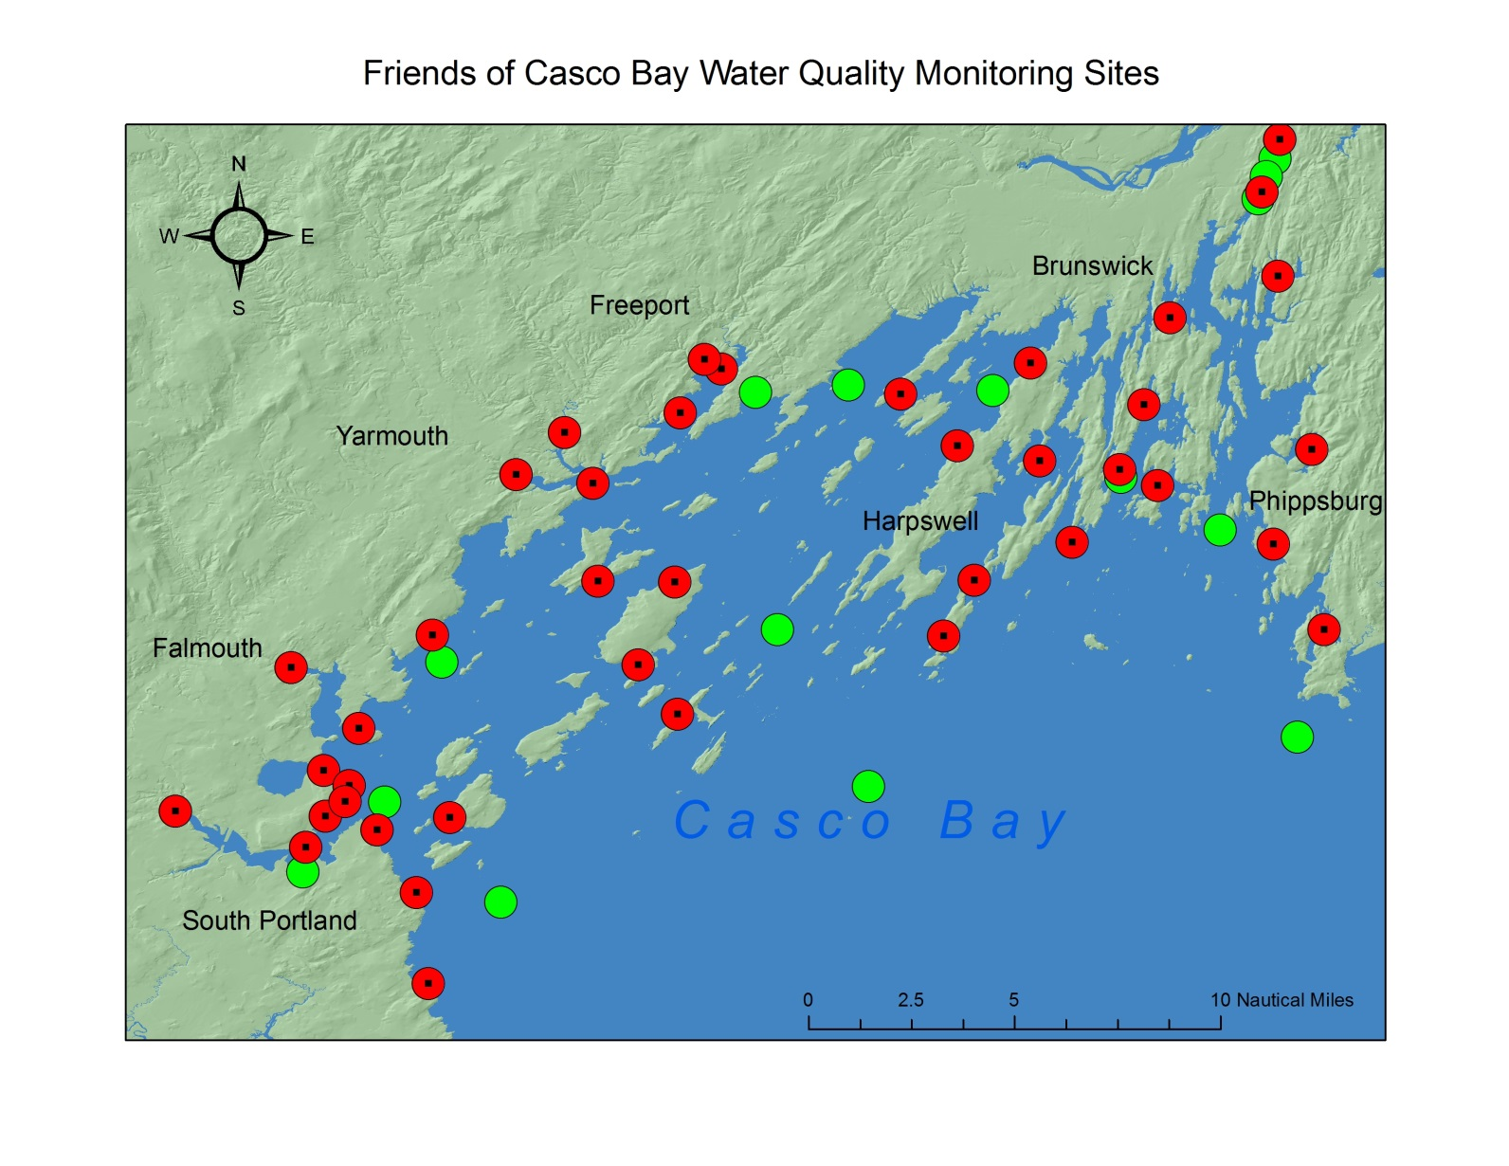

Slide 5
What we look for in the data…
  Relationships Between Parameters

Slide 6
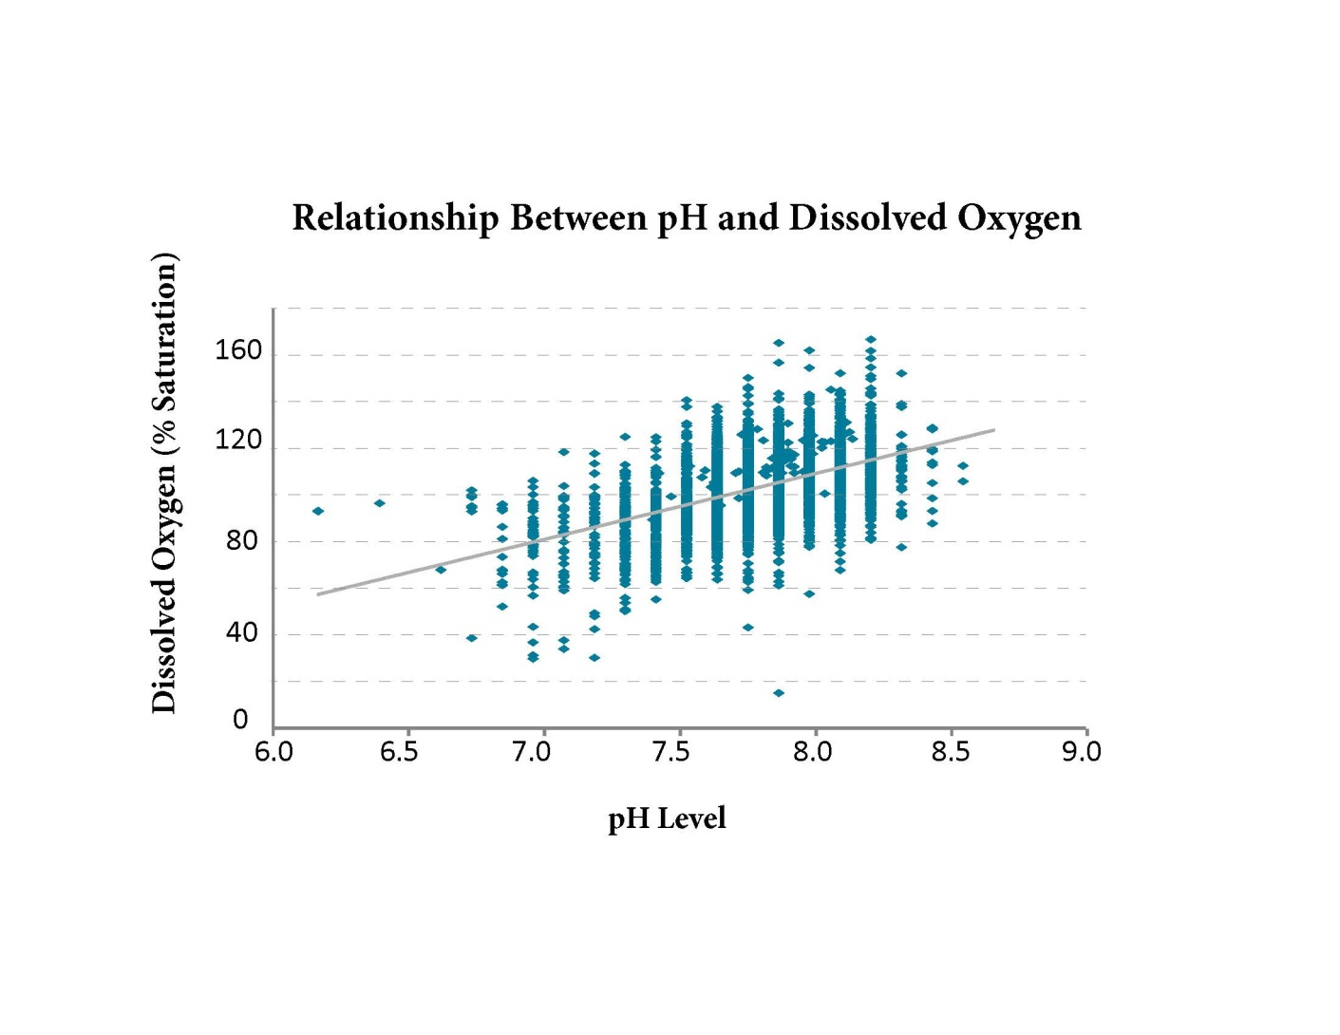

Slide 7
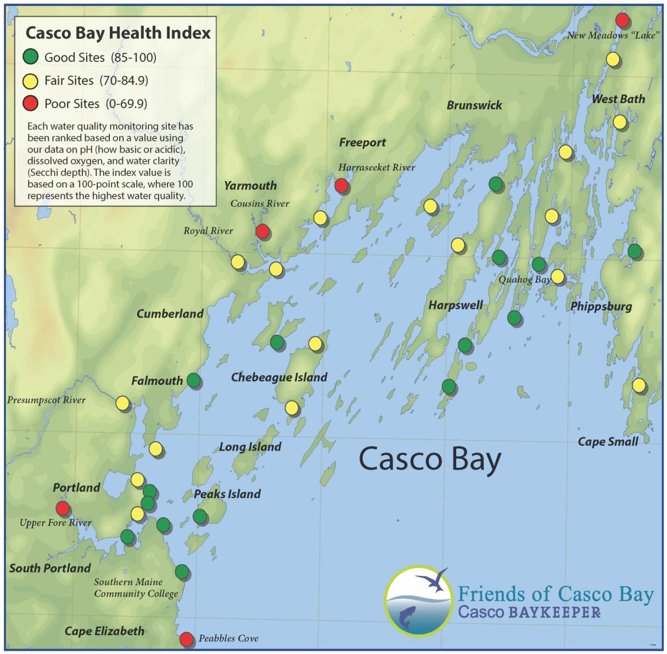
Spatial Trends

Slide 8
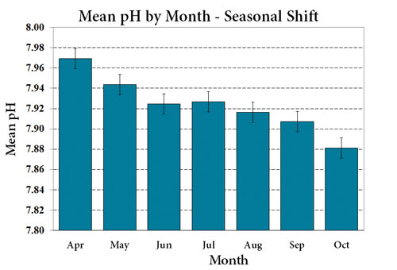
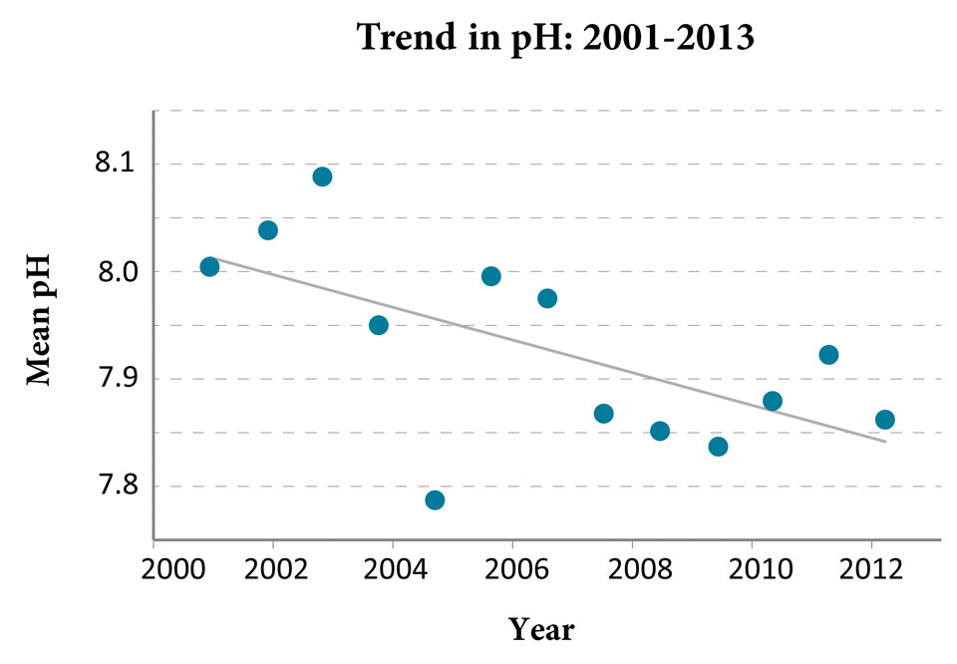
Temporal Trends

Slide 9
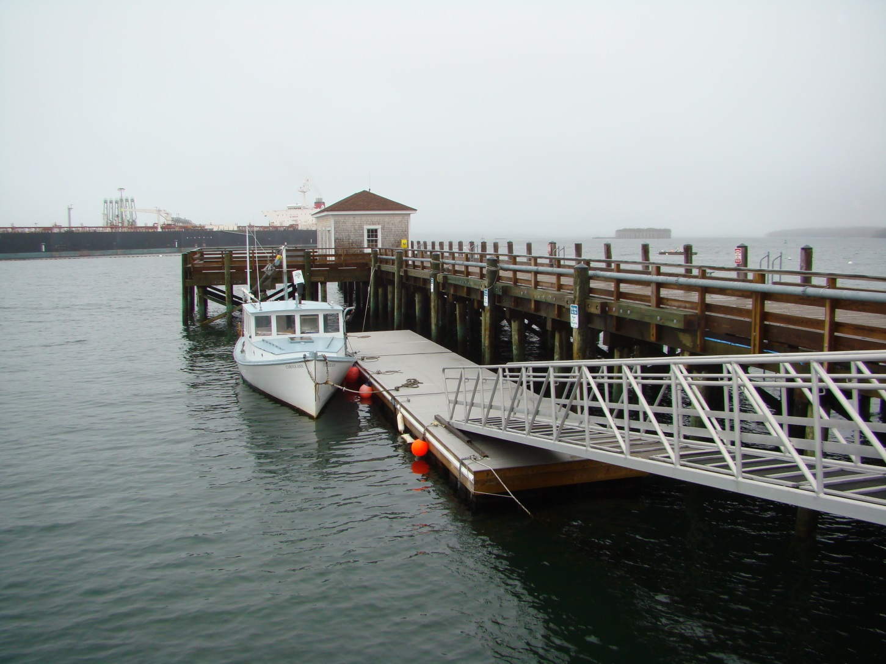
SMCC Pier – Unattended Data Collection

Slide 10
SMCC Pier Hourly Data - September
pH
Chlorophyll fluoresence

Slide 11
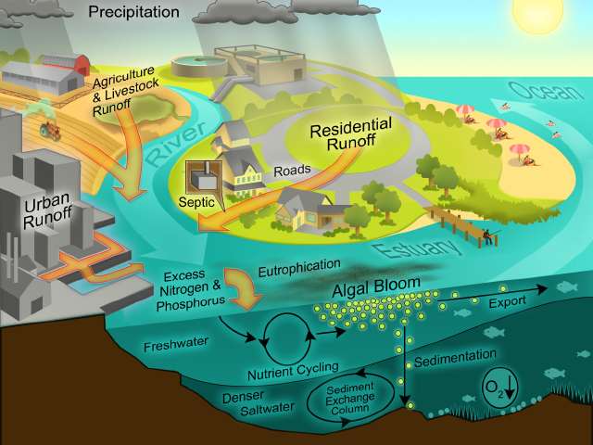
Nitrogen Pollution

Slide 12
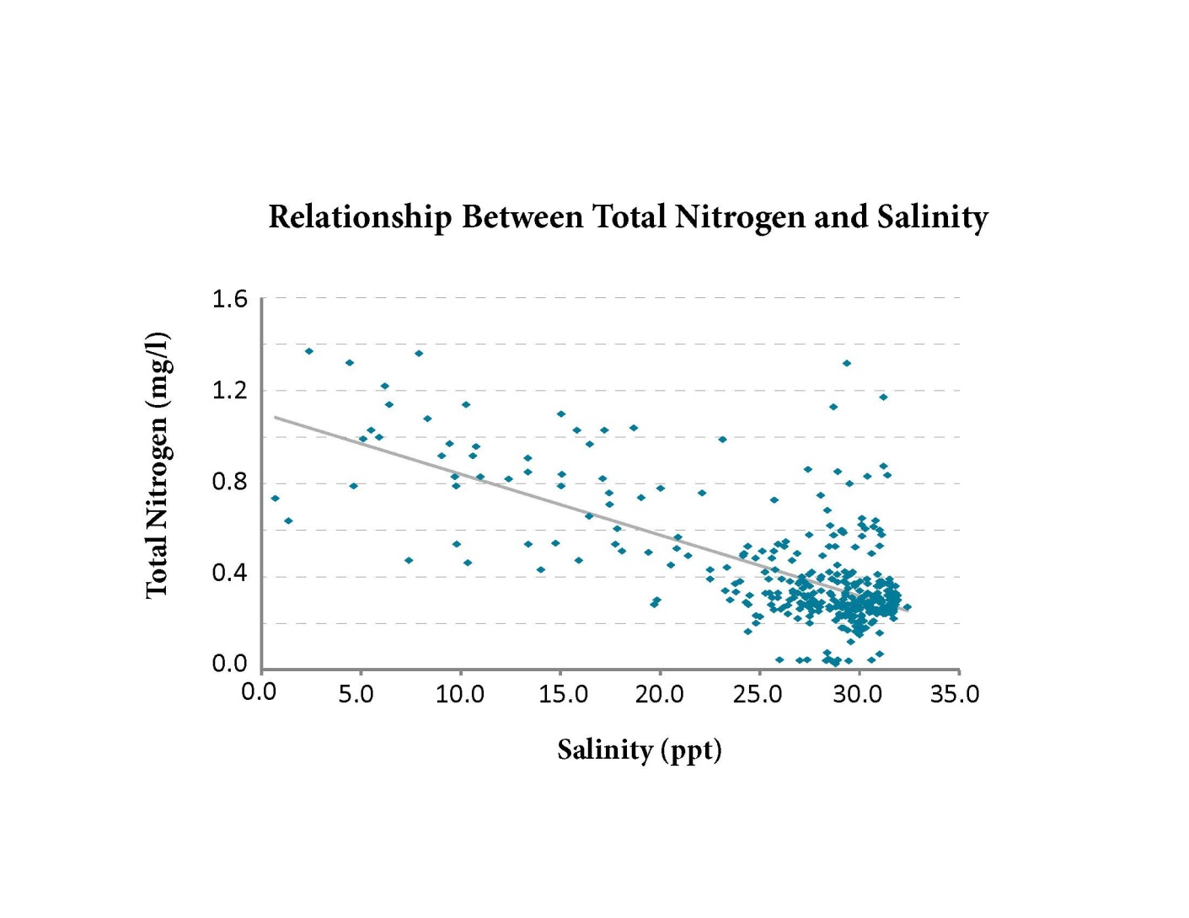

Slide 13
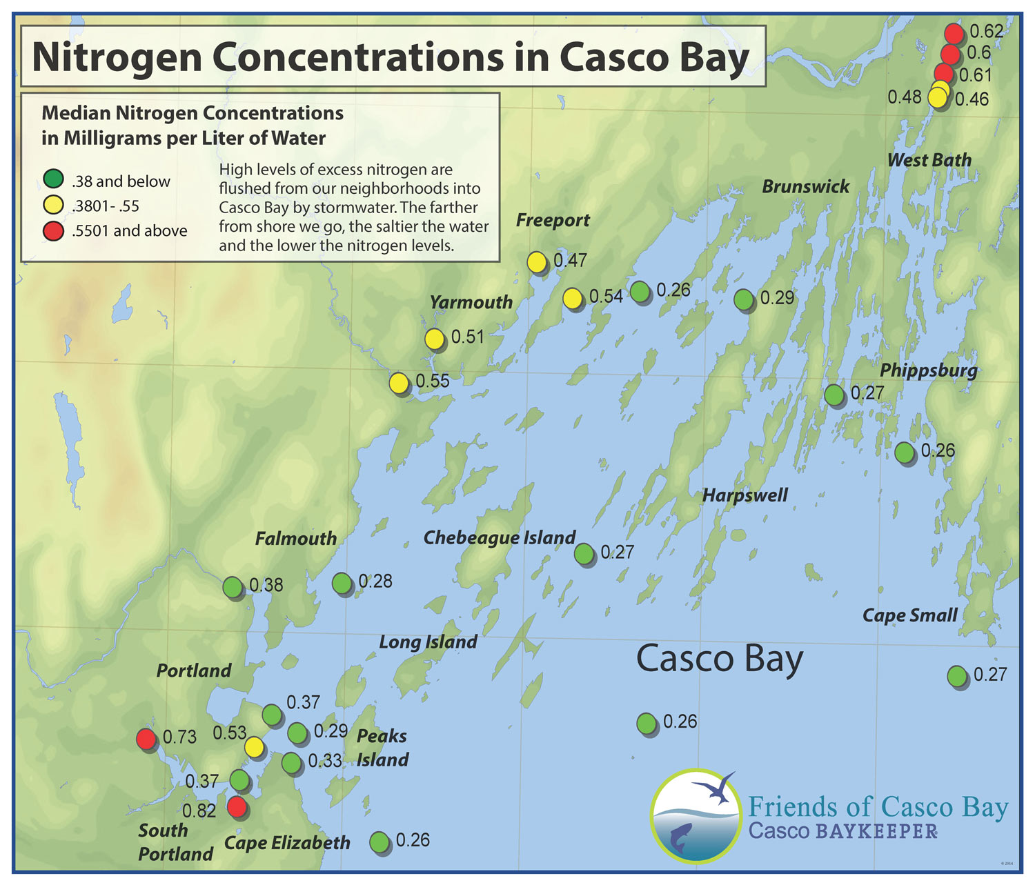

Slide 14
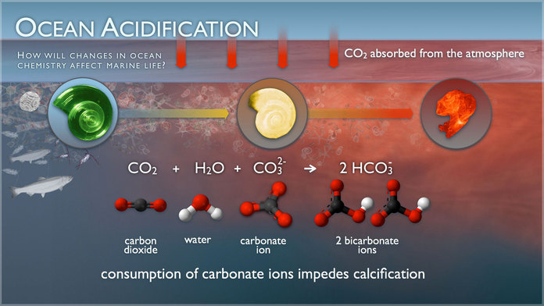

Slide 15
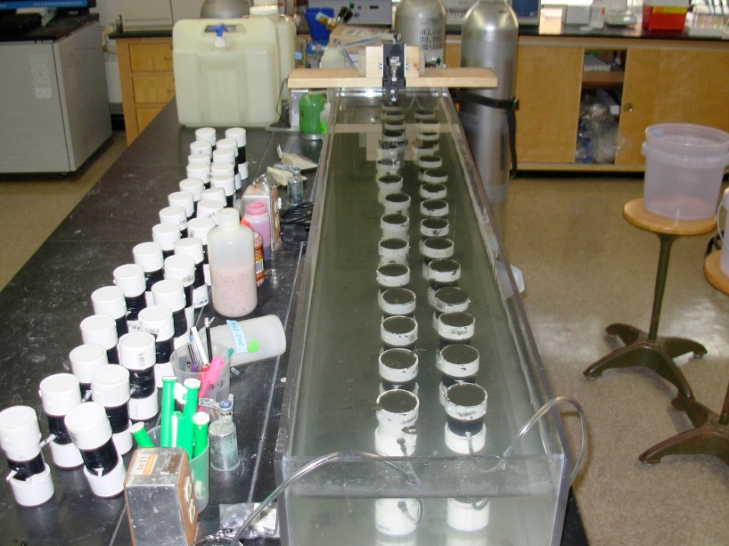

Slide 16
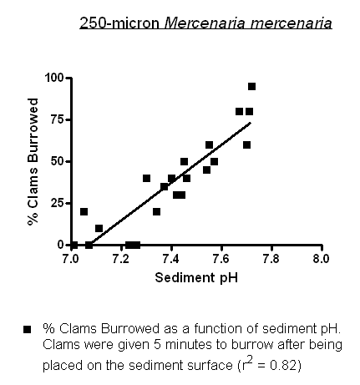
Green et al, 2009

Slide 17
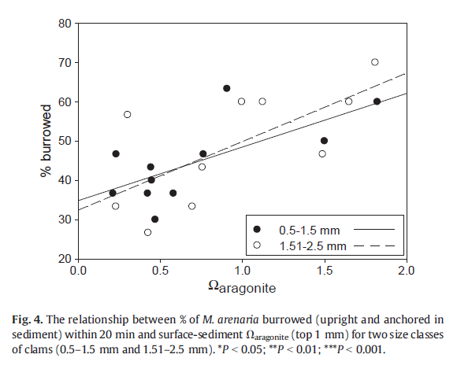
Clements, 2014

Slide 18
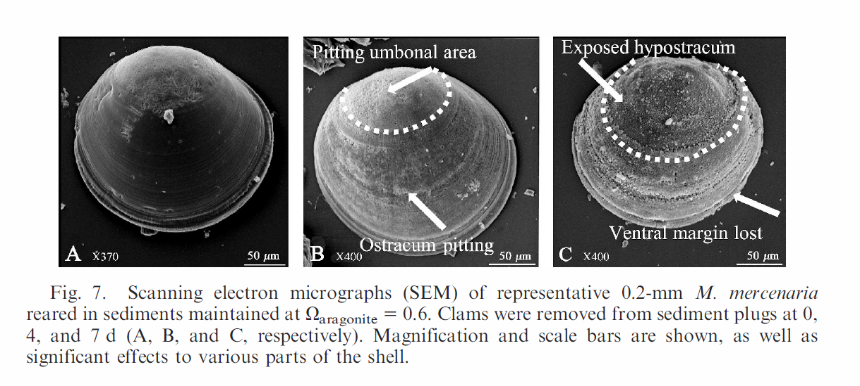
Green et al, 2009

Slide 19
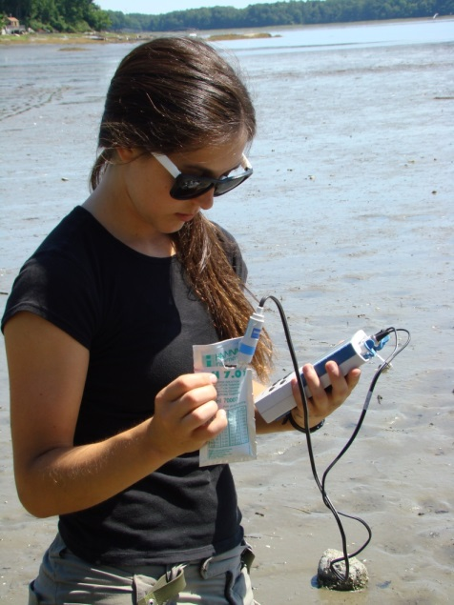
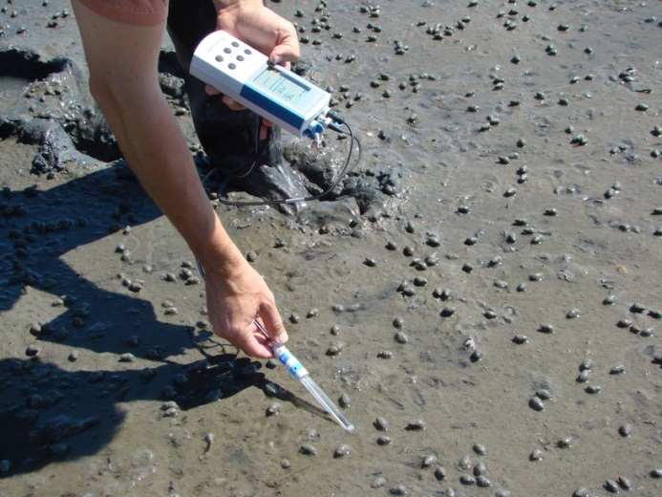
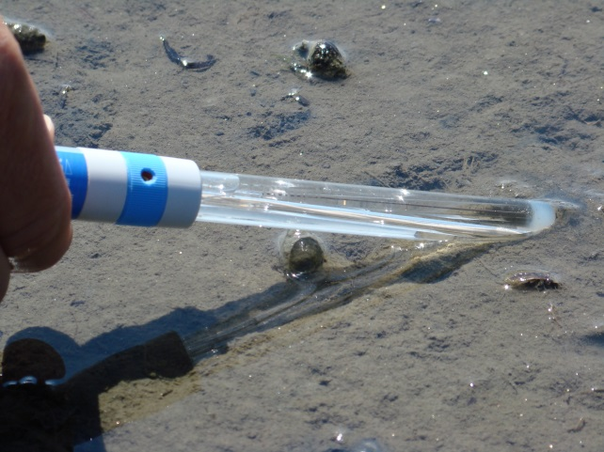
Sediment pH Protocol Development

Slide 20
Sediment pH Distribution
Two years of sediment pH measurements, 2012-2013
1000 measurements
  75% fell below 7.5
  25% fell below 6.8

Slide 23
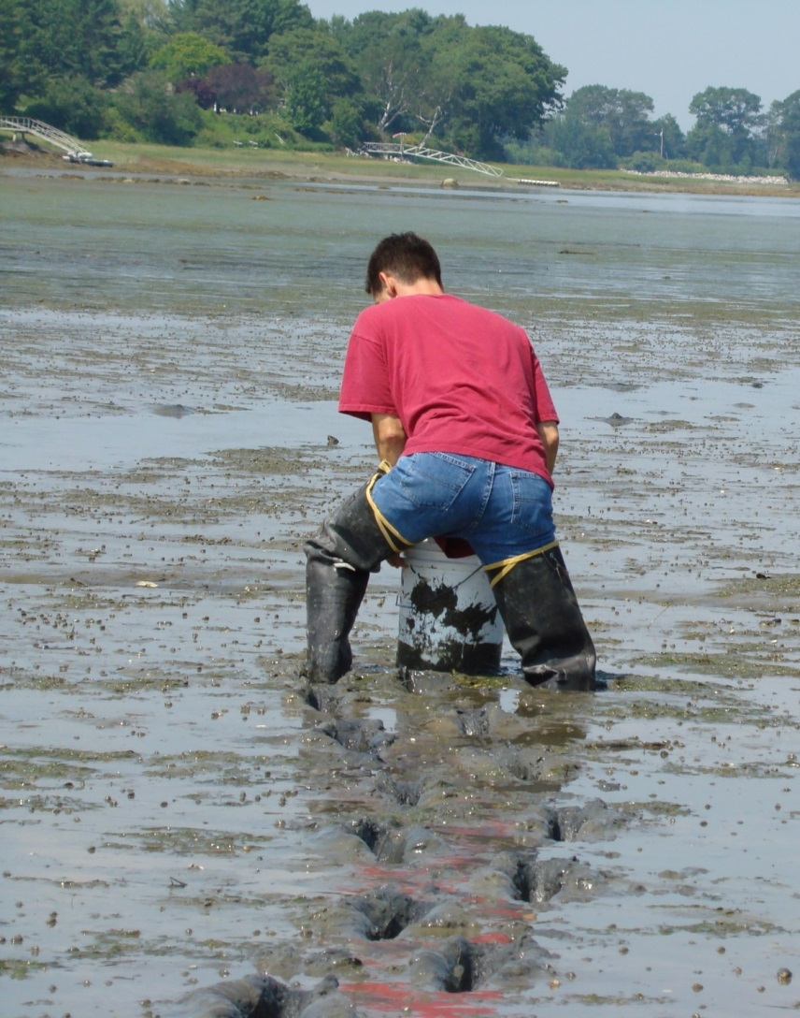
Conclusions
The Bay is changing...
Friends of Casco Bay will continue to collect the most relevant data to better understand these changes.
We will continue to focus on Nitrogen Pollution and Coastal Acidification.

