Slide 1
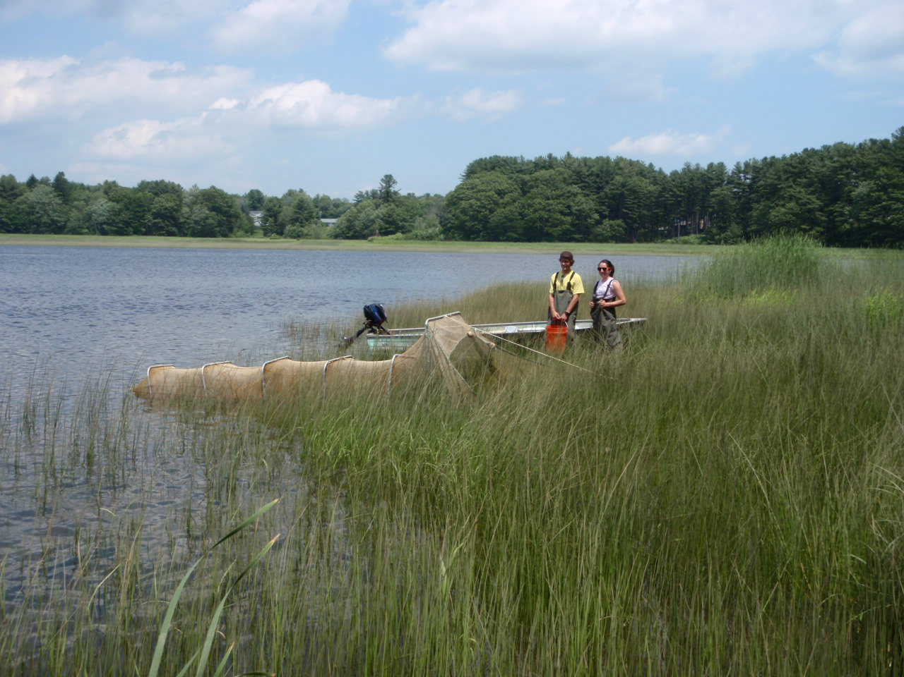
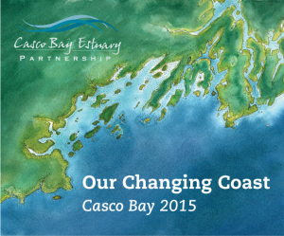
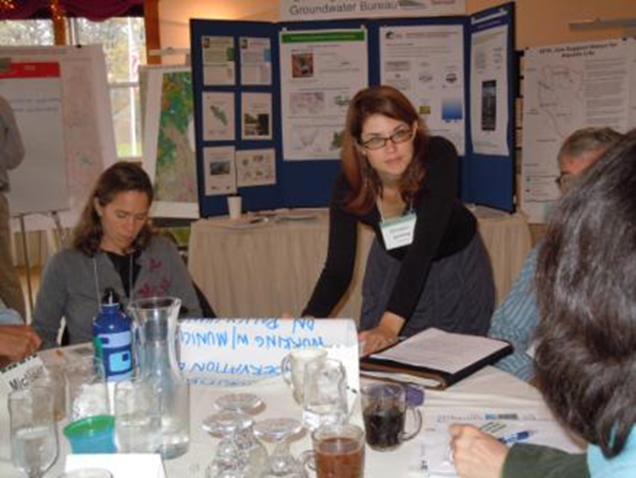
Successful Approaches to Change
Working Together to Get Things Done
State of the Bay Conference
Portland, Maine
October 13, 2015
Dr. Christine Feurt
Wells National Estuarine Research Reserve
Coastal Training Program Director
UNE, Department of Environmental Studies
Director, Center for Sustainable Communities

Slide 2
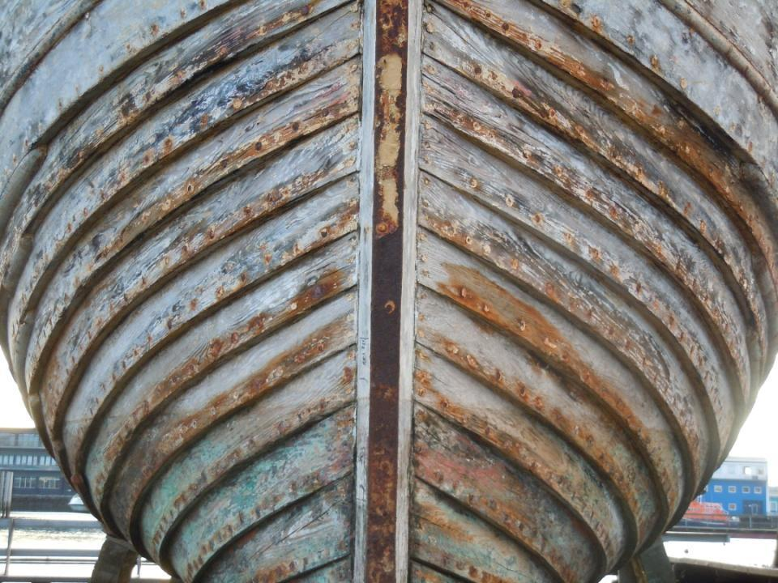
We’re All in the Same Boat
Notes:
We are all faced with unprecedented challenges in our work
Listening to your ideas and responses this morning I came to one conclusion
We care deeply about our work
We care deeply about the people we serve and who are touched by our work
We care deeply about the natural resources affected by our actions
"We're All in the Same Boat"
Topic(s): - Sustaining ecosystem services through research, planning, conservation and restoration
Kirsten at ESNEER, end of interview about what she has learned that her old way of thinking has been changed. And with unprecedented opportunities to meet those challenges
Most challenges are characterized by change
We find more and more that what we may have prepared for in school is not what we are faced with
Changing climates create challenges in our work
Economic climate
Political climate
Governance climate
CLIMATE
Missing link is Values

Slide 3
Working Together to Get Things Done…
To protect and restore the things people care about
The Millennium Ecosystem Assessment
Notes:
Recognizing what you are already doing, building on that
http://www.maweb.org/en/index.aspx
Ivory Tower High Level discussions easy to talk about these ideas
What does it feel like to be involved in making these ideas reality
This is about how we all work to bring these ideas into practice in our work
Use an example from my work to show you how similar the elements of the collaborative process are to what you are doing here

Slide 4
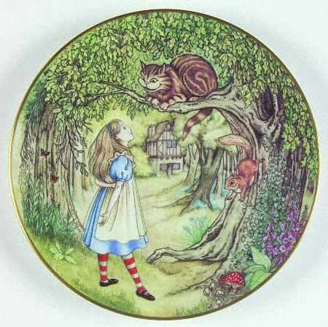
Which Way Should I Go?
Notes:
Spreading the ideas to those who are not in the room.
One day Alice came to a fork in the road and saw a Cheshire cat in a tree. "Which road do I take?" she asked. "Where do you want to go?" was his response. "I don't know," Alice answered. "Then," said the cat, "it doesn't matter."
My career has been punctuated by a series of what I call Alice in Wonderland moments.
One of those decisions led me to take the path of graduate school to learn how social science could be combined with natural science to foster actions that protected the qualities of the natural world that people care about.
Learned about Collaborative Learning and a suite of other social science based approaches that have the ability to increase the impact that science can have on decisions, management and policy. I hope to share what I found in Wonderland with you

Slide 5
Inspiring and Motivating Change
The most powerful theory you will ever learn . . .

Slide 6
Diffusion of Innovations
4 Elements of Diffusion
The Innovation or Idea
Communication pathways
The social system within which the innovation or idea moves
Time
Notes:
Think of an idea you would like to spread

Slide 7
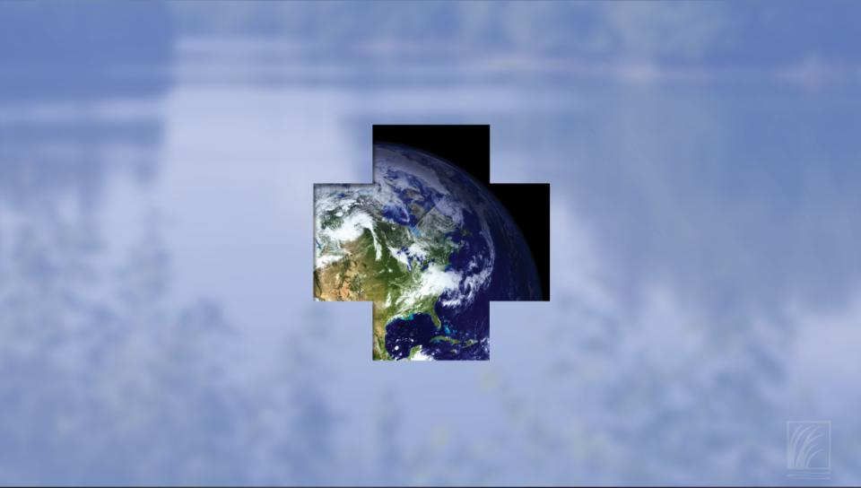
The Kaleidoscope of Expertise Working Together to Get Things Done
Regulations, Ordinances & Enforcement
Land Conservation
Planning & Land Use Management
Drinking/Source Water Protection
Engineering Public Works and Wastewater
Science: Water Research & Monitoring
Citizen & Business Watershed Stewardship
Education & Community Outreach
Notes:
This system is not the receptacle for our science these are our partners in developing solutions.

Slide 8
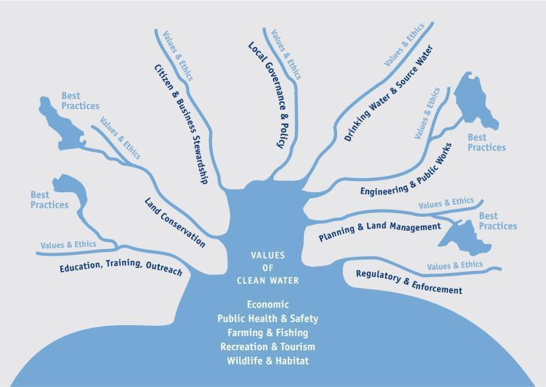
The Social Landscape of
Watershed Protection
Notes:
This social landscape is what this story is about new mental model of watershed protection

Slide 9
The steps of diffusion
Knowledge – Did you hear about…?
Persuasion – Tell me more about …
Decision – I’d like to try…
Implementation – Just do it!
Confirmation –Keep doing it
Notes:
Personal decisions and time to adopt

Slide 10
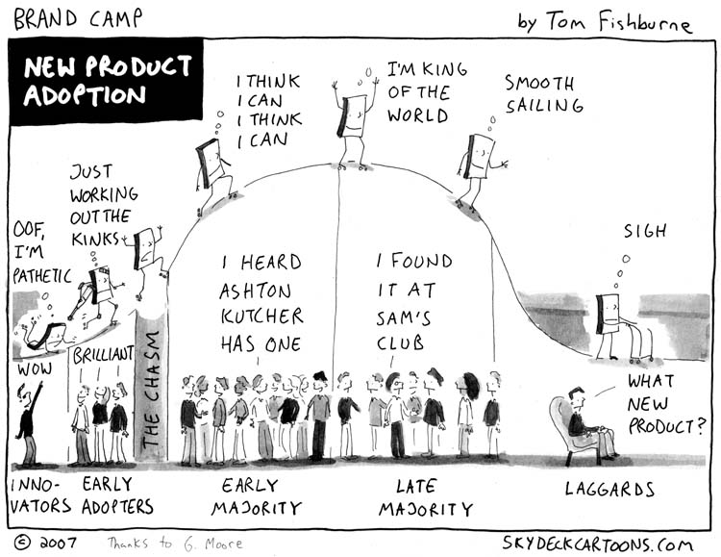
Notes:
System acceptance of idea

Slide 11
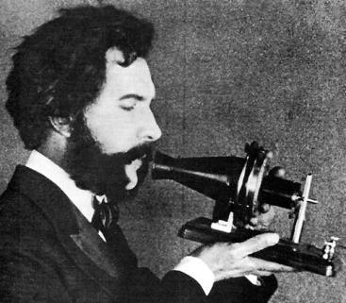
The 5 most powerful qualities of an idea that spreads and is used
#1 Relative Advantage
Will it make my life easier?
Notes:
March 10, 1876: 'Mr. Watson, Come Here ... ‘ 2015 139 years almost 140!
Evaluate these qualities for your idea
Relative Advantage How improved an innovation is over the previous generation.
Compatibility The level of compatibility that an innovation has to be assimilated into an individual’s life.
Complexity or Simplicity If the innovation is perceived as complicated or difficult to use, an individual is unlikely to adopt it.
Trialability How easily an innovation may be experimented. If a user is able to test an innovation, the individual will be more likely to adopt it.
Observability The extent that an innovation is visible to others. An innovation that is more visible will drive communication among the individual’s peers and personal networks and will in turn create more positive or negative reactions.
Will I be better off
Does this fit my life
Can I figure out how to use this
Can I try this out
Are others doing this

Slide 12
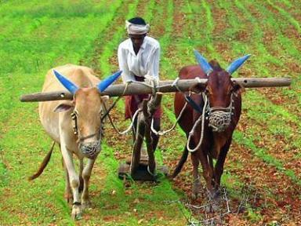
The 5 most powerful qualities of an idea that spreads and is used
#2 Compatibility
Does this fit my life?
Notes:
Includes technology and cost
Does this fit my life
Compatibility - The level of compatibility that an innovation has to be assimilated into an individual’s life.

Slide 13
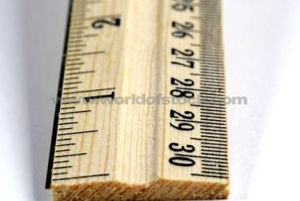
The 5 most powerful qualities of an idea that spreads and is used
#3 Simplicity
Can I figure out how to use this?
Notes:
Can I figure out how to use this
Complexity or Simplicity If the innovation is perceived as complicated or difficult to use, an individual is unlikely to adopt it.

Slide 14
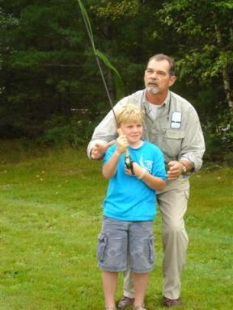
The 5 most powerful qualities of an idea that spreads and is used
#4 Trialability
Can I test this out?
Notes:
Trialability - How easily an innovation may be experimented with. If a user is able to test an innovation, the individual will be more likely to adopt it.

Slide 15
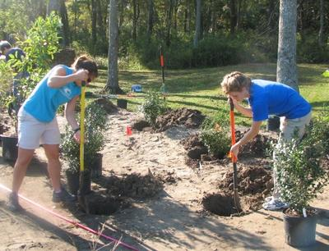
The 5 most powerful qualities of an idea that spreads and is used
#5 Observability
Are others doing this?
Notes:
Observability - The extent that an innovation is visible to others. An innovation that is more visible will drive communication among the individual’s peers and personal networks and will in turn create more positive or negative reactions.

Slide 16
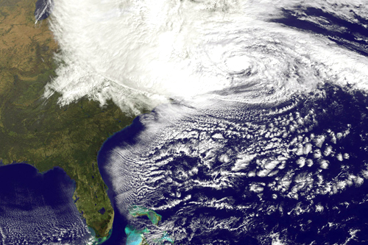
Sandy: The Change in the Coastal Conversation
Notes:
October 29, 2012 Mid Atlantic

Slide 17
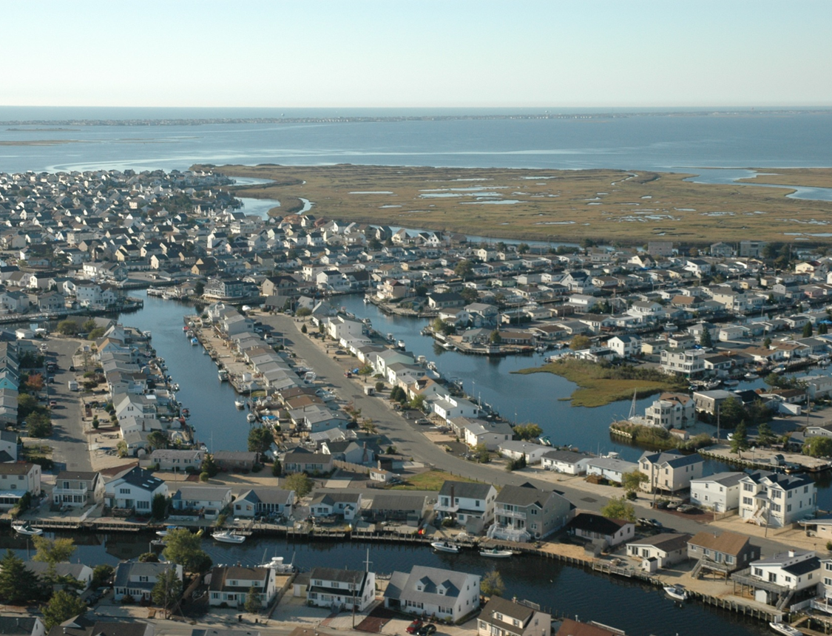

Slide 18
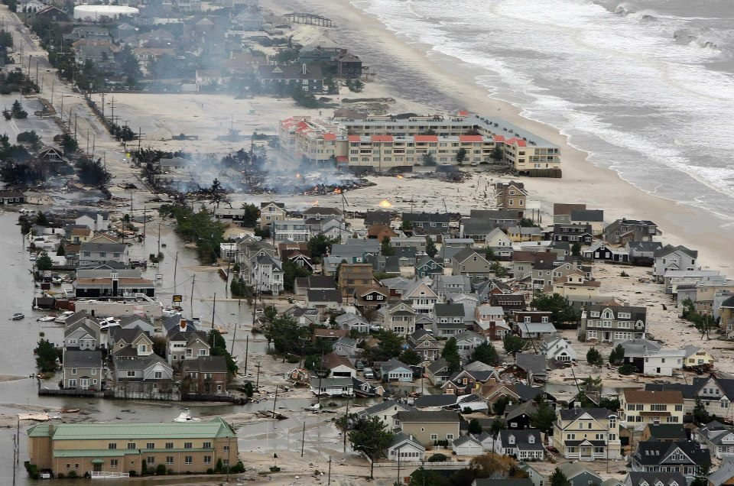

Slide 19
2012 The Sandy Dialogues 2014
Partnership Wells Reserve and Jacques Cousteau Reserve in New Jersey
Peer to peer learning municipal officials
Road trip to New Jersey to observe recovery
Road trip to Maine to share the story
Observability-Relative Advantage-Compatibility-Complexity-Trialability
Resources available at Wells Reserve.org
Notes:
October 29, 2012
June 2014
Sept 2014

Slide 20
2012 The Sandy Dialogues 2014
Observability-Relative Advantage-Compatibility-Complexity-Trialability
Maine officials could see lingering impacts
Maine officials recognized advantages of planning
Maine officials learned from counterparts in New Jersey who had similar roles and responsibilities
Maine officials recognized that pre-disaster planning would make storm response more efficient, effective and economical
Maine officials could try planning ideas before a storm hits.
Resources available at Wells Reserve.org
Notes:
October 29, 2012
June 2014
Sept 2014

Slide 22
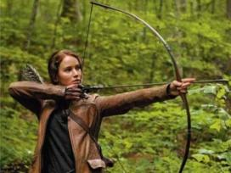
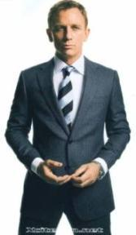
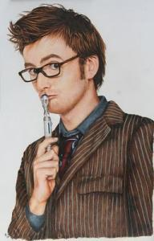
Using Diffusion of Innovation Theory What kind of a Change Agent will you be?
Super Heroes
Rebel
Magical Chosen One
Secret Agent
Time Lord/Intellectual
Innovator
Notes:
http://en.wikipedia.org/wiki/Diffusion_of_innovations
https://www.indiana.edu/~simed/istdemo/dsgaect/dsg.phtml?member=13411
Diffusion Simulation Game

Slide 23
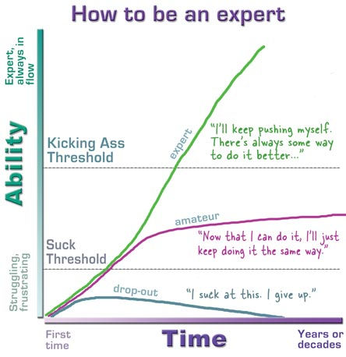
Notes:
http://headrush.typepad.com/creating_passionate_users/2006/03/how_to_be_an_ex.html
This two days as CL 101 to introduce you to CL and tempt you to try it during the next 6 months.
If it works for you, you can go deeper

