Slide 1

Successful Approaches to Change: MaineDOT’s Experience
Charles Hebson
MaineDOT / Environmental Office
16 State House Station
Augusta ME 04333-0016
presented at
Our Changing Bay 2015
Casco Bay – State of the Bay Conference
Double Tree – Hilton, South Portland, ME
13 October 2015

Slide 2
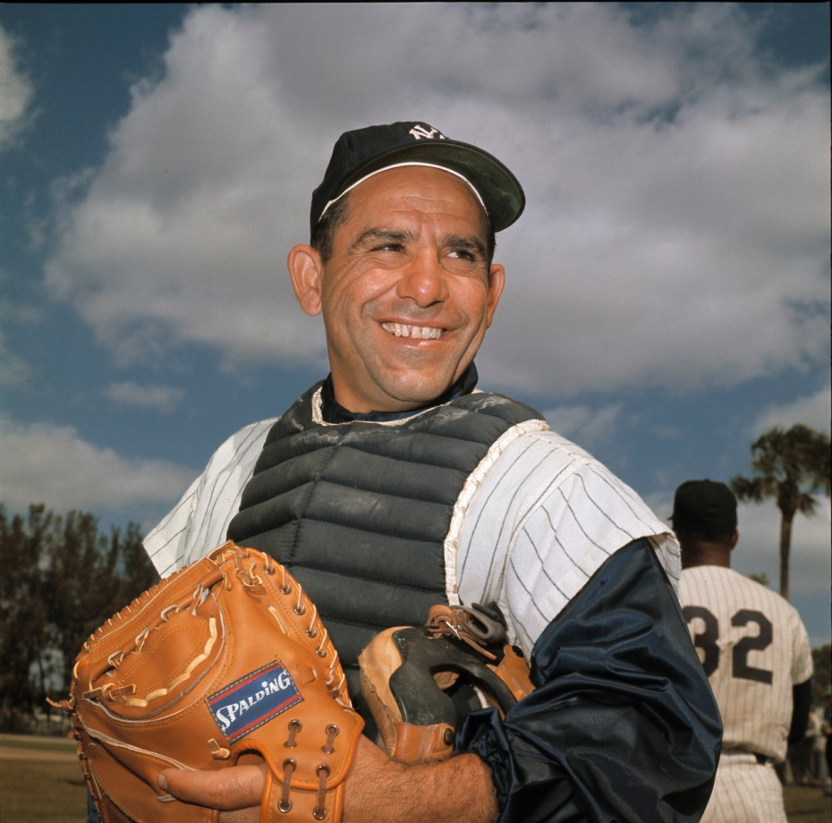
As a famous climate scientist once said …
The future ain’t what it used to be.

Slide 3
Some DOT Challenges
Hydraulic Structures
Assets:
  Thousands of bridges (span S > = 10 ft)
  Thousands of large culverts (5 <= S < 10 ft)
  Many thousands of cross-culverts (S < 5 ft)
Exposures:
  Coastal: seal-level rise (SLR)
  Inland: riverine runoff peak flow events
Projects:
  Individual assets
  Corridor reconstruction
Design Life of New Structures
  100 YRS +

Slide 4
Some Very Simplistic Starting Assumptions
Bridges: they are generally big, climate change not a worry
Culverts: existing structures tend to be undersized by current standard
Sea Level Rise: elevation is the issue, not capacity
Inland Peak Flows: asset capacity is the primary issue
Asset Replacement:
  Due to poor condition or chronic hydrologoc failure
  Not according to some prediction of future failure

Slide 5
MaineDOT Efforts
Data & Engineering Methods
  Cooperative projects with USGS
  Internal design policy
Planning, Research & Pilot Studies
  FHWA sponsorship
  Catalysis & GEI projects (Sam Merrill & collaborators)
  Decision Support Tool for Enhanced Early Project Scoping and Program / Project Risk Identification

Slide 6
Major Change to MaineDOT
Culvert Design Standard
Cross Culverts (S < 5 ft)
  Design Flow Q₅₀
  Allowable Headwater H_{w}/D <= 1.5
  (former standard for all culverts)
Large Culverts (5 < S < 10)
  Design Flow Q₁₀₀
    Q₁₀₀ 20% > Q₅₀
  Allowable Headwater H_{w}/D <= 1
  Result: bigger structures
- Complemented by environmental “bankfull sizing” for fish passage.
- Protection against Q₁₀₀++ .
- Relatively few culverts on “real streams” sized purely for hydraulic capacity.

Slide 7
Benefits of New Standard
Enhanced protection of assets
  Protection against increased flows due to climate change
  Design for Q₁₀₀ now, get Q₅₀ protection 50 – 100 yrs from now
Most useful, biggest impact on “production work”
  Smaller structures, routine work – lots of them!
Improved fish passage
  Reducing & eliminating undersized culverts
“We’re doing something!”
Better than interim standard – strong first step - but not final story
  Ideally – still need to capture future climate expectations
    Which change scenario plays out?
    Uncertainty in predictions within that scenario
  Address MaineDOT system in some fashion

Slide 8
Some Ideas
Total DOT asset base too big for meaningful assessment
  Break it up into digestible portions
  Corridors
  Vulnerable geographic settings
  Leverage local experience and staff knowledge
    Efficient, effective screening
Risk-Based Design (vs current Frequency-Based Design)
  Goal: Balance Underdesign against Overdesign in a Rational Manner
  Minimize total expected project cost over asset lifetime
  Challenges & Limitations:
    Data
    Models

Slide 9
Corridor Selections
Route 2 - Mercer
Courtesy of Sam Merrill
Route 4 - Berwicks

Slide 10
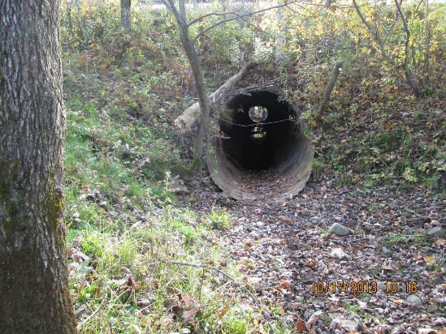
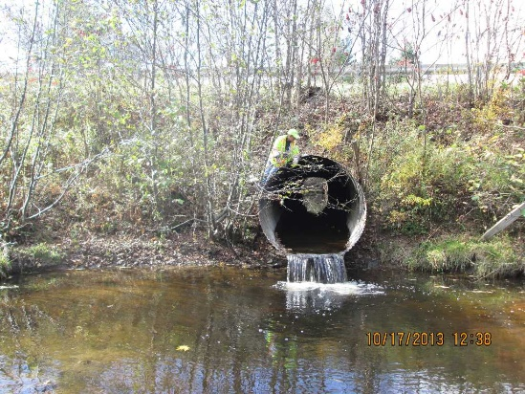
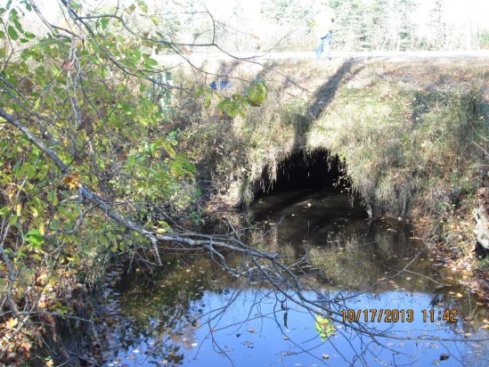
Courtesy of Sam Merrill

Slide 11
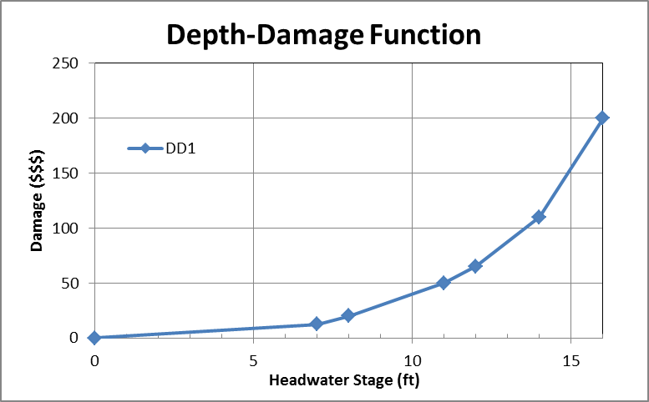
Depth Damage Functions for Each Candidate Structure
Elev. Damage Cost
14-16’ Extreme = $E/event
12-14’ Severe = $E/event
11-12’ Serious = $D/event
8-11’ Moderate = $C/event
7-8’ Slight = $B/event
D = 7’
0-7’ Negligible = $A/event
Waterway
Base Elevation
Courtesy of Sam Merrill

Slide 12
Transformation of Hydrologic Probabilities to Damage Probabilities

Slide 13
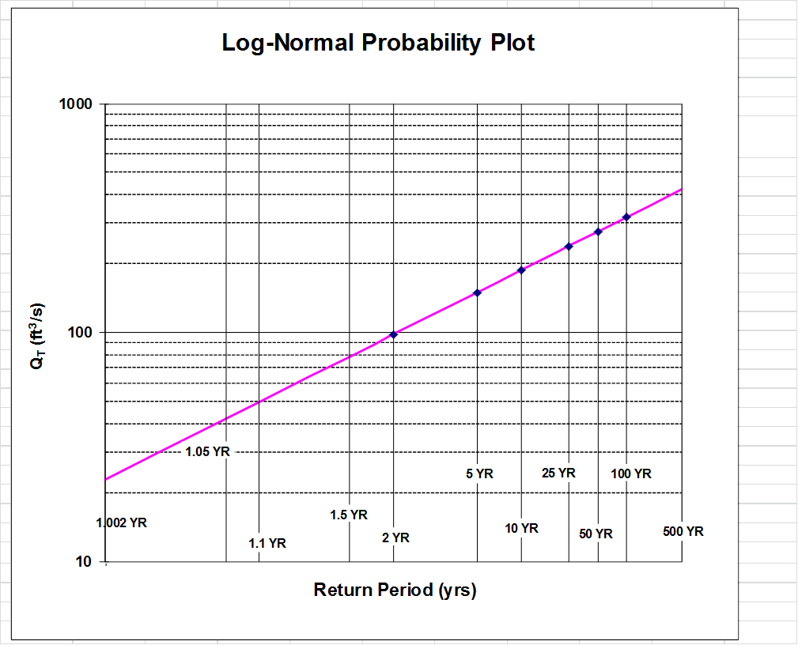
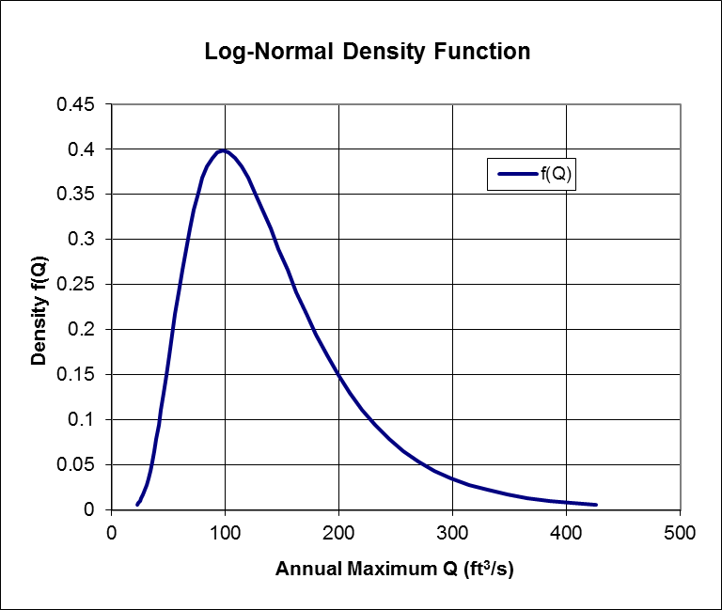
Sort of like the
Cumulative Distribution Fn – CDF
“showroom product”
Probability Density Fn – PDF
“under the hood”
Alternative Representations of the Same Underlying Probability Function

Slide 14
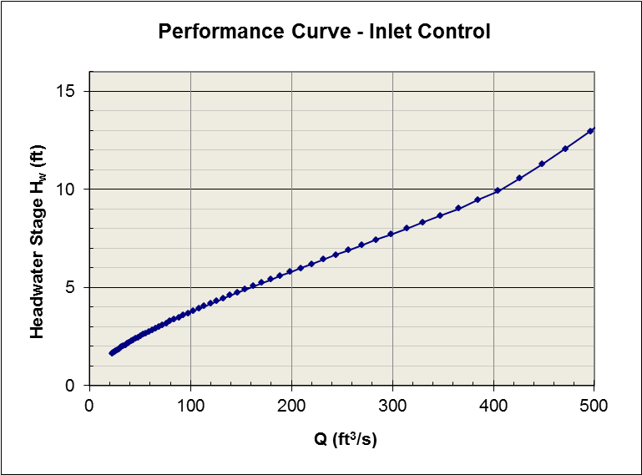
Culvert Performance Curve
Flow – Depth Function
For D = 7’

Slide 15
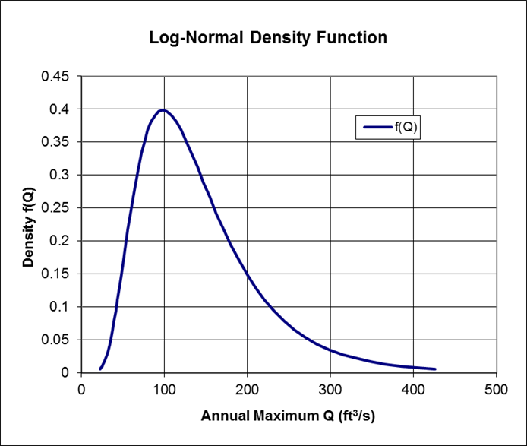

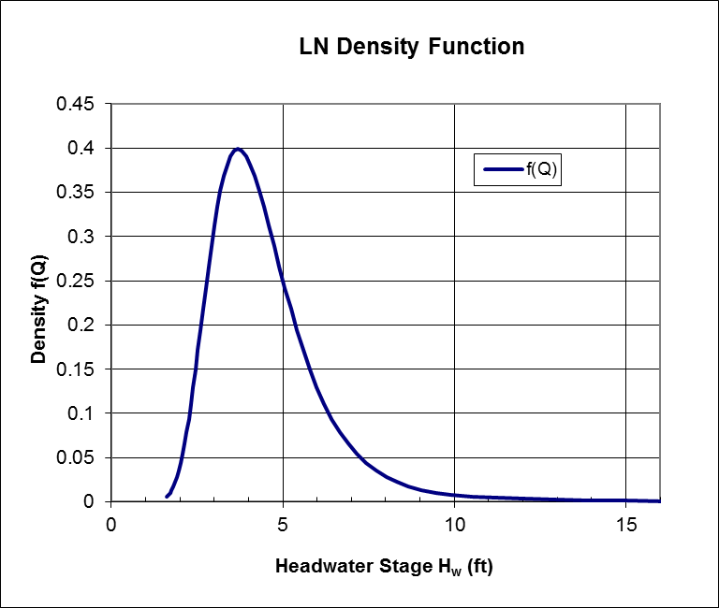
Transform the Flow PDF to a Depth PDF

Slide 16
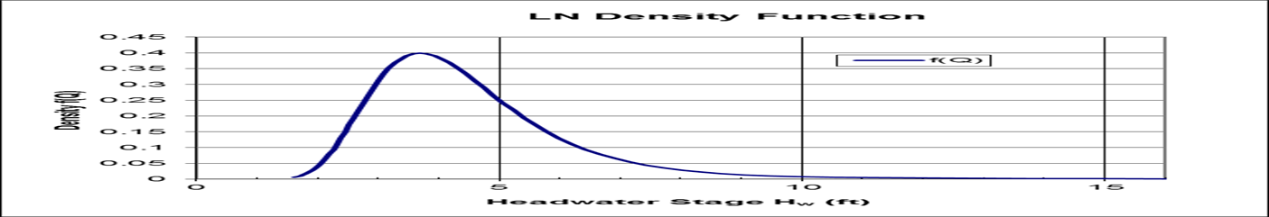
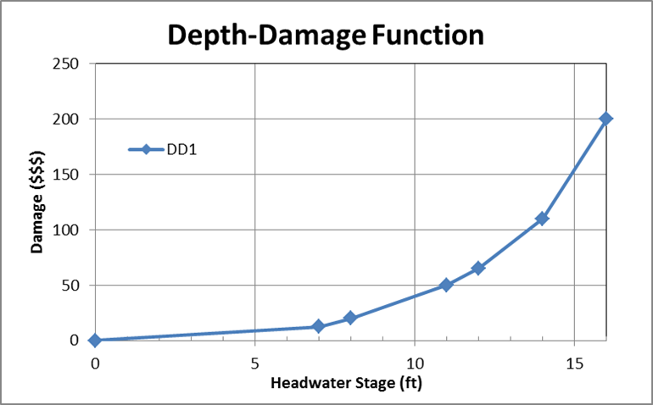
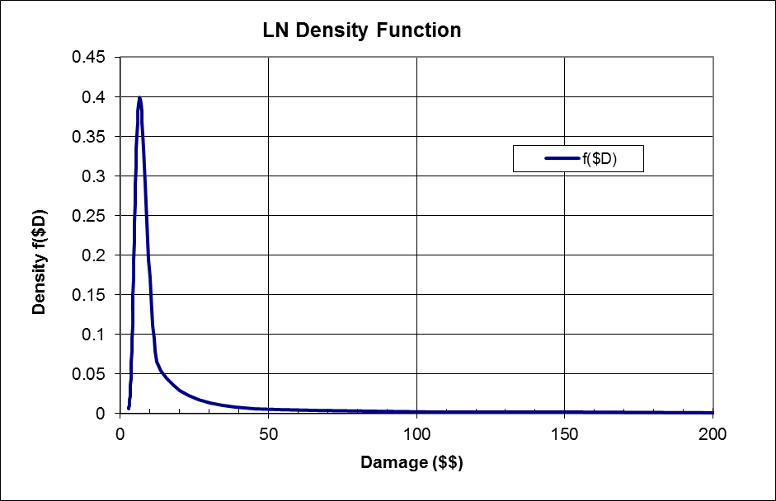
Transform Depth PDF to Damage PDF
Expected (Avg) Damage = $62

Slide 17
Challenges to Application
Models
  Depth-damage functions
    Identify ALL costs
    Get good estimates (relative? absolute?)
  Flood frequency curves
Data
  Basic asset data
    Size (capacity)
    Elevations
  Real construction costs
  Screen for vulnerable, at-risk assets

