Slide 1


CBEP State of the Bay 2015
Habitat Resilience: Dams
The Past, the Future and Everything In-between

Slide 2

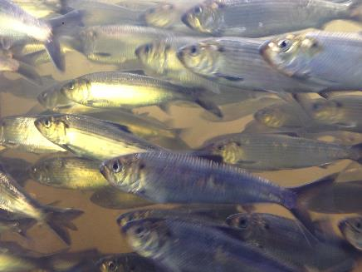
“No man ever steps in the same river twice, for it's not the same river and he's not the same man.” -Heraclitus

Slide 3
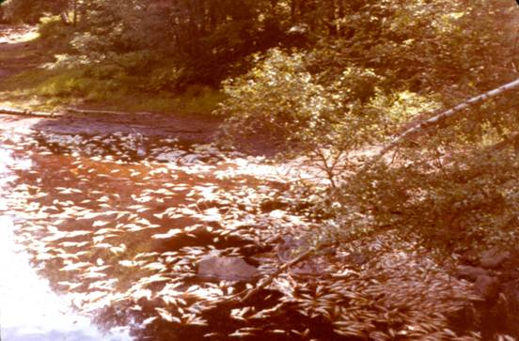
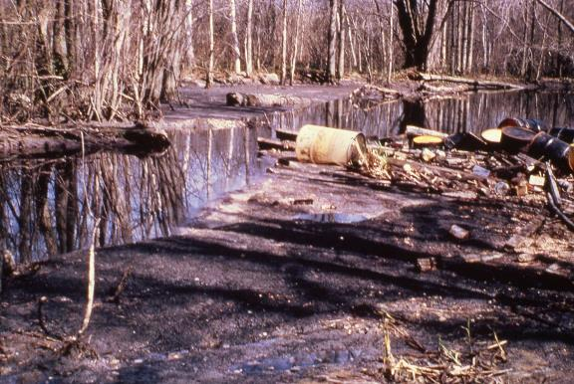
Chemical containers,
Eastland Woolen Mill
Fish kill, Androscoggin River

Slide 4
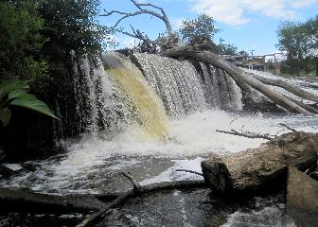
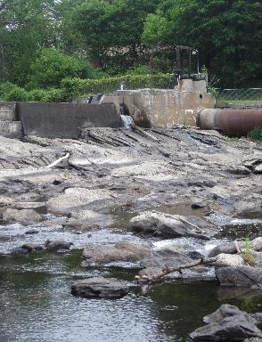
Environmental impacts of dams:
Difficult or impossible for migratory species to pass
Change water temperature in impoundments- usually
increasing temperatures by decreasing flow
Reducing the circulation of water and increasing the temperature often results in less oxygen
Increased upland flooding
Dams hold back silt, debris, and nutrients
Dams increase predator risk- reservoirs tend to be warm and murky, favoring predators
Dams reduce the productivity of estuaries and bays
(= fewer juvenile fish due to inaccessibility of spawning grounds)

Slide 5
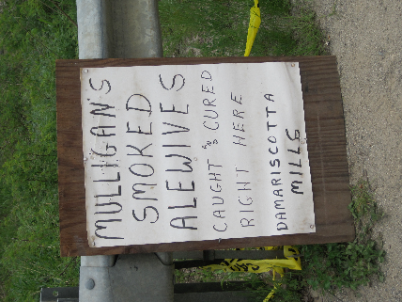
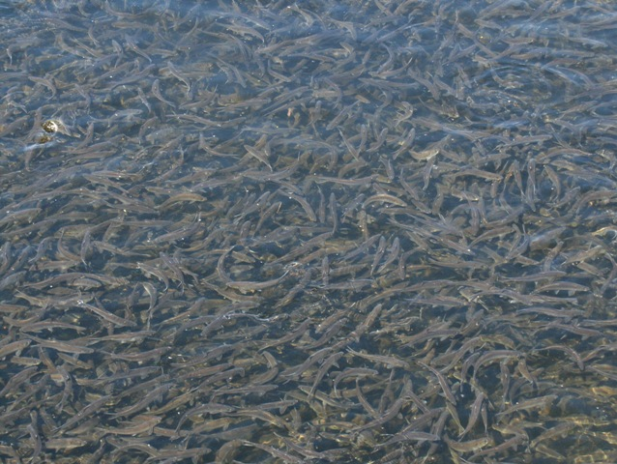
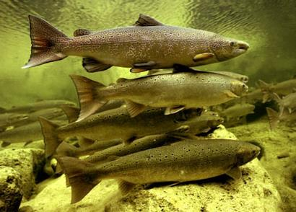
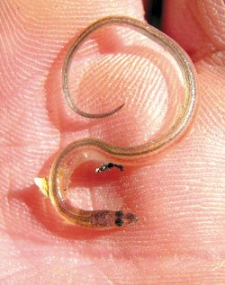


Slide 6
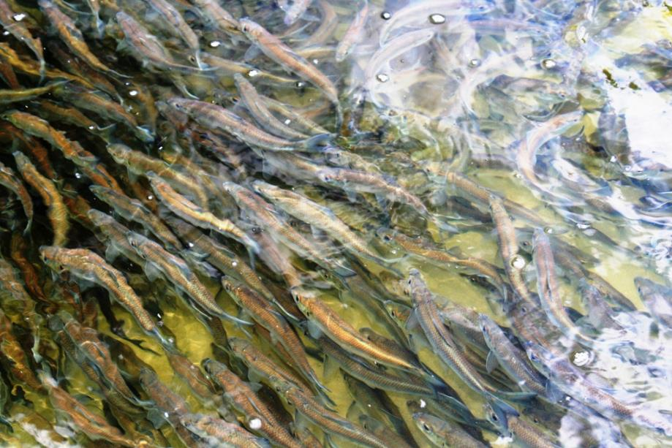

Slide 7

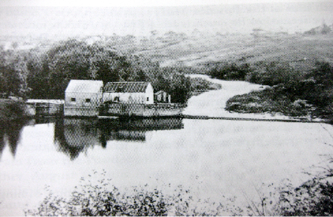
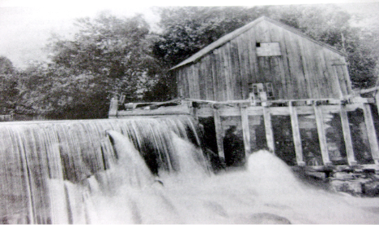
Left: Carolyn Hall
Above: mill on Megunticook River
Below: mill on St. George River

Slide 8
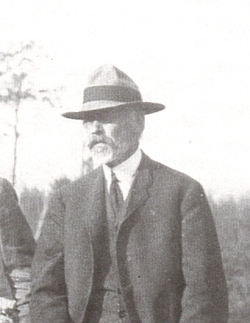
Charles Atkins

Slide 9
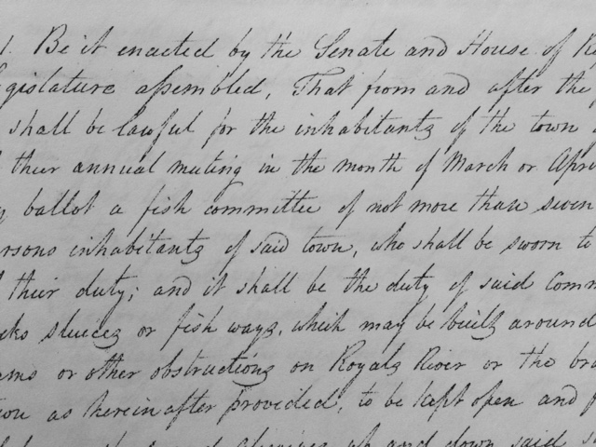

Slide 10
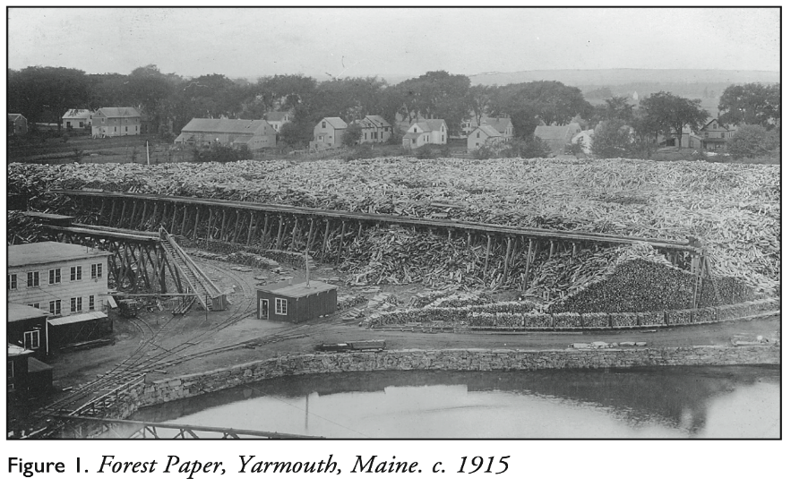

Slide 11
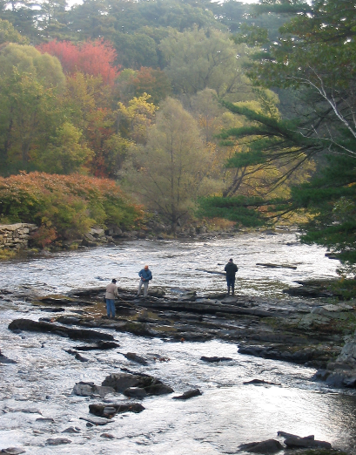
Royal River
Watershed dams

Slide 12
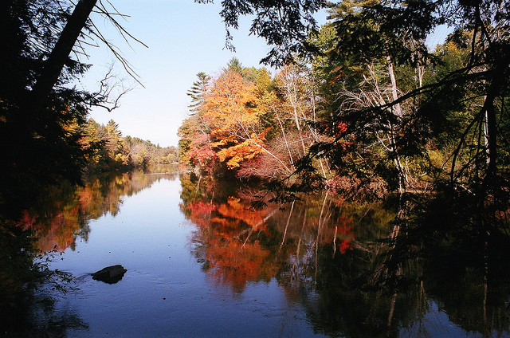
Presumpscot River

Slide 13
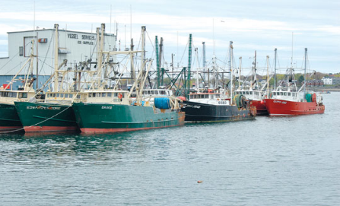
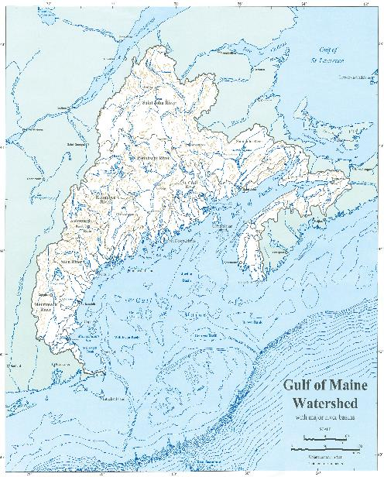
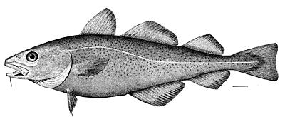
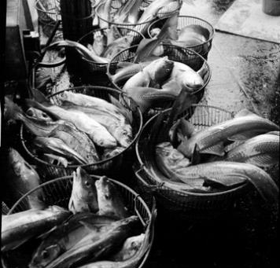
Map created by Richard D. Kelly, Jr., Maine State Planning Office, for the Gulf of Maine Council on the Marine Environment

Slide 14
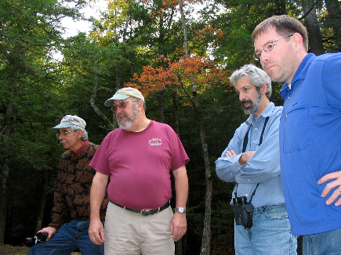
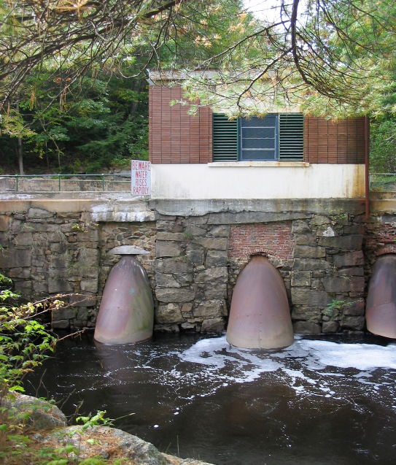

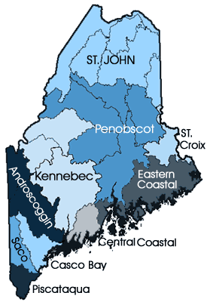
Old Falls Dam on the Mousam River

Slide 15
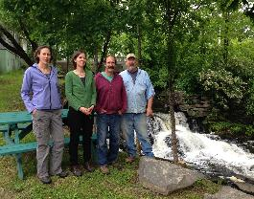
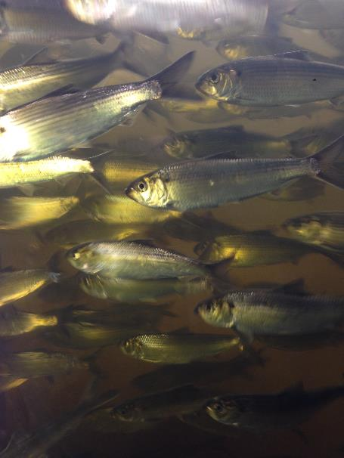

China Lake Alewife Restoration Initiative

Slide 16
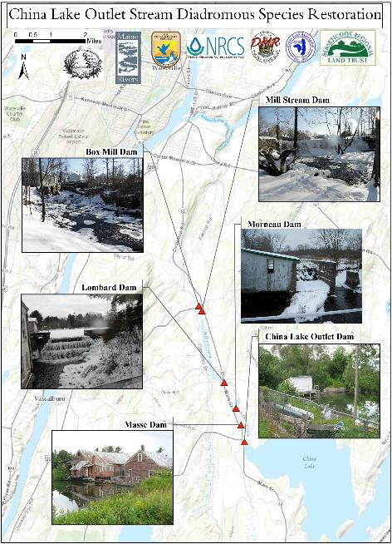
Alewife
Restoration
Initiative

Slide 17
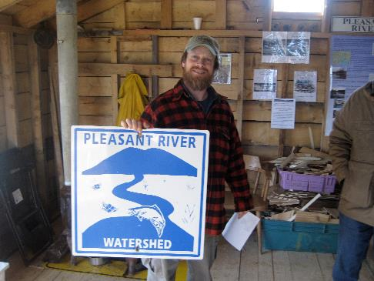

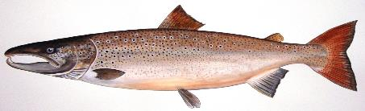
Above: Dwayne Shaw, Downeast Salmon Federation
Right: 22 ukuleles supporting river restoration
Columbia Falls, ME

Slide 18
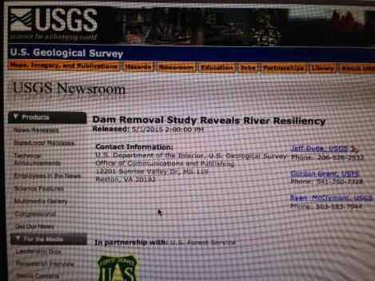
Science 1 May 2015:
Vol. 348 no. 6234 pp. 496-497
ECOLOGY
1000 dams down and counting
^{J. E. O'Connor1}, ^{J. J. Duda2}, ^{G. E. Grant3}
+
Author Affiliations
¹U.S. Geological Survey, Portland, OR, USA.
²U.S. Geological Survey, Seattle, WA, USA.
³USDA Forest Service, Corvallis, OR, USA.
E-mail: ^{oconnor@usgs.gov}
Forty years ago, the demolition of large dams was mostly fiction, notably plotted in Edward Abbey's novel The Monkey Wrench Gang. Its 1975 publication roughly coincided with the end of large-dam construction in the United States. Since then, dams have been taken down in increasing numbers as they have filled with sediment, become unsafe or inefficient, or otherwise outlived their usefulness (1) (see the figure, panel A). Last year's removals of the 64-m-high Glines Canyon Dam and the 32-m-high Elwha Dam in northwestern Washington State were among the largest yet, releasing over 10 million cubic meters of stored sediment. Published studies conducted in conjunction with about 100 U.S. dam removals and at least 26 removals outside the United States are now providing detailed insights into how rivers respond (2, 3).

Slide 19


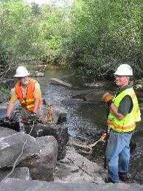

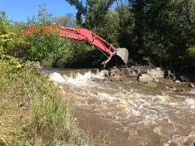

Supreme Court Affirms States’ Role in Dam Licensing
S.D. Warren Co. v. Maine Board of Environmental Protection, (2006).

