Slide 1
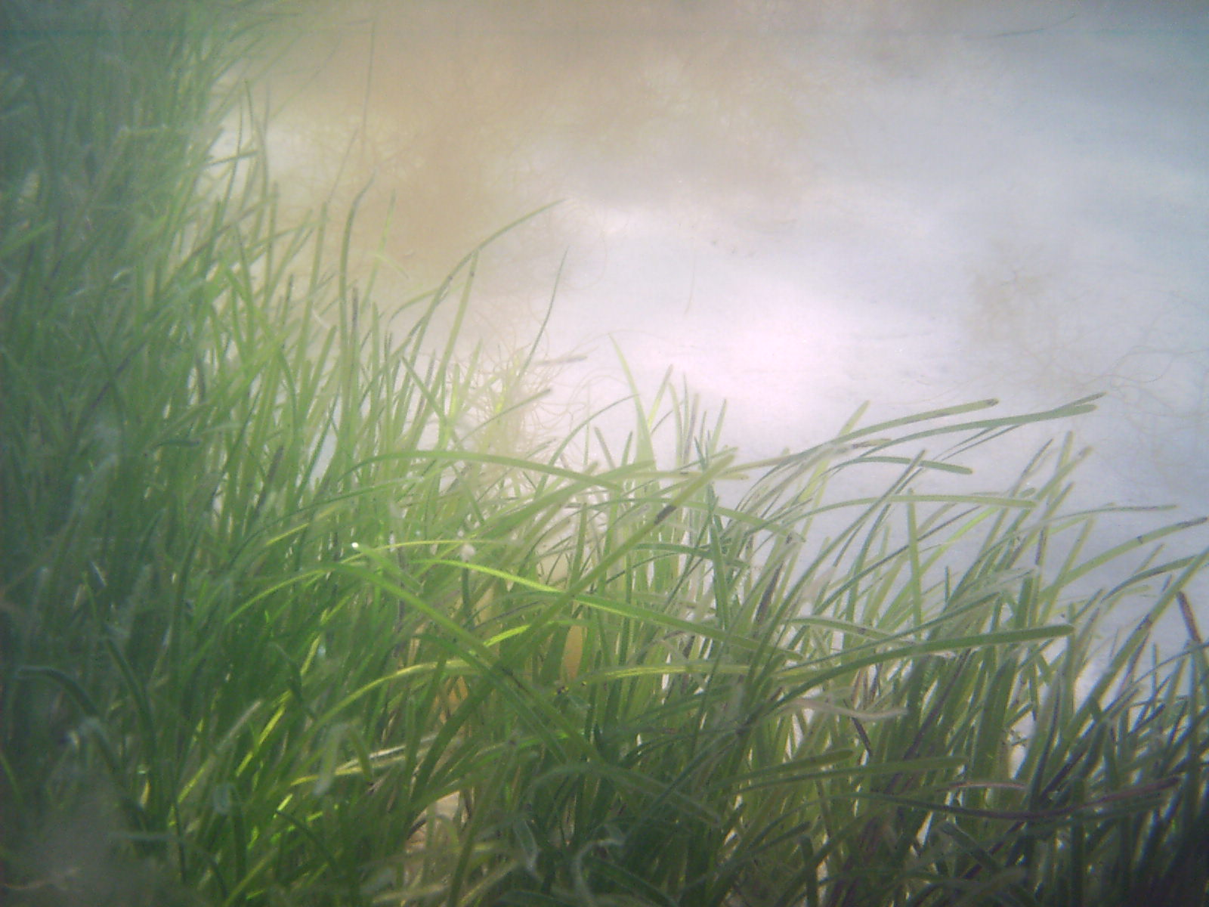
Eelgrass Habitat in Casco Bay:
Past, Present, and...
Future?
Hilary Neckles
USGS Augusta, ME
hneckles@usgs.gov

Slide 2
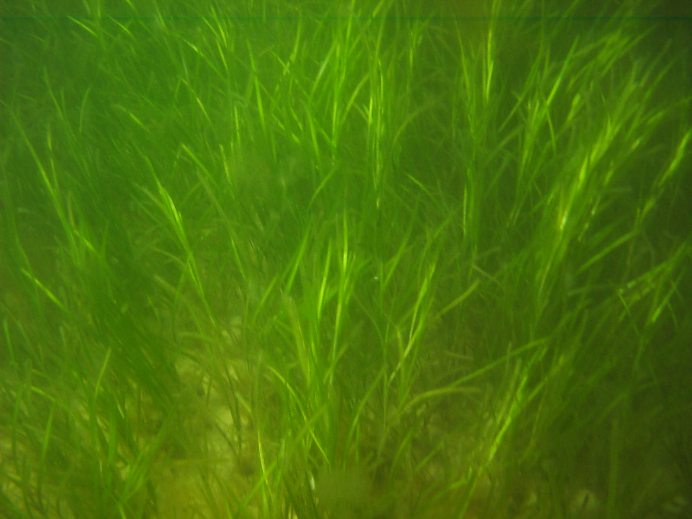
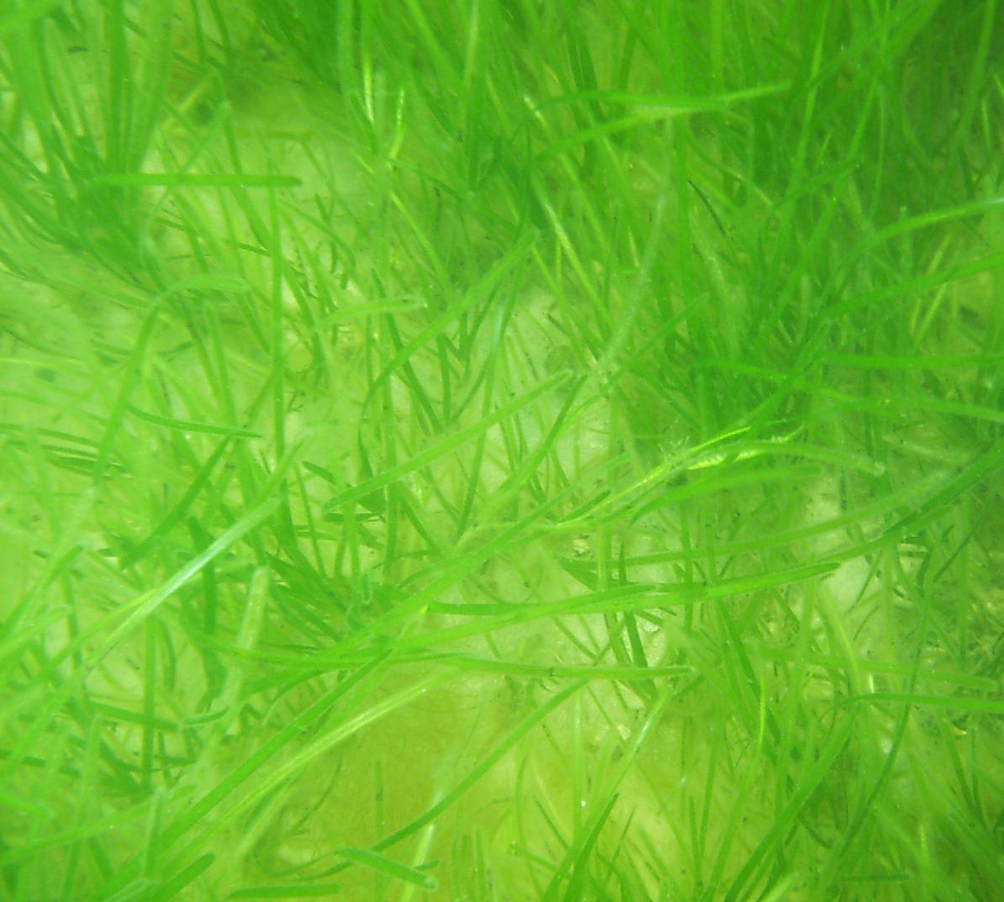
Eelgrass: Zostera marina
* marine flowering plant *
Hilary Neckles

Slide 3
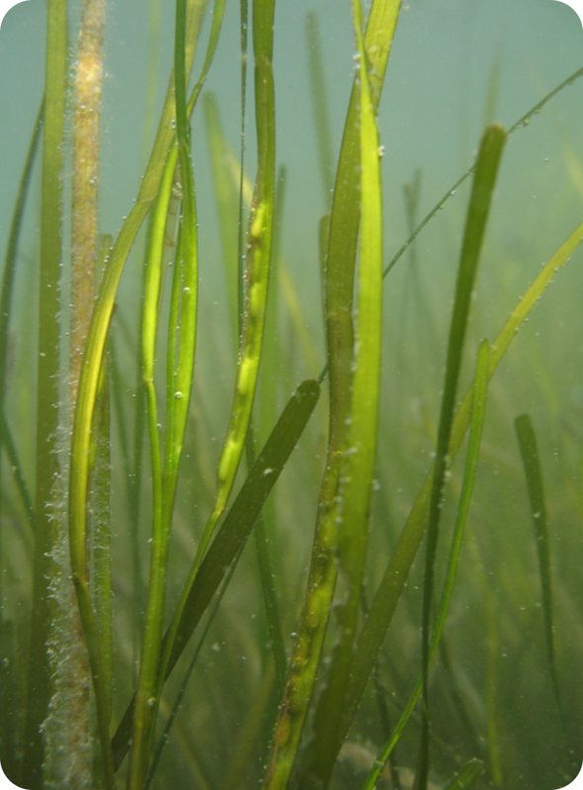
Eelgrass: Zostera marina
* marine flowering plant *
Robert J. Orth
Hilary Neckles

Slide 4
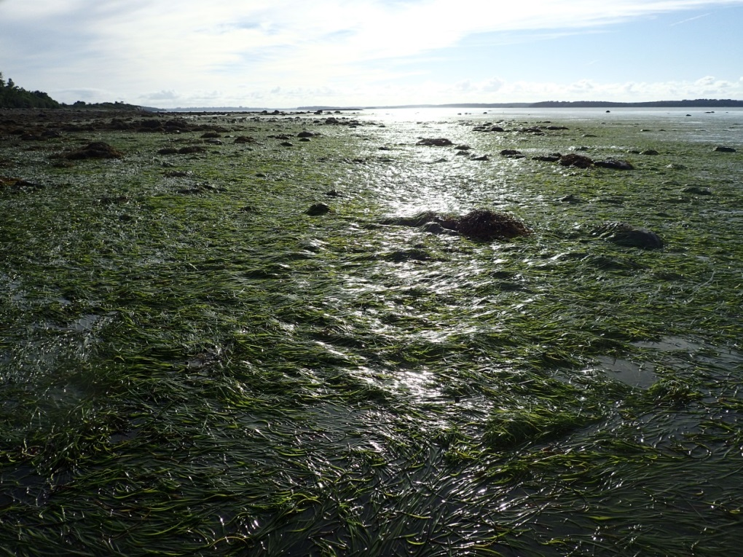
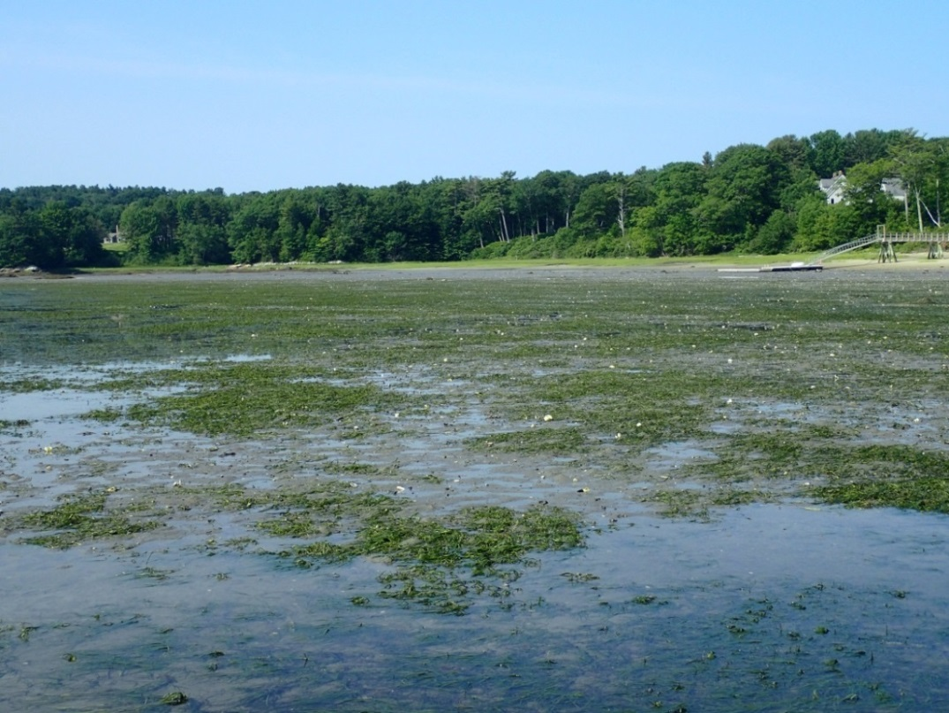
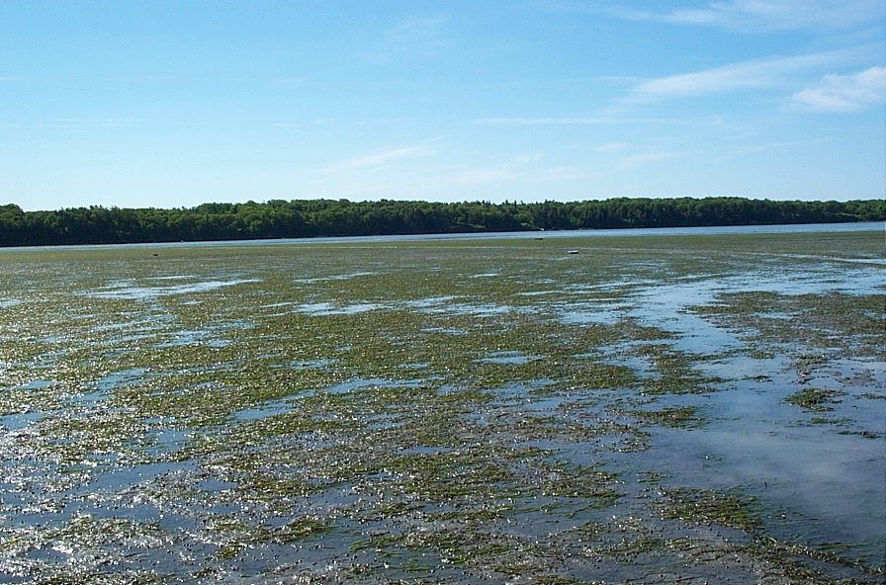

Slide 5
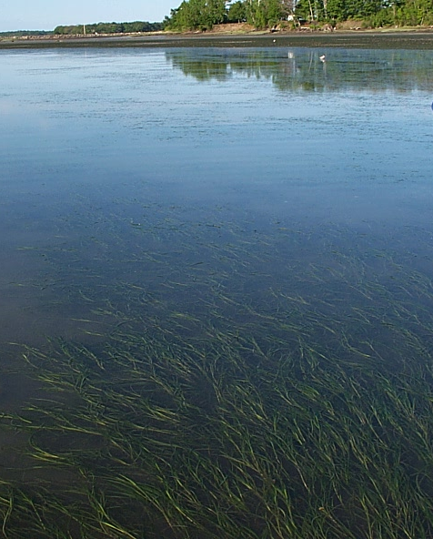
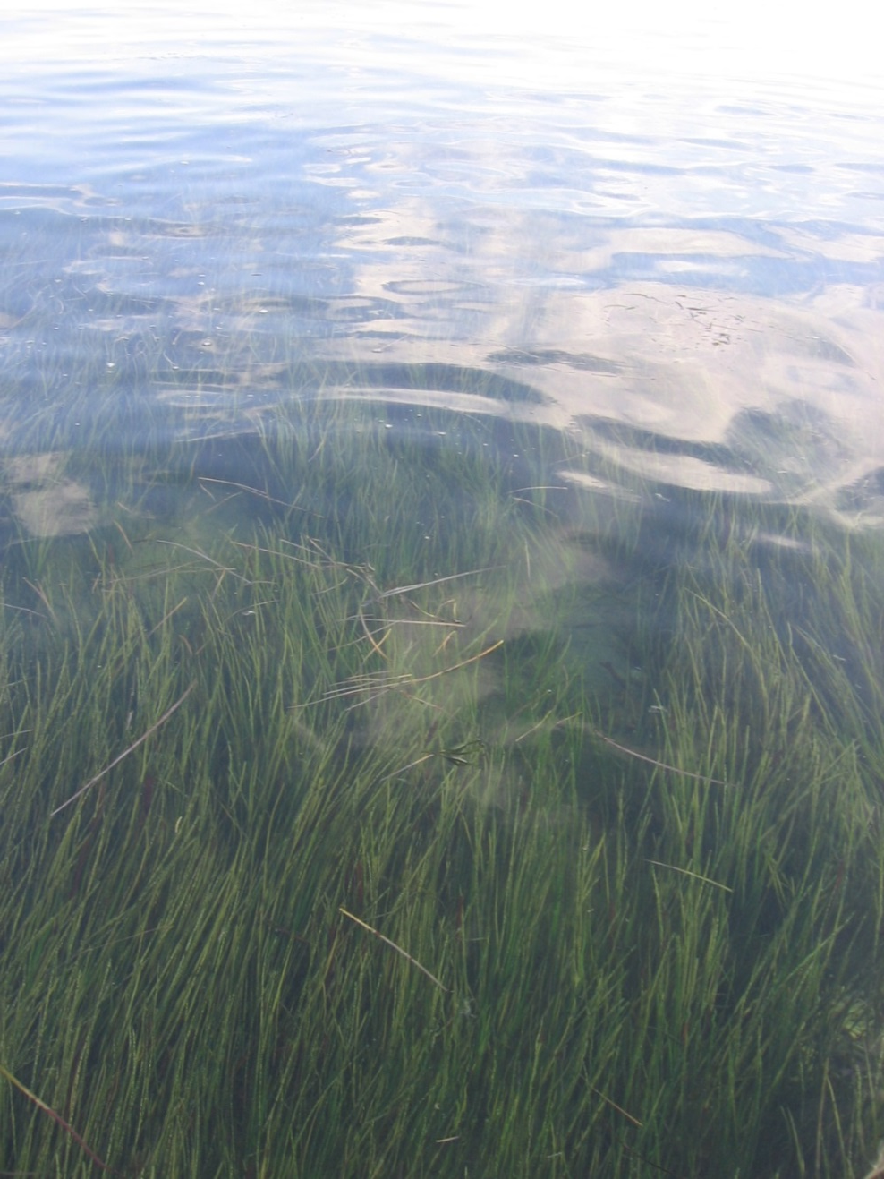

Slide 6
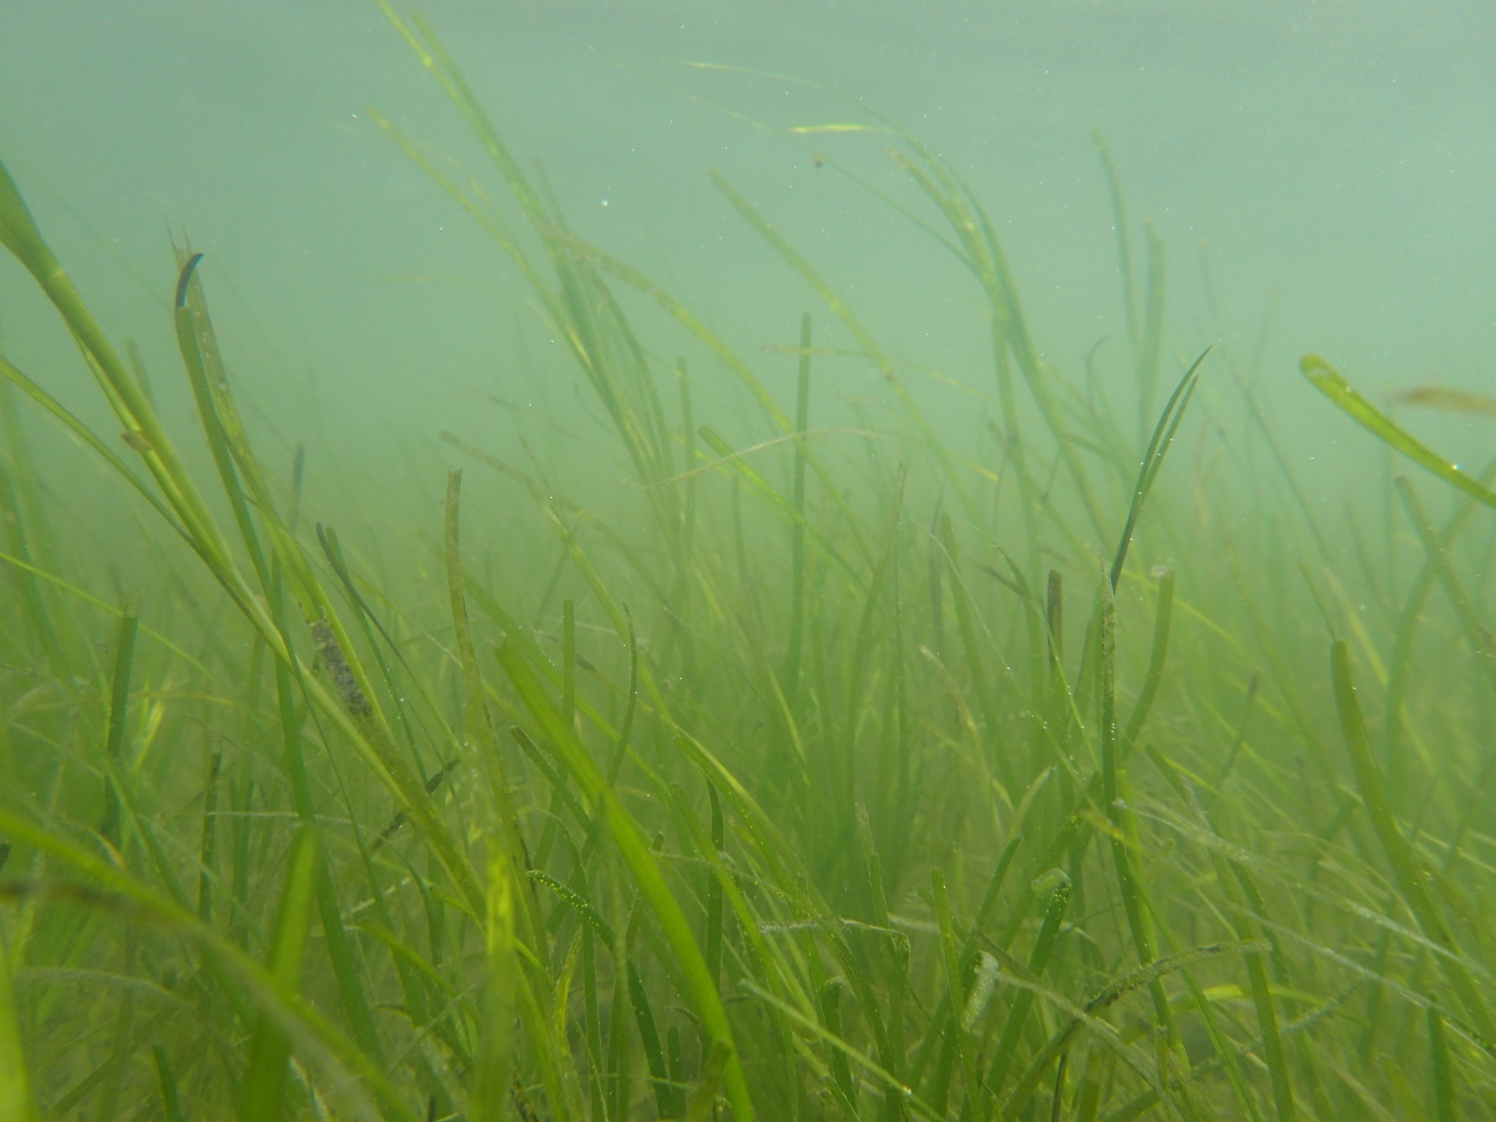
Eelgrass beds are among the most productive plant communities on the planet!
Hilary Neckles

Slide 7
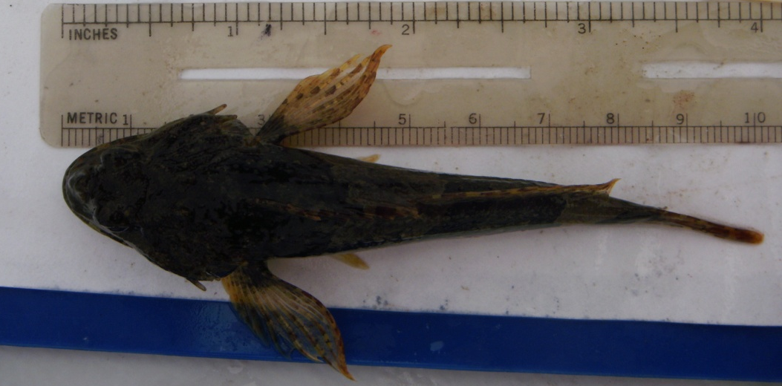
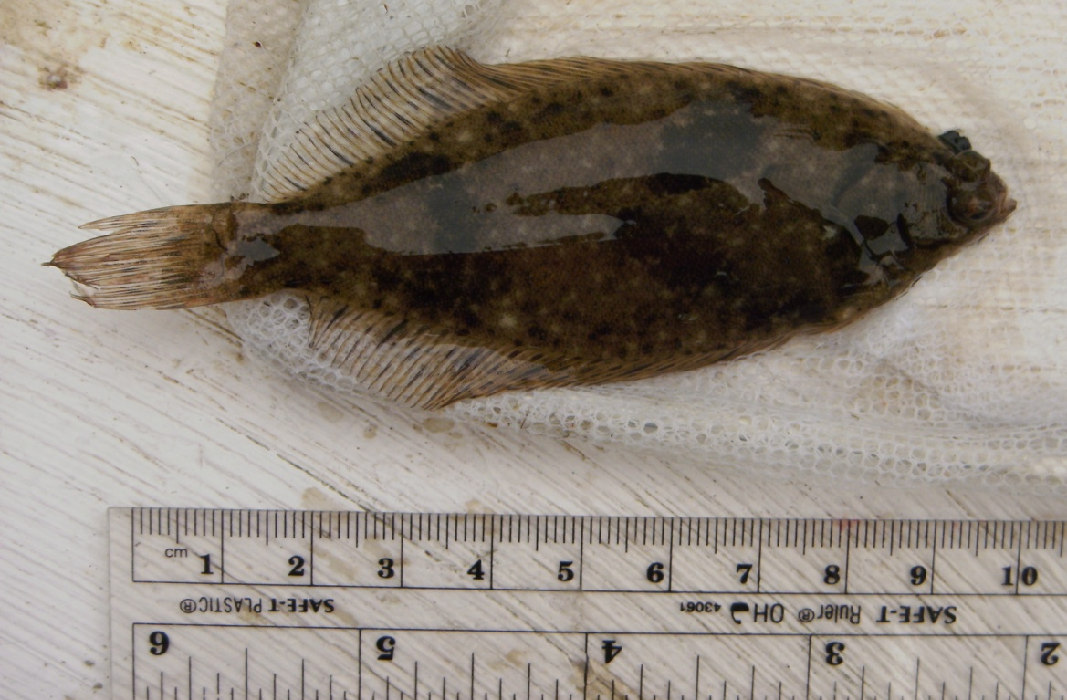
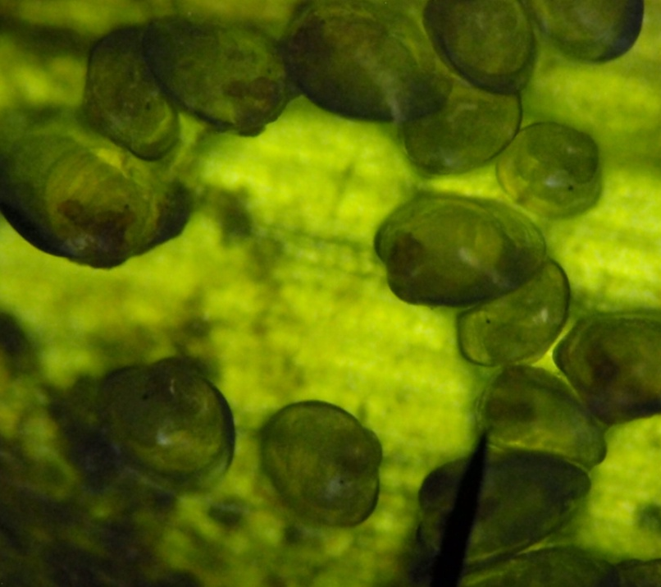
Critical Habitat: Fin- and Shellfish
Minnow (Urophycis regius)
Grubby (Myoxocephalus aeneus)
All photos by Jane Disney, MDI Bio Lab
Winter flounder (Pseudopleuronectes americanus)
Blue mussels (Mytilus edulis)

Slide 8
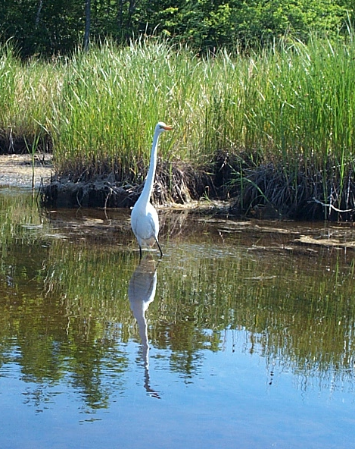
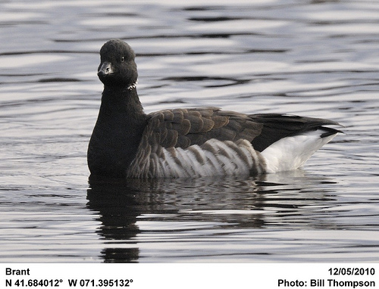
Bird Habitat
© Bill Thompson
Hilary Neckles

Slide 9
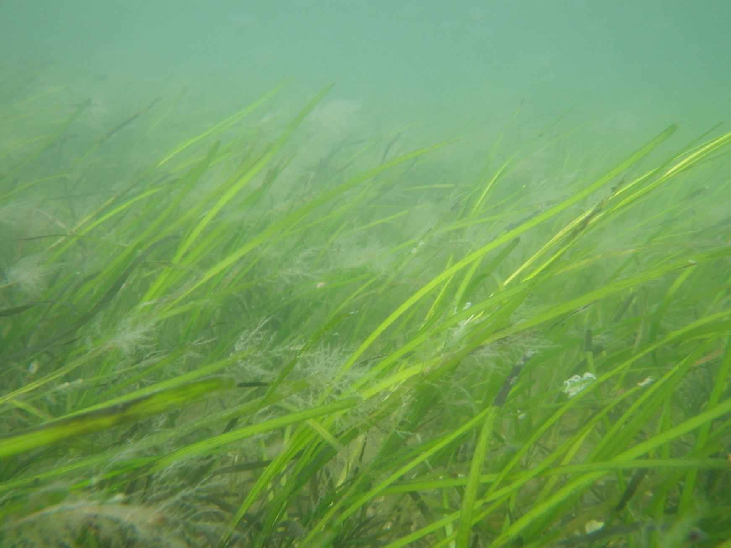
Eelgrass beds absorb nutrients, dampen wave energy, slow currents, and bind sediments
Hilary Neckles

Slide 10
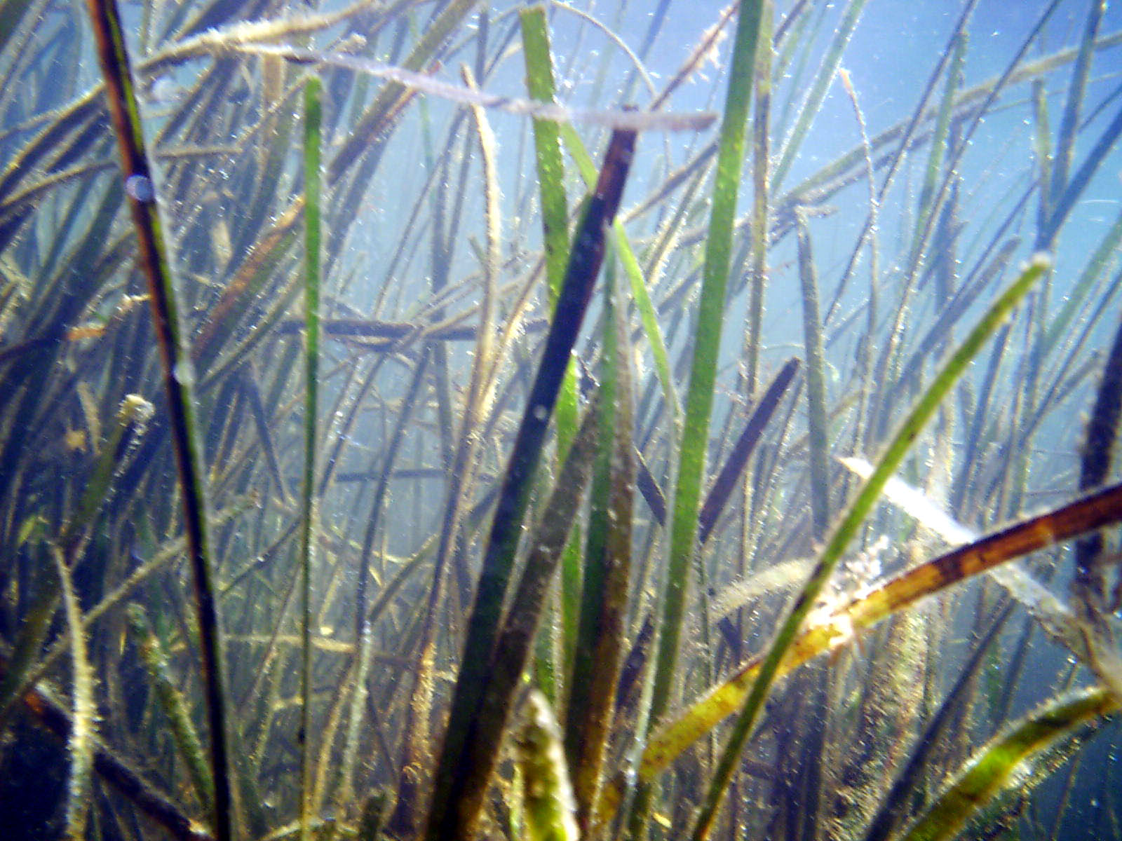
Photosynthetic uptake of CO₂ elevates pH
and eelgrass sediments are a natural carbon sink
Hilary Neckles

Slide 11
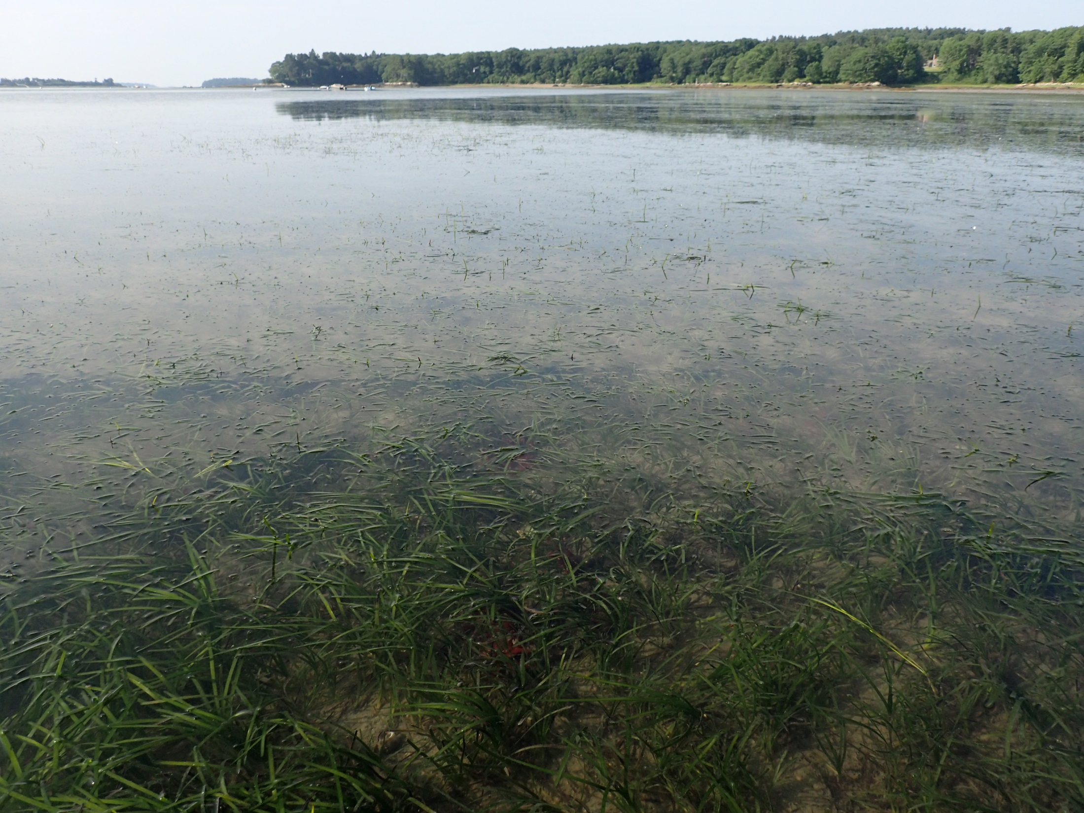
Loss of eelgrass beds leads to decreased fish and wildlife populations, degraded water quality, increased shoreline erosion, and reduced capacity to mitigate anthropogenic carbon dioxide emissions.

Slide 12
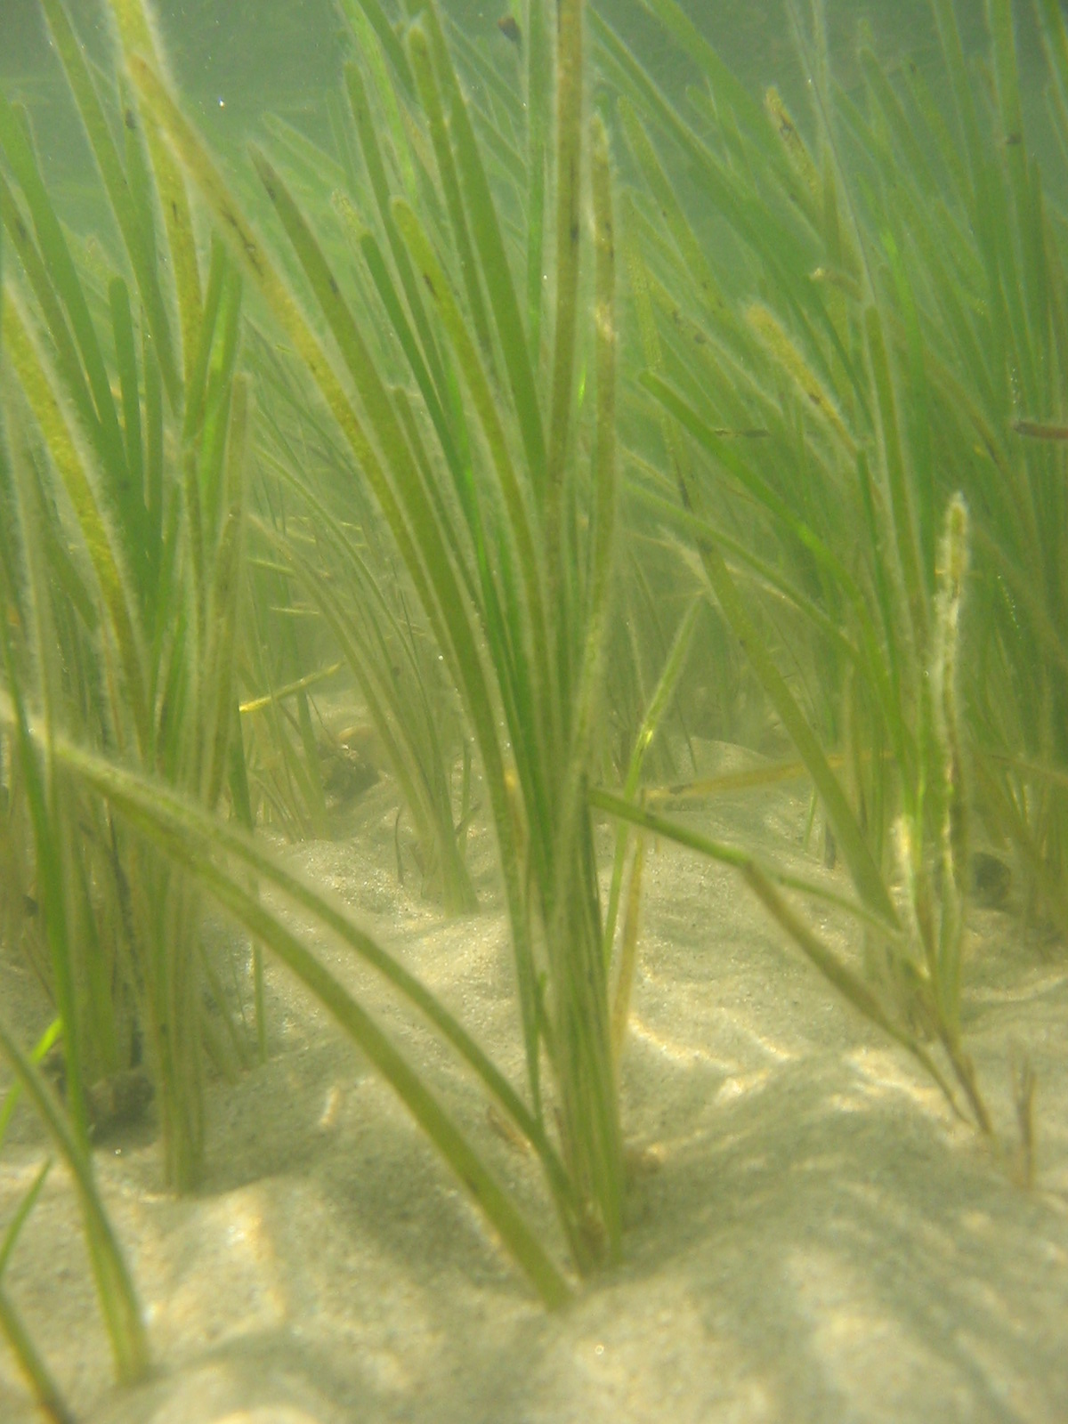
Eelgrass Habitat in Casco Bay:
Past
Present
Future?

Slide 13
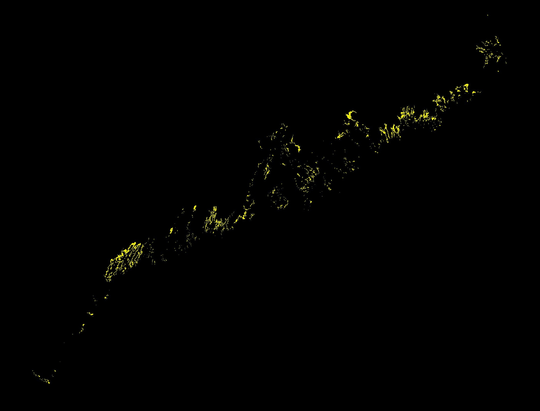
Maine Eelgrass Distribution 1992 - 1998
Casco Bay
Data Maine Department of Marine Resources
Graphic by Blaine Kopp

Slide 14
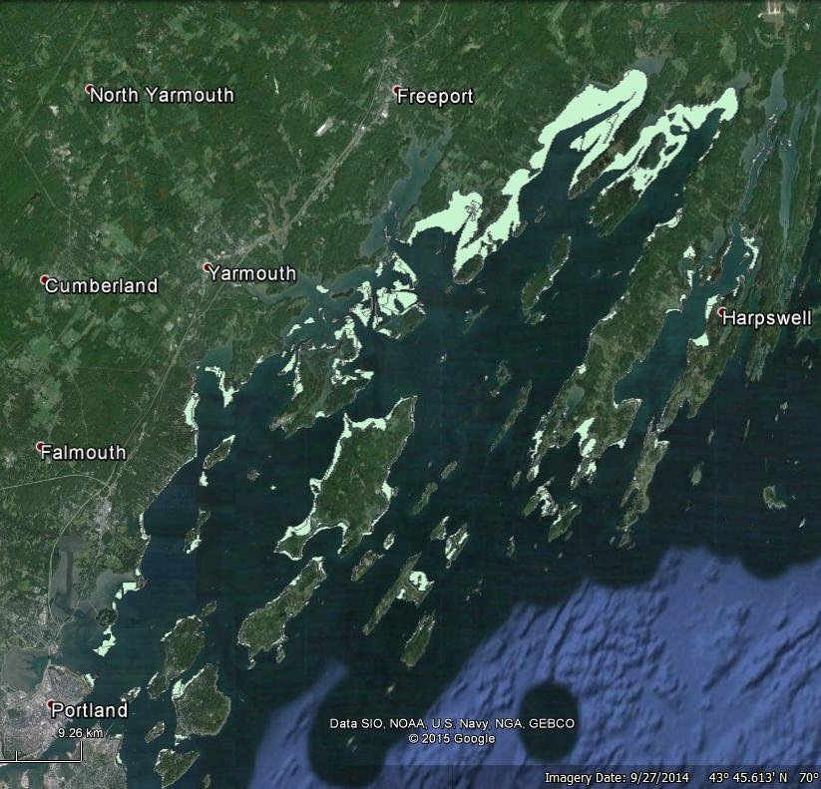
Casco Bay Eelgrass Distribution 2001/02
Data source: Maine Department of Marine Resources, Bureau of Resource Management

Slide 15
Eelgrass Habitat in Casco Bay:
Past
Present
Future?

Slide 16
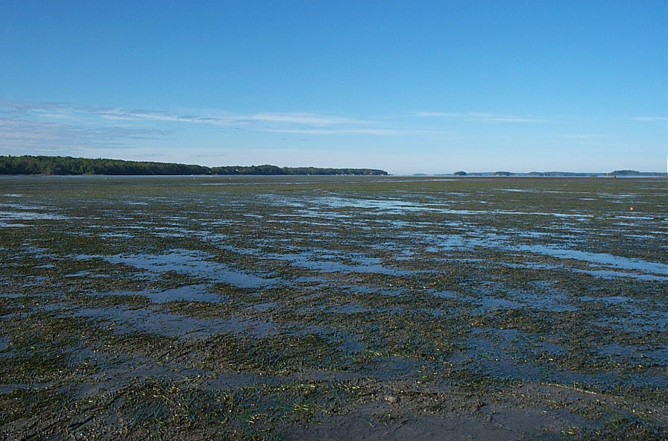
Intertidal Flats at Head of Maquoit Bay
2001
Hilary Neckles

Slide 17
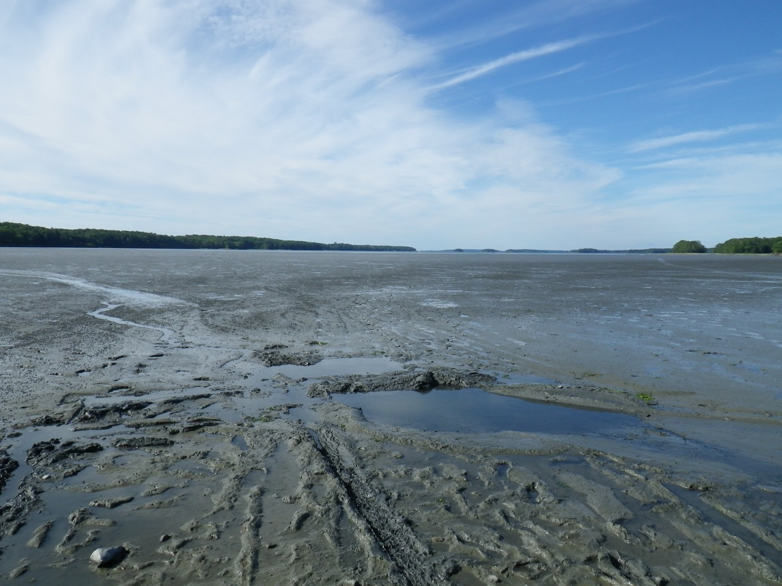
Intertidal Flats at Head of Maquoit Bay
2013
Hilary Neckles

Slide 18
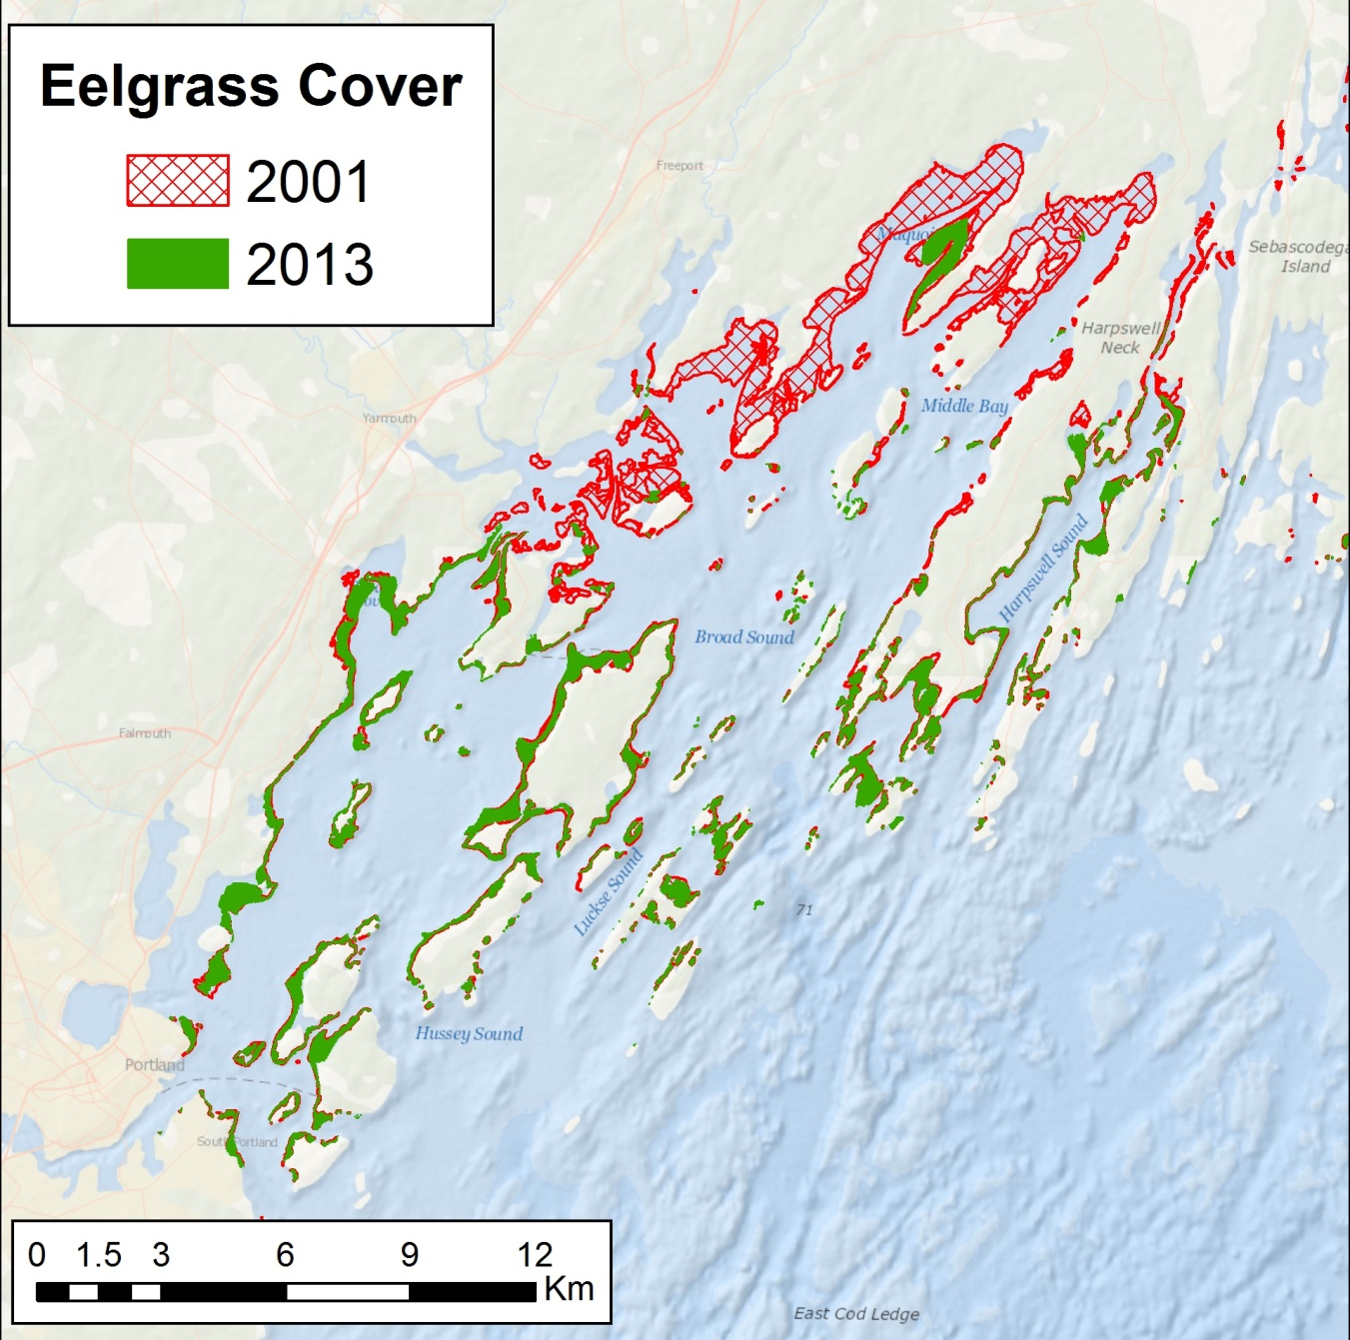
Eelgrass Change in Casco Bay
2001/02
Mapping by Seth Barker
Data produced by:
ME DMR (2001/02)
ME DEP & CBEP (2013)
Neckles. 2015. Northeastern Naturalist 22:478-500.

Slide 19
Eelgrass Habitat in Casco Bay:
Past
Present
Future?

Slide 20
Casco Bay Eelgrass Partners
Federal
US Geological Survey
USFWS Gulf of Maine Program
State
Maine Dept. of Environ. Protection
Maine Coastal Program
Municipal
Town of Brunswick Marine Resources Division
Conservation Organizations
Casco Bay Estuary Partnership
Friends of Casco Bay
Maine Nature Conservancy
Academic and Research Entities
Bowdoin College
University of New Hampshire
Resource Access International
Independent seagrass mapping experts
MDI Biological Laboratory
Bigelow Laboratory for Ocean Sciences
Southern Maine Community College
Concerned citizens
Flying Point shoreline residents

Slide 21
Questions
Has Upper Casco Bay exceeded system thresholds for eelgrass?
Are there sites amenable to restoration?
What restoration methods are most successful?

Slide 22
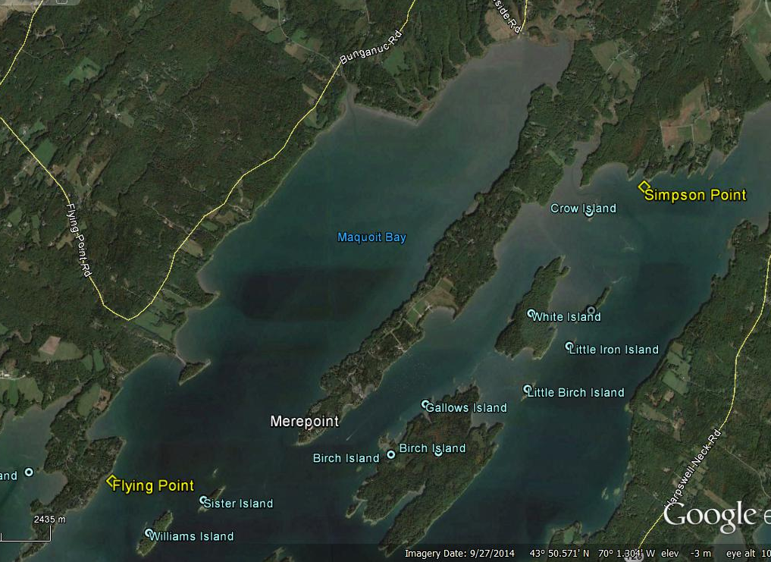
Test Sites 2015

Slide 23
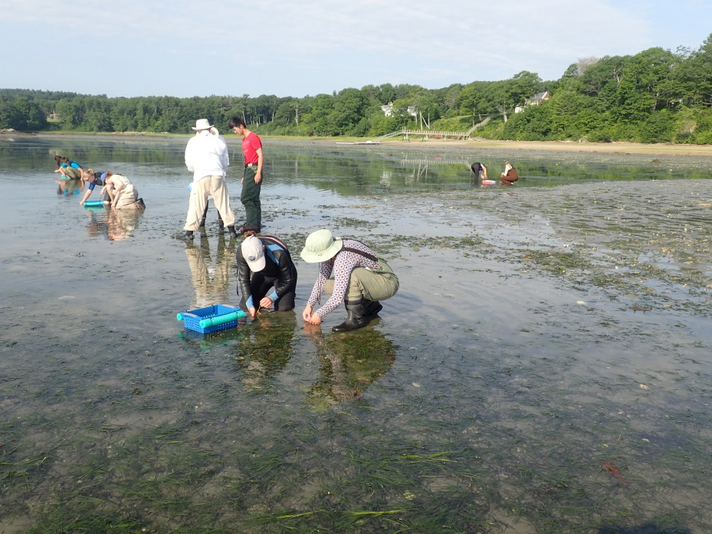
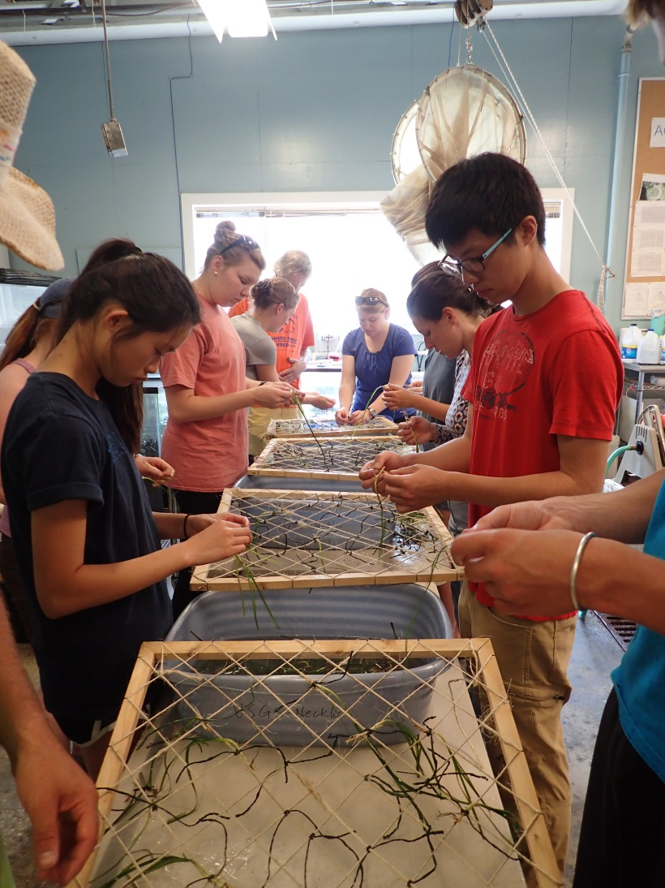
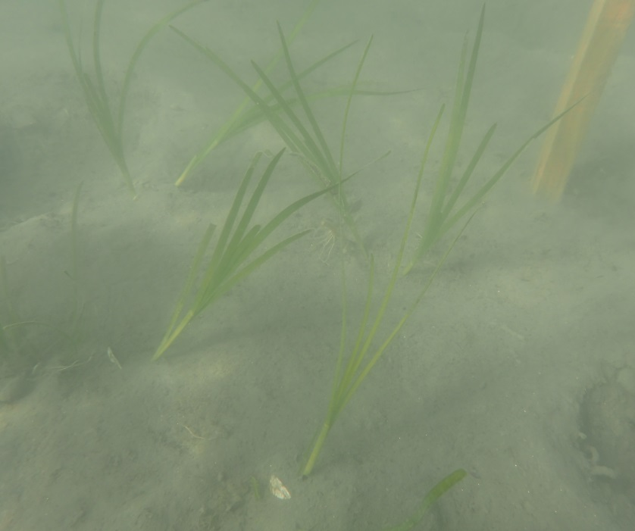
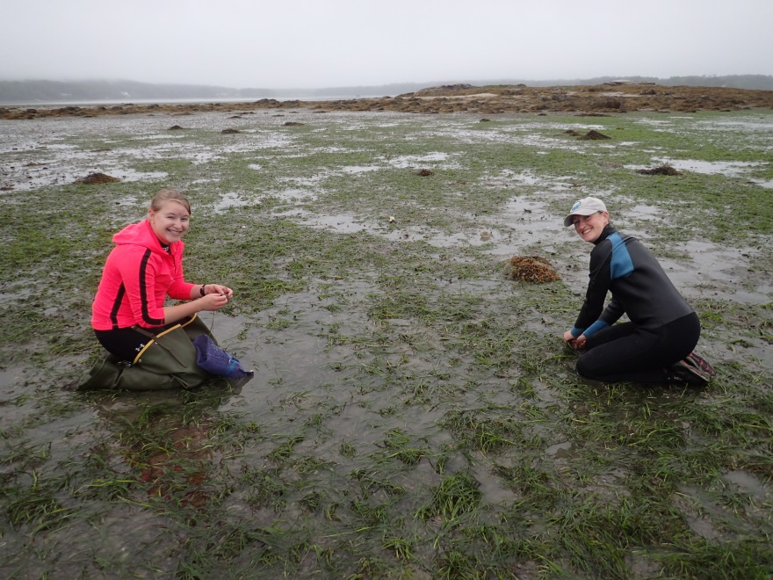
Test Transplants June/early July

Slide 24
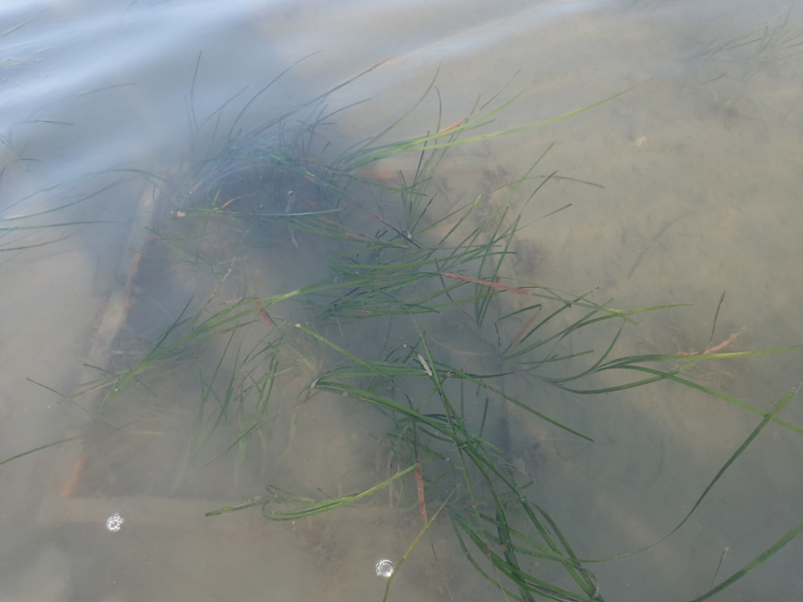
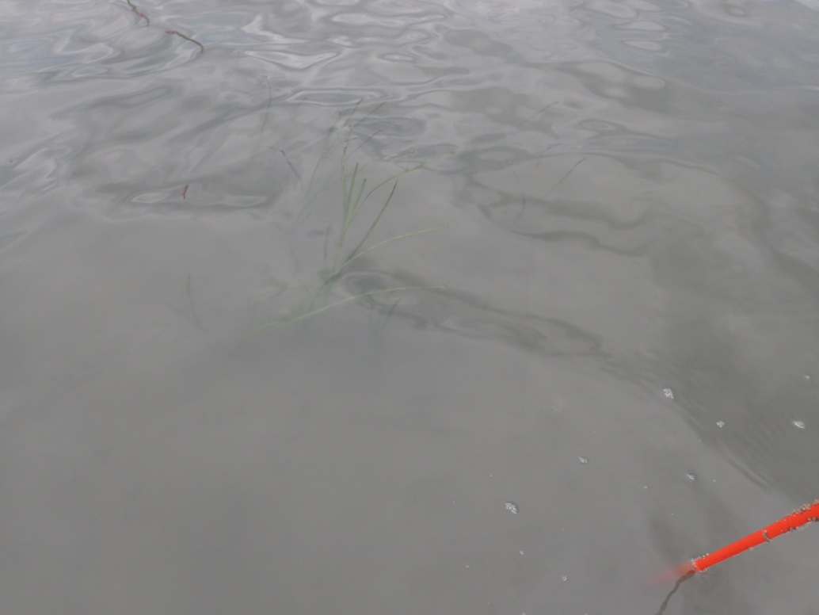
August 2015
Flying Point,
Freeport
Simpson Point,
Brunswick

Slide 25
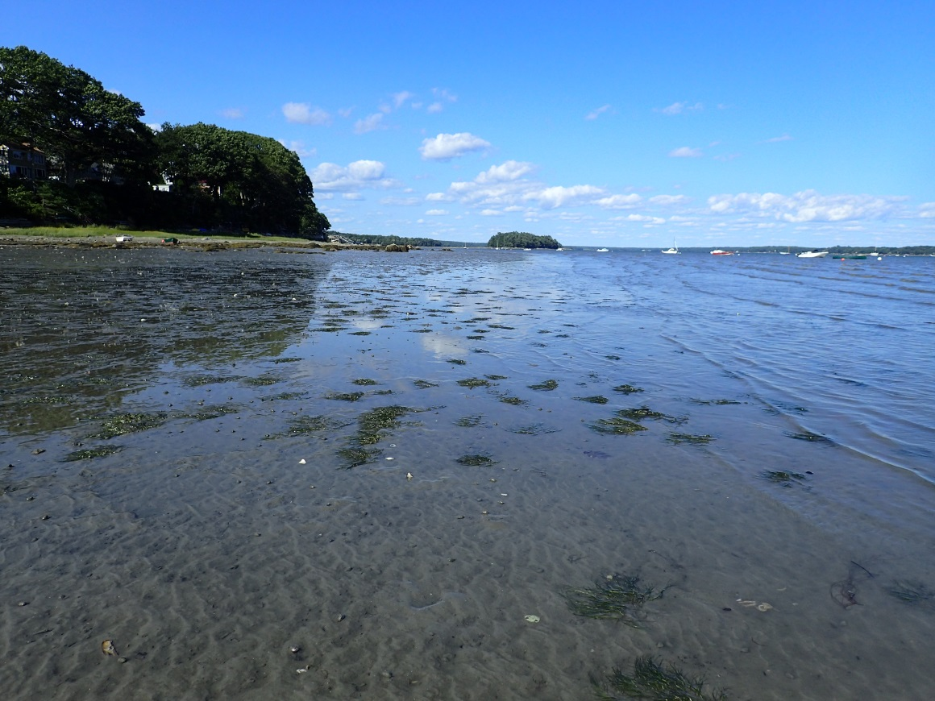
Natural Recovery is Beginning
2001/02
2015
Mapping by Seth Barker
Data produced by:
ME DMR (2001)
ME DEP & CBEP (2013)

Slide 26
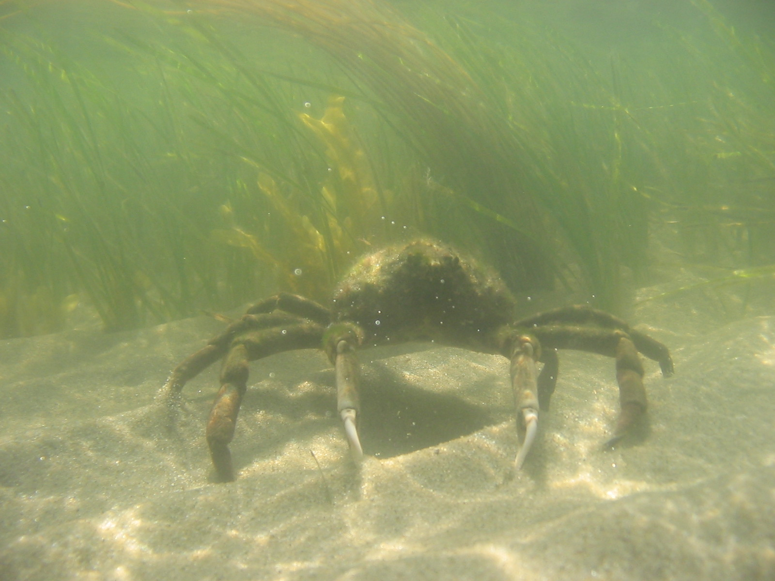
COC2
How resilient is
my habitat?

