Slide 1
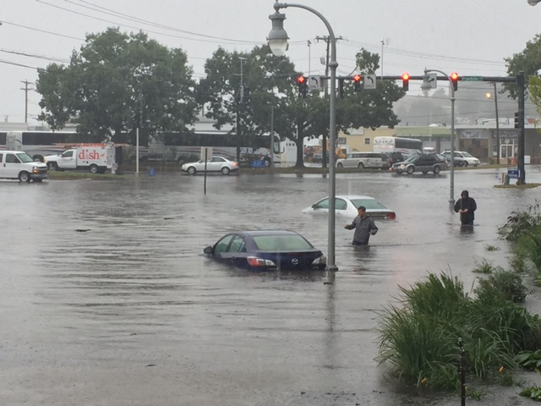

Adapting Maine’s coastal communities to sea level rise and storm surge
Mobilizing Community Support for Casco Bay
State of the Bay Conference
Casco Bay Estuary Partnership
Peter A. Slovinsky, Marine Geologist
C. Adams, 2015

Slide 2
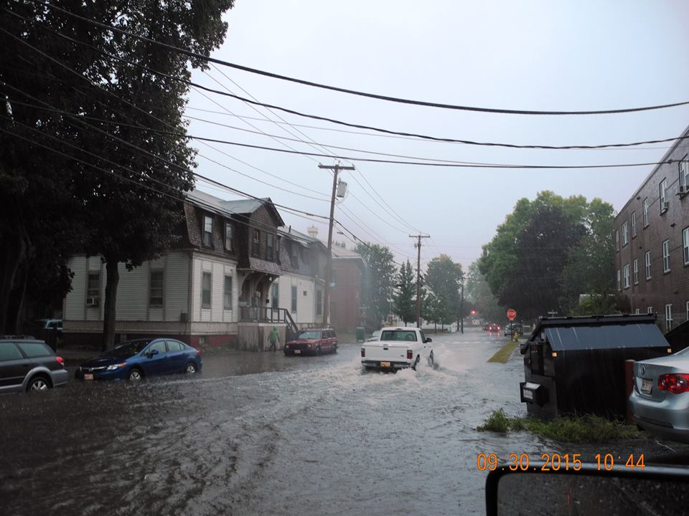
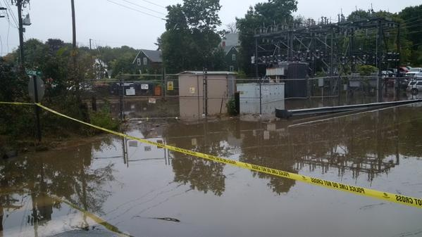
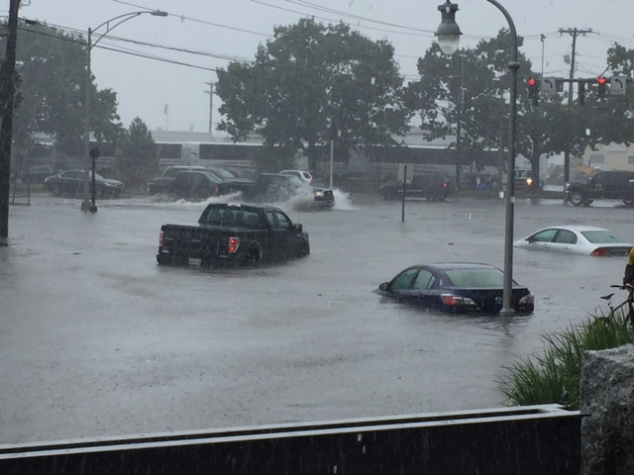
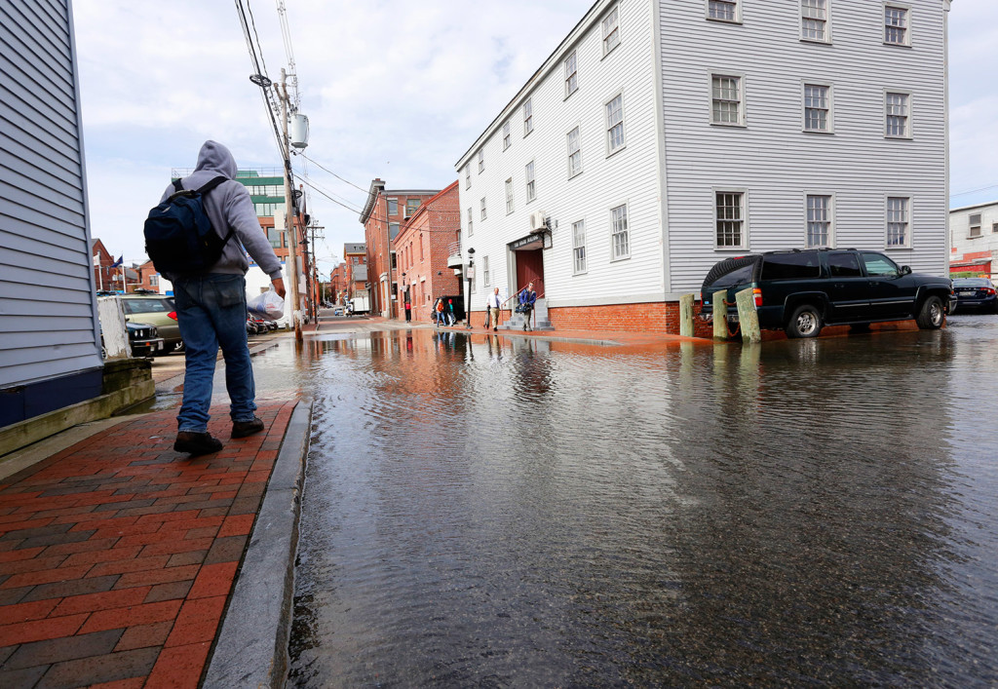
Coastal flooding due to both precipitation and tides is increasing
100-year 24-hour rainfall has increased by about 25% (TP-40 to Atlas 14)
Brunswick Public Works
www.wunderground.com
Wmtw.com
4.8” of rain (within 6 hours!) and an 11.6 ft tide with 0.5 ft of surge!
Portland Press Herald
C. Adams, MGS

Slide 3
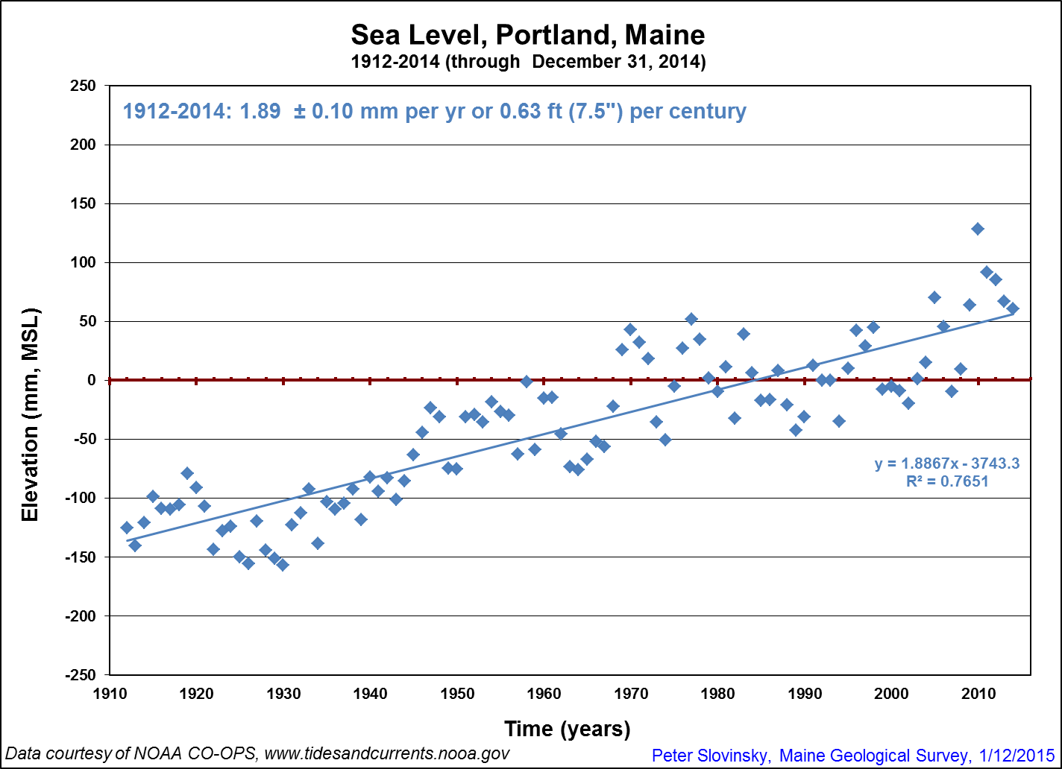
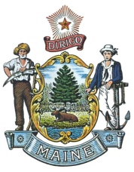
Sea level is rising in the long term…
Notes:
Sea level rise at Portland, ME has been about 1.9 mm/yr from 1912-2014. Globally averaged measurements over the past century are about 1.8 mm/yr. Over the last 20 years, this has increased to 4.2 mm/yr, and 6.7 over the last 10

Slide 4
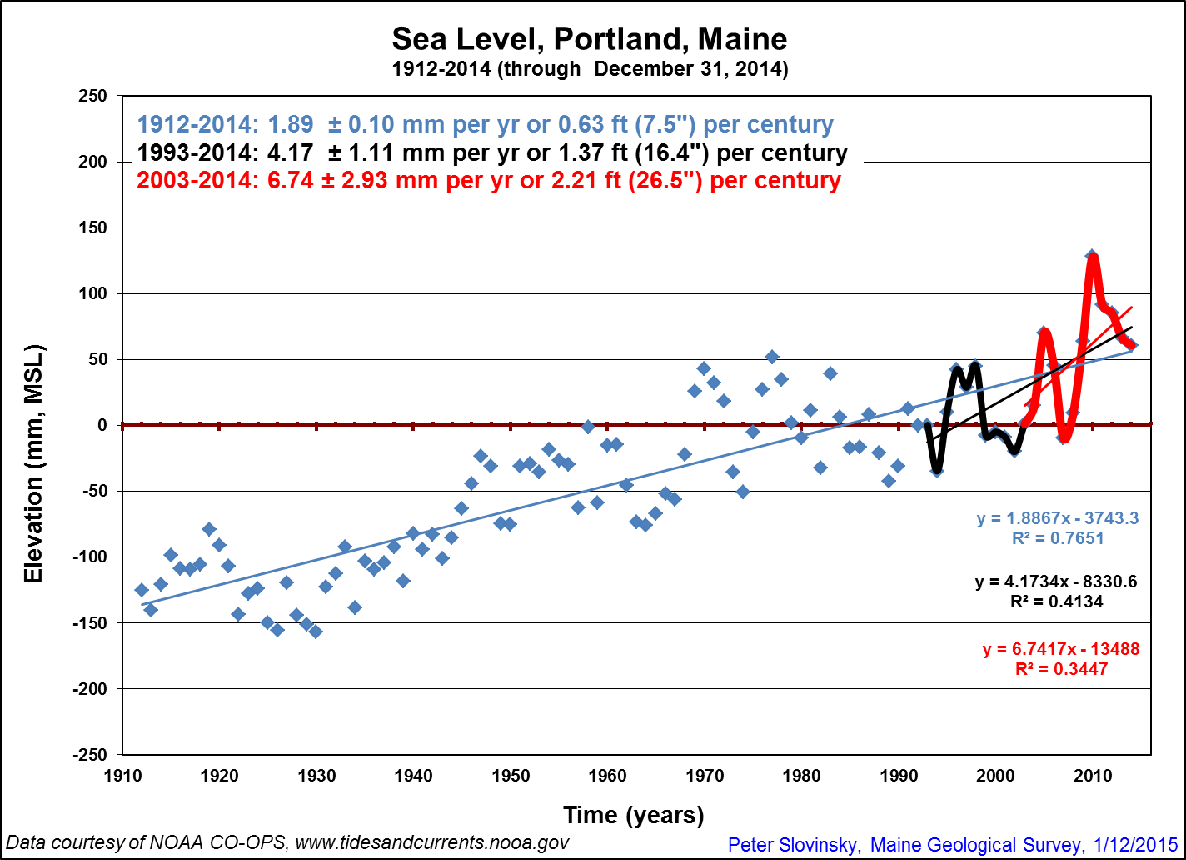
…is rising faster in the short term…
2010
Notes:
Sea level rise at Portland, ME has been about 1.9 mm/yr from 1912-2014. Globally averaged measurements over the past century are about 1.8 mm/yr. Over the last 20 years, this has increased to 4.2 mm/yr, and 6.7 over the last 10

Slide 5
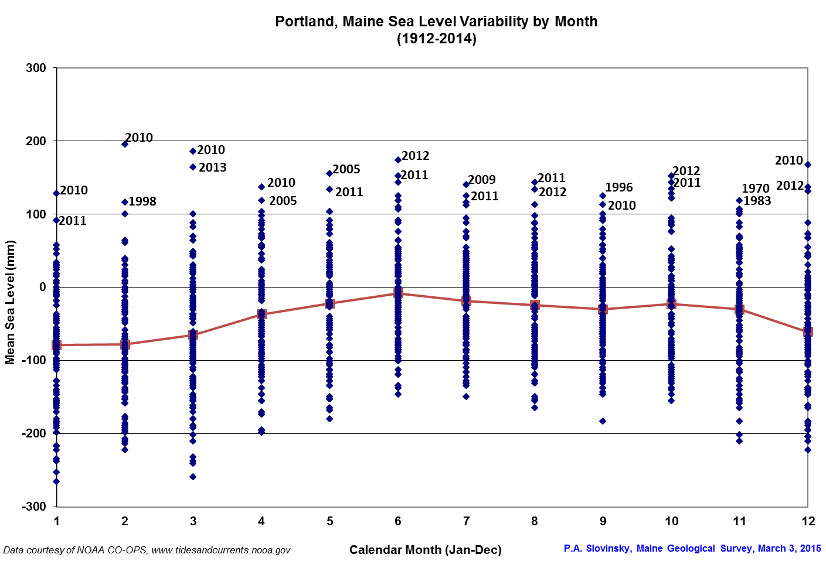
…can rise rather abruptly…
In 2010, Portland had the largest abrupt SLR change on the east coast
2010 had the highest mean sea levels recorded for 5 months

Slide 6
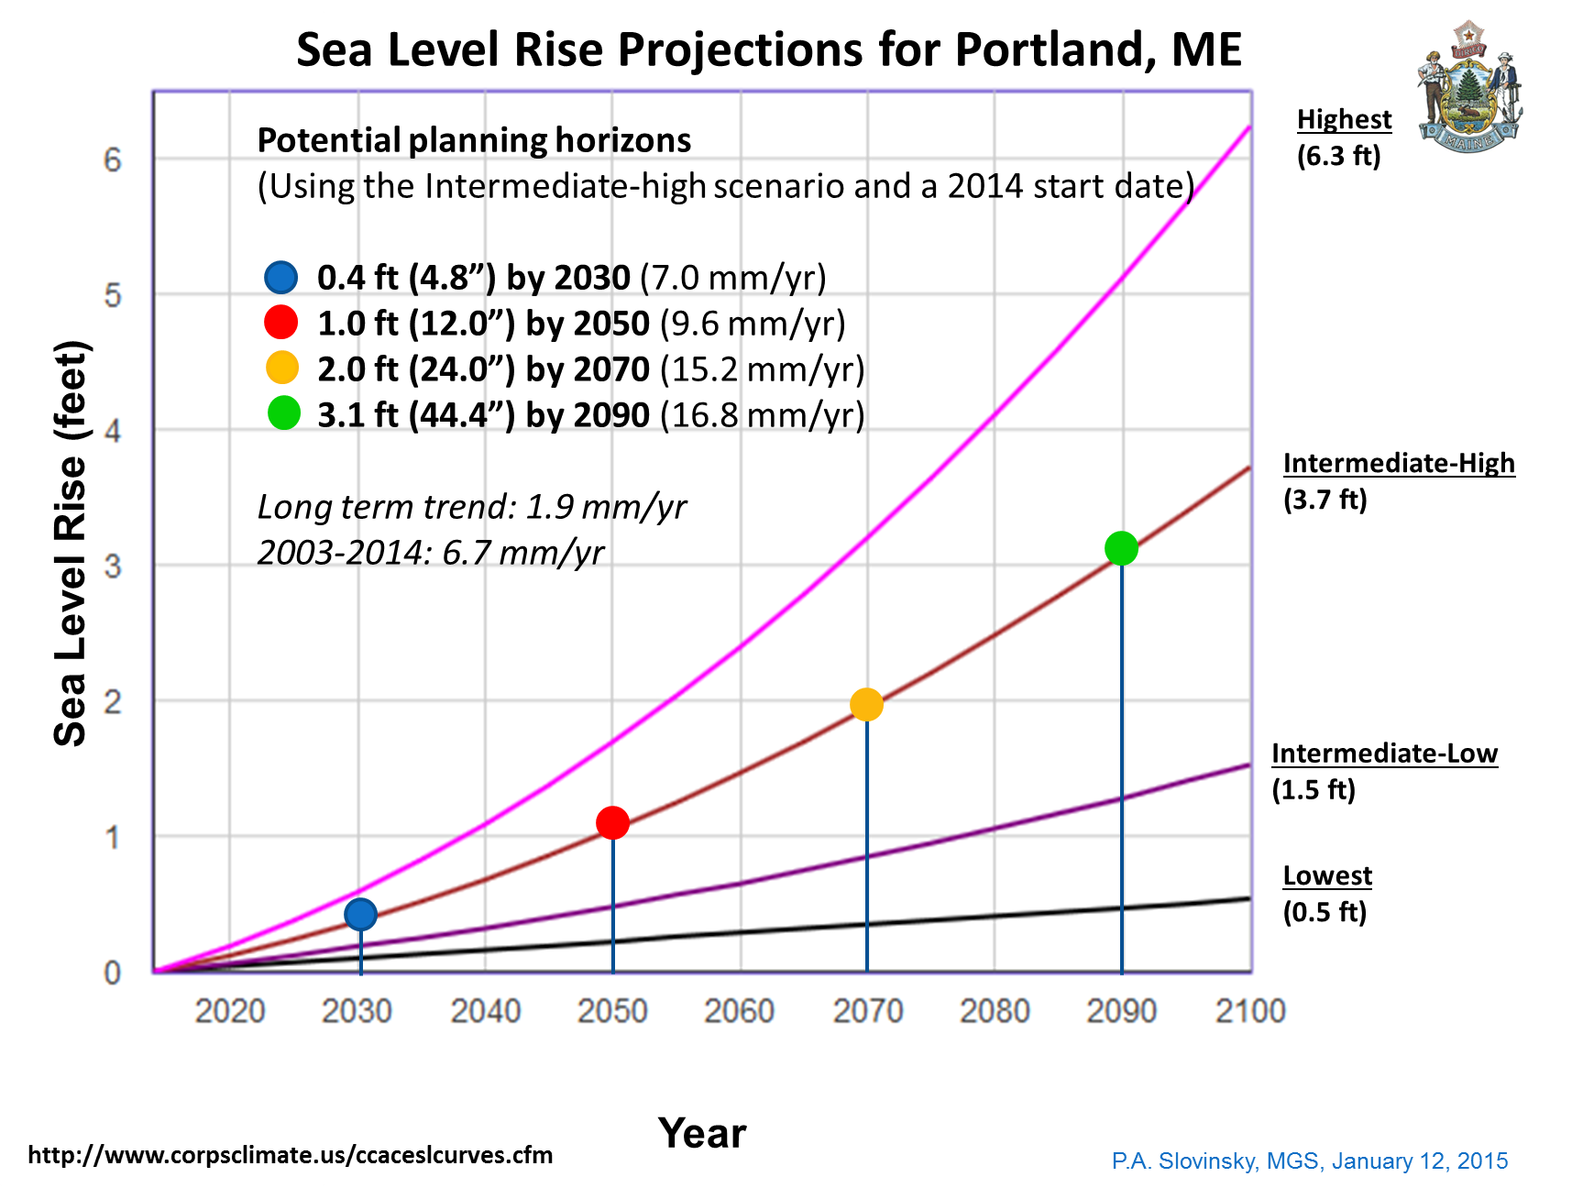
…and is expected to continue to rise.
Notes:
We have also seen an acceleration in the rate of sea level rise in Portland over the shorter term trends. From 1993-2014 (black and red lines), sea level rose about 120% faster than the 102-year trend, up to 4.17 mm/yr. For the past decade (red line only), the rate of sea level rise has increased from the long-term trend by 246% to about 6.7 mm/yr (over 1.9 mm/yr).

Slide 7
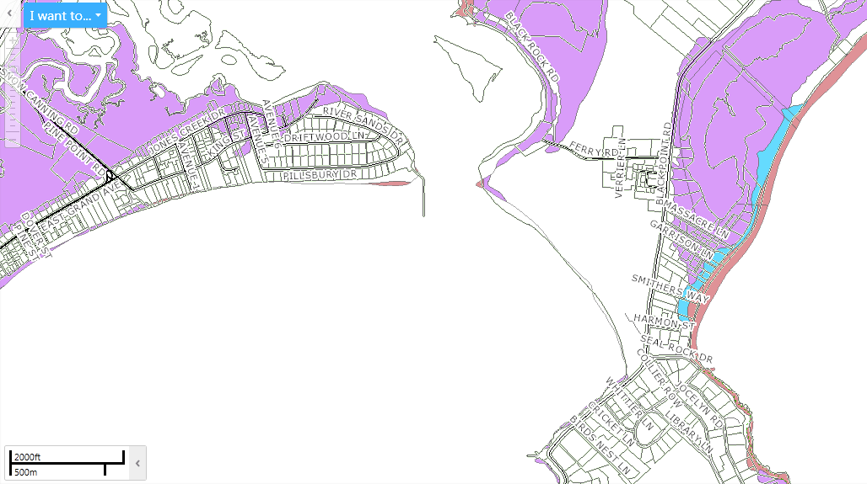
FEMA Flood Insurance Rate Maps are changing…
are changing…
AE 10
AE 10
AE 10
AO
VE 13
VE 13
Courtesy Town of Scarborough WebGIS

Slide 8
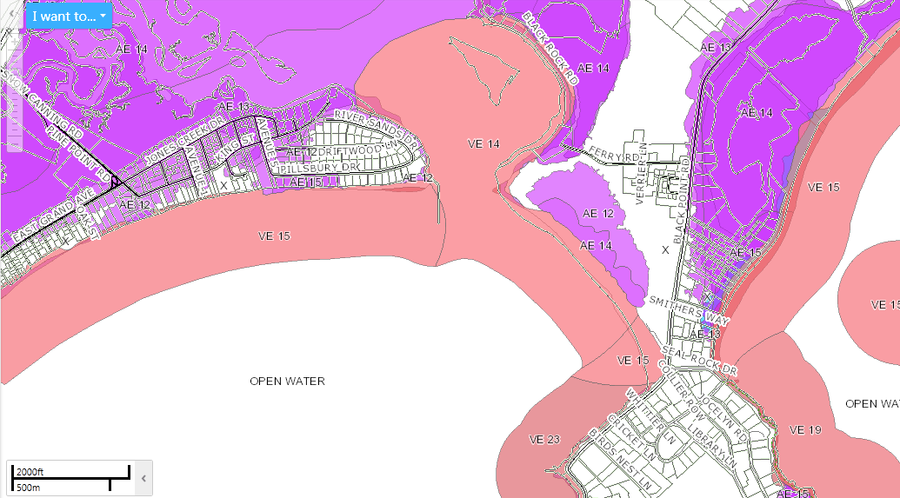
…and in general, more areas are mapped as flood zones and are increasing in height.
Courtesy Town of Scarborough WebGIS

Slide 9

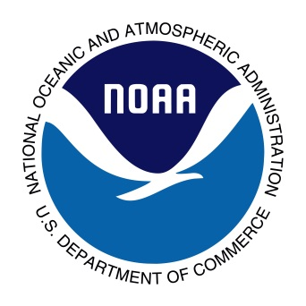
Coastal Hazard and Resiliency Tools (CHRT) Project
Federal funding (CZMA Section 309)
State funding, planning assistance, scientific and technical support
Regional planning organization assistance
Private partners (as needed)
Municipal, locally-driven adaptation

Slide 10
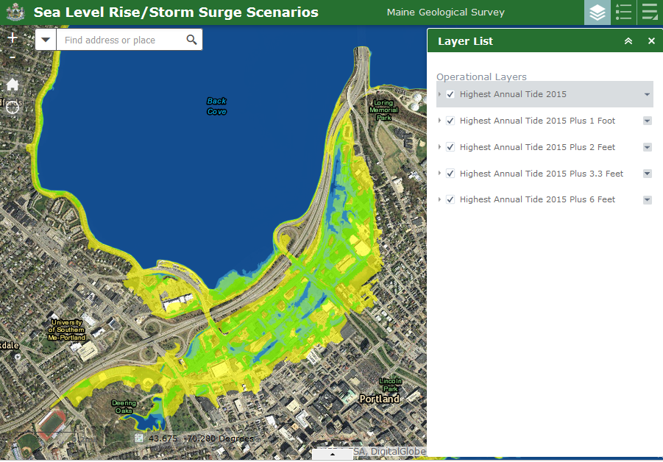
Creation of State-wide datasets and viewers
Sea Level Rise/Storm Surge
Hurricane Inundation
Flood Map Status
http://www.maine.gov/dacf/mgs/hazards/coastal/index.shtml

Slide 11
Communities engaged at some level as part of CHRT
39 different communities in 6 different coastal counties
County-based approaches in Lincoln and Washington counties
WCOG efforts

Slide 12
Casco Bay Communities
engaged as part of CHRT

Slide 13
What have communities done?
“Just the basics…”
Most communities have completed the basic first step of a sea level rise and storm surge Vulnerability Assessment.
“With the Fixins”
Only a few communities have gone further completed more detailed analyses.
Even fewer have already undertaken some type of adaptation towards resiliency.

Slide 14
What have Casco Bay communities done?
Just the Basics: Cape Elizabeth, South Portland, Portland, Freeport, Harpswell, Phippsburg, Bath
With the Fixins’:
  Cape Elizabeth – GPCOG/MGS vulnerability assess.
  Portland – COAST modeling
  South Portland – GPCOG/MGS vulnerability assess.
  Phippsburg – marsh migration public outreach
  Bath – road and infrastructure and COAST modeling
Significant Ordinance Changes or Other:
  Portland – Resolve on SLR
  South Portland – Comprehensive Plan Chapter on SLR
  Cape Elizabeth - Changed Shoreland Zoning

Slide 15
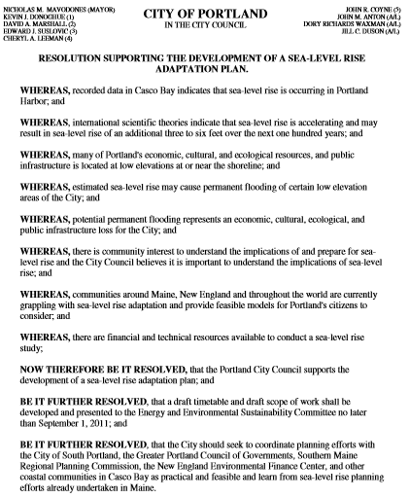
Timeline
2011 – Resolve passed
2012 – MGS detailed mapping efforts; COAST modeling by NEEFC
2012 – Draft Framework for SLR adaptation
2014 – Urban Land Institute Resiliency Study
2014 – current DHS Casco Bay RRAP
http://www.portlandmaine.gov/1307/Climate-Adaption

Slide 16
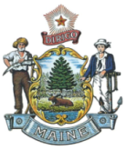
Cape Elizabeth’s Shoreland Zoning
Normal High Water Line of Coastal Waters: That line on the shore of tidal waters which is the apparent extreme limit of the effect of the tides, i.e. the top of the bank, cliff or beach above high tide
Maine’s Mandatory Shoreland Zoning Act (MSZA) defines the upper SZ boundary in tidal waters as the upland edge of a coastal wetland, including all areas affected by tidal action (the upper edge of coastal wetland is defined by the Highest Annual Tide).

Slide 17
Recommendation to Cape:
Instead of using the predicted Highest Annual Tide (which changes each year), consider using the Highest Astronomical Tide, which is the highest tide level for the effective 19 year National Tidal Datum Epoch (1983 – 2001, made effective in April 2003). This occurs during the spring tide when the sun and moon are closest to the earth during an 18.6 year tidal cycle which accounts for all significant variations in moon and earth orbits. The NTDE is recalculated every 20-25 years.
“The elevation of the highest predicted astronomical tide expected to occur at a specific tide station over the National Tidal Datum Epoch.”
http://tidesandcurrents.noaa.gov/datum_options.html#HAT

Slide 18
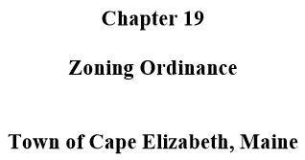
Normal High Water Line: Adjacent to tidal waters, the normal high water line shall be the topographic line located at the Highest Astronomical Tide, plus three (3) vertical feet upland.
This is an elevation which can be determined using tidal station data and approximated, using LiDAR, along the Cape Elizabeth shoreline.

Slide 19
Comparing Elevations

Slide 20
What have other communities done that is transferable to Casco Bay?
Some locally-derived and driven strategies:
Infrastructure Adaptation:
  Ogunquit – Worked to adapt WWTP (Wiscasset under way)
  Saco Bay - road infrastructure vulnerability
  Damariscotta – Worked to adapt historic downtown
Significant Ordinance Changes:
  York, Bowdoinham, South Portland – Wrote Comprehensive Plan Chapters on SLR and storm surge
  Saco, Damariscotta, Berwick - Increased floodplain ordinance to 3 ft over BFE

Slide 21
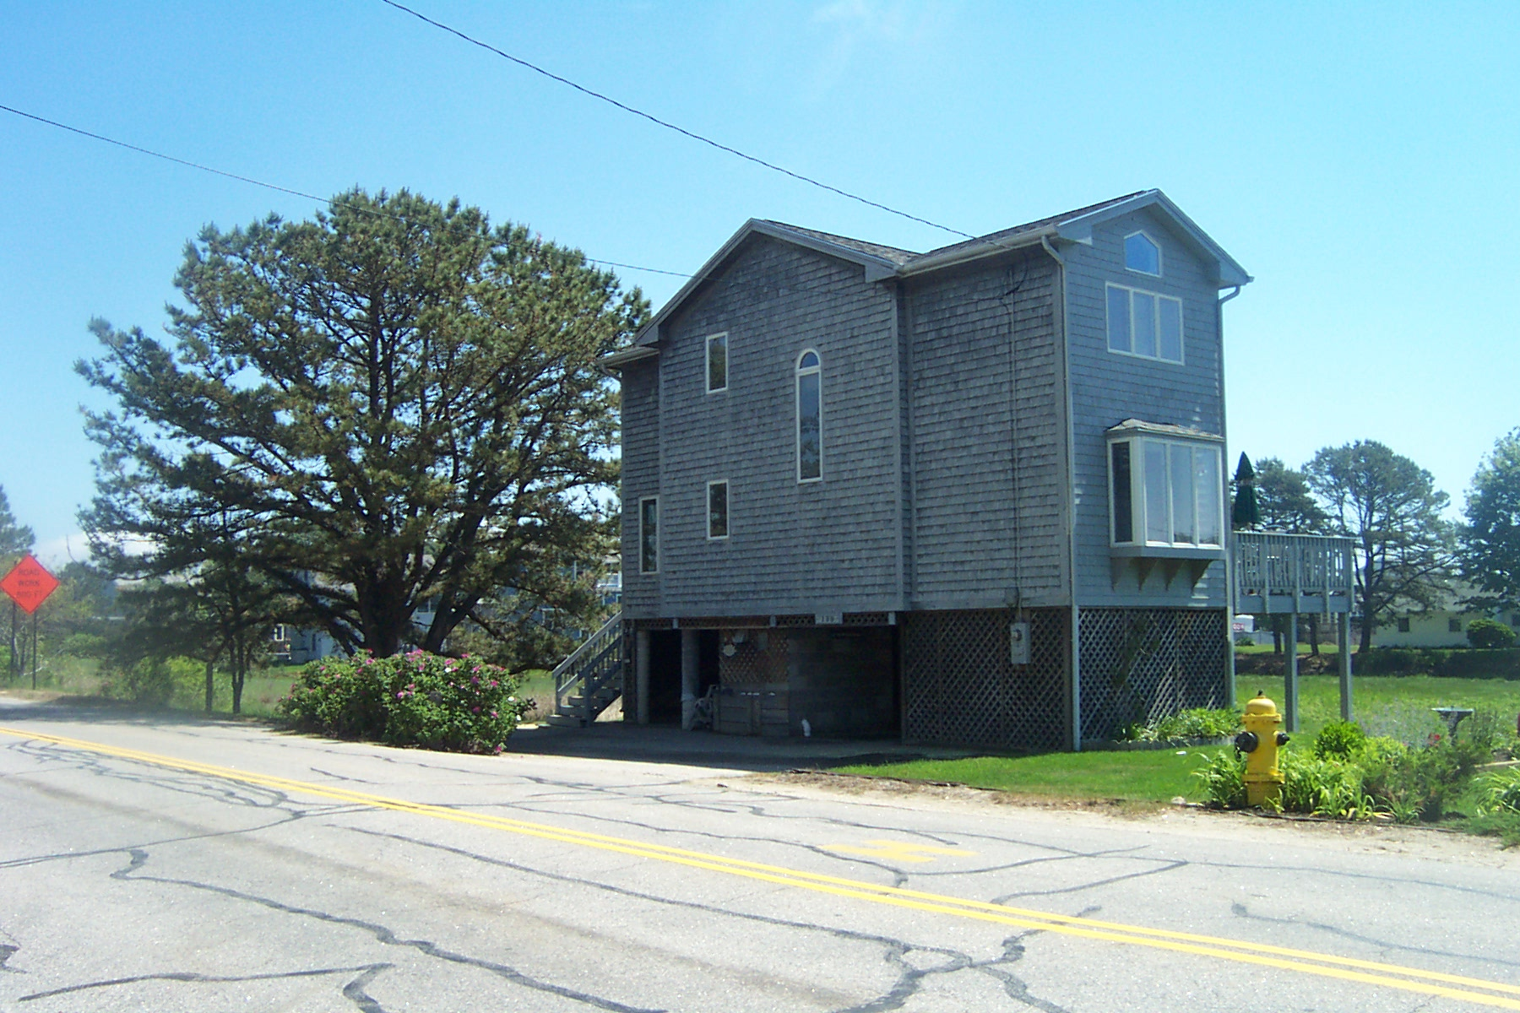

Resiliency Strategy: Incorporating more freeboard into municipal floodplain ordinances to account for storms or increased SLR
P.A. Slovinsky, MGS
The City of Saco made ordinance changes to increase freeboard to three feet above the 100-year Base Flood Elevation (BFE). Also done in South Berwick.

Slide 22
“Low Hanging Fruit” : Flood Insurance Premium Benefits
Annual A-zone policy: $1,556
Annual A-zone policy: $509
Based on 2012 rates for a one-floor residential structure, no basement, post-FIRM, $1,000 deductible with $250,000 coverage and $100,000 contents.
Flood policy rating quotes graciously provided to Maine Floodplain Management Program by Chalmers Insurance Group, www.chalmersinsurancegroup.com

Slide 23
Increase Freeboard
(above 100-year BFE)
One foot (minimum state standard): South Portland, Falmouth, Yarmouth, Freeport, Brunswick, Harpswell, Phippsburg, Bath, West Bath
Two foot (1 foot above state standard): Cape Elizabeth, Portland, Cumberland
Three feet: none.
There’s room for improvement!

Slide 24
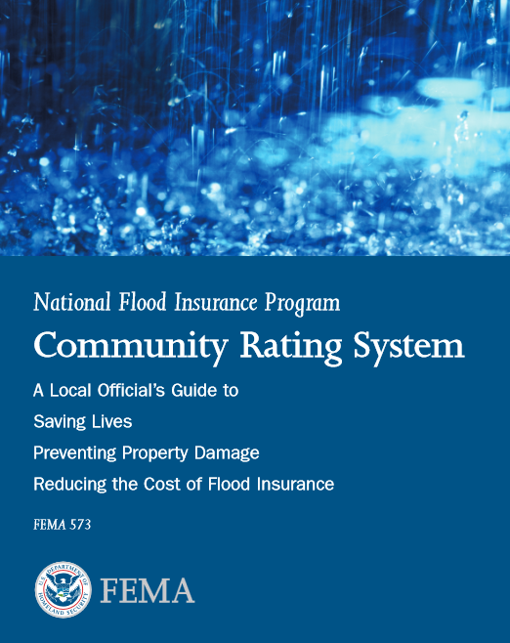
New 2015-2017 Adaptation Strategy Effort
With more properties being located in the 1% flood zone (and higher flood zones!) due to FEMA Flood Insurance
Rate Map remapping, it makes sense to focus on creating community resiliency through existing incentive programs that relate to flood mapping.
Project goal: get more communities to participate in the voluntary FEMA Community Rating System program, and increase scores for participating communities.

Slide 25
The National Flood Insurance Program
Community Rating System (CRS)
CRS has three goals:
Reduce flood damage to insurable property;
Strengthen and support the insurance aspects of the NFIP, and
Encourage a comprehensive approach to floodplain management.
Notes:
A voluntary incentive program that recognizes and encourages community floodplain management activities that exceed the minimum NFIP requirements, resulting in discounted flood insurance premium rates to reflect the reduced flood risk resulting from the community actions.

Slide 26
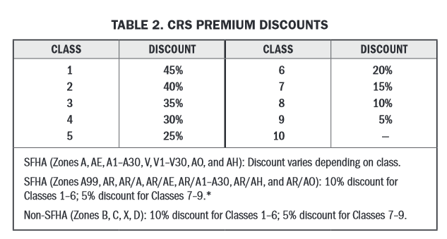
The National Flood Insurance Program
Community Rating System (CRS)

Slide 27
Participation in the CRS Program
Statewide
17 communities of 889* (2%)
In the Coastal Zone
9 coastal communities of 141* (6%)
In Casco Bay
As of April 1, 2015, only Cape Elizabeth (Class 8) and Portland (Class 8) participate in CRS!
* includes unorganized and unincorporated territories that participate in the NFIP.
Notes:
There are only 52 communities in New England in CRS; 17 in Maine! There are efforts underway in Barnstable County, MA, RI, and NH on increasing CRS participation.

Slide 28
Many communities are already doing things that would help earn points towards CRS but don’t even know it…
Shoreland Zoning and open space preservation
Meeting state minimum freeboard standards
Building codes (but no state standard)
Outreach Projects and Floodplain Mapping activities (making information available to the public)
Comprehensive Planning (certain components)
Stormwater/MS4 efforts (certain components)
http://www.wetlandswatch.org/WetlandScience/SeaLevelRise/CRSGuide.aspx

Slide 29
Challenges for the CRS Program in Maine
Lack of knowledge of the program
The amount of documentation required by FEMA to enter the program or maintain annual membership
Technical capability and lack of time or staffing capacity for communities to dedicate to the effort
“Unsavory” municipal and citizen views of FEMA

Slide 30
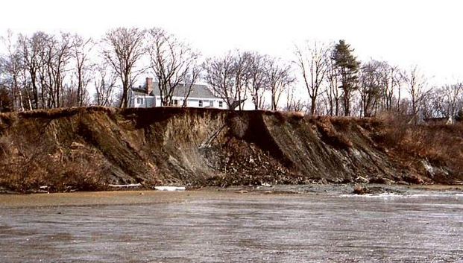
Building Resiliency along Maine’s Bluff Coast
2 year NOAA POSM funded effort
MCP, MGS, MPAP, DMR, NOAA, CCSWCD, UMaine, UMSG, CBEP
Develop more scientifically sound bluff erosion hazard prediction models, maps, and ordinances
Work with selected municipalities to develop a locally-driven effort to create more resilient Casco Bay bluffs

Slide 31
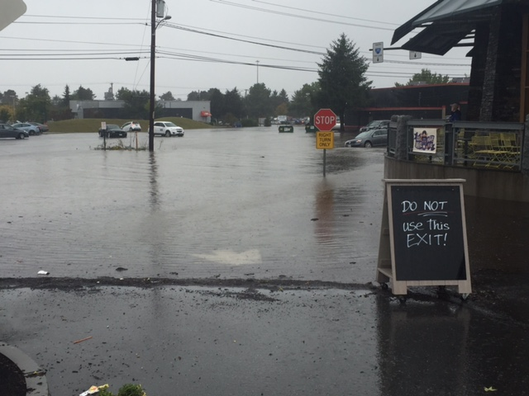
Thank you!
Peter A. Slovinsky, Marine Geologist
Maine Geological Survey
Department of Agriculture, Conservation and Forestry
peter.a.slovinsky@maine.gov, (207) 287-7173
C. Adams, MGS

