Slide 1
Monitoring Casco Bay Connections: a freshwater perspective
Karen Wilson
Dept. of Environmental Science and Policy
University of Southern Maine
karen.wilson@maine.edu
Notes:
Format: Each speaker, including the Moderator, will have up to 15 minutes to describe who they are, their group’s accomplishments, and upcoming initiatives. Then the Moderator will pose questions for the speakers to consider. The Moderator may develop questions or may ask the audience to participate in raising questions. The Moderator may contact the speakers or Curtis Bohlen in advance for suggestions in developing questions. The Moderator will be responsible for keeping the time and ensuring that each panelist has a fair opportunity to speak. There will be a note-taker present in the session.
Possible question: How can we coordinate the efforts of various groups toward the common goal of improving the future health of Casco Bay?

Slide 2
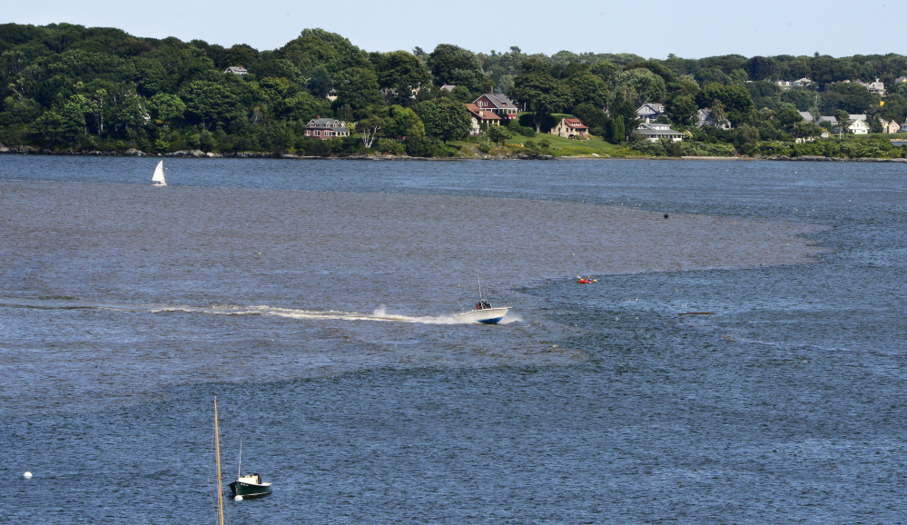
Freshwater-marine linkages
Aug 14, 2014 Presumpscot River plume after a 6 inch rainfall
(Source: Portland Press Herald, Photographer John Patriquin)
Notes:
Photo source: http://www.pressherald.com/2014/08/14/storm-overwhelms-sewer-systems-triggering-shellfish-closures-beach-advisories/

Slide 3
Alewife on their spawning run, Mill Brook, 2014.
Photo: T. Willis.

Slide 4
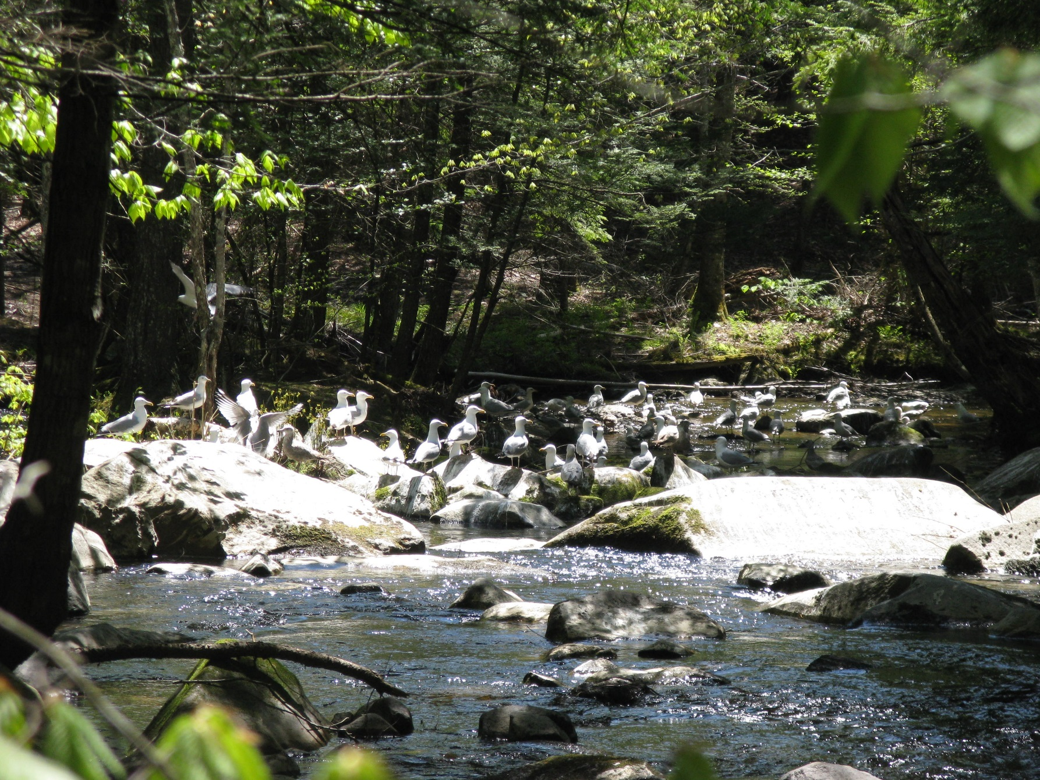
Gulls feeding at Mill Brook (Source: PRLT)

Slide 5
Monitoring
Presumpscot River water quality [Presumpscot River Watch, VRMP, CBEP, DEP, CCSWCD, PWD, USM, EPA, SAPPI]
Presumpscot River fish [IFW]
Highland Lake [VLMP]
Cumberland Mills Dam fish counts [SAPPI]
Highland Lake/Mill Brook alewife spawning run [DMR, USM, CBEP, PRLT, GMRI]

Slide 6
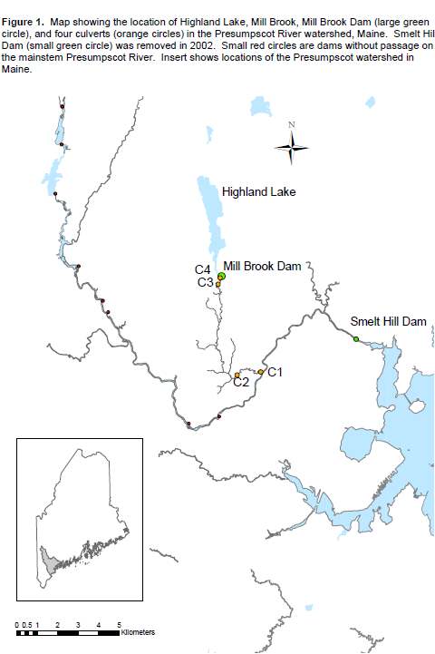
Highland Lake alewife spawning run
Highland Lake
Mill Brook Dam
Former Smelt Hill Dam
Valuable: one of only non-harvested, counted runs
Largest accessible lake habitat in Presumpscot watershed
Presumpscot
Stroudwater
Source: MeDMR

Slide 7
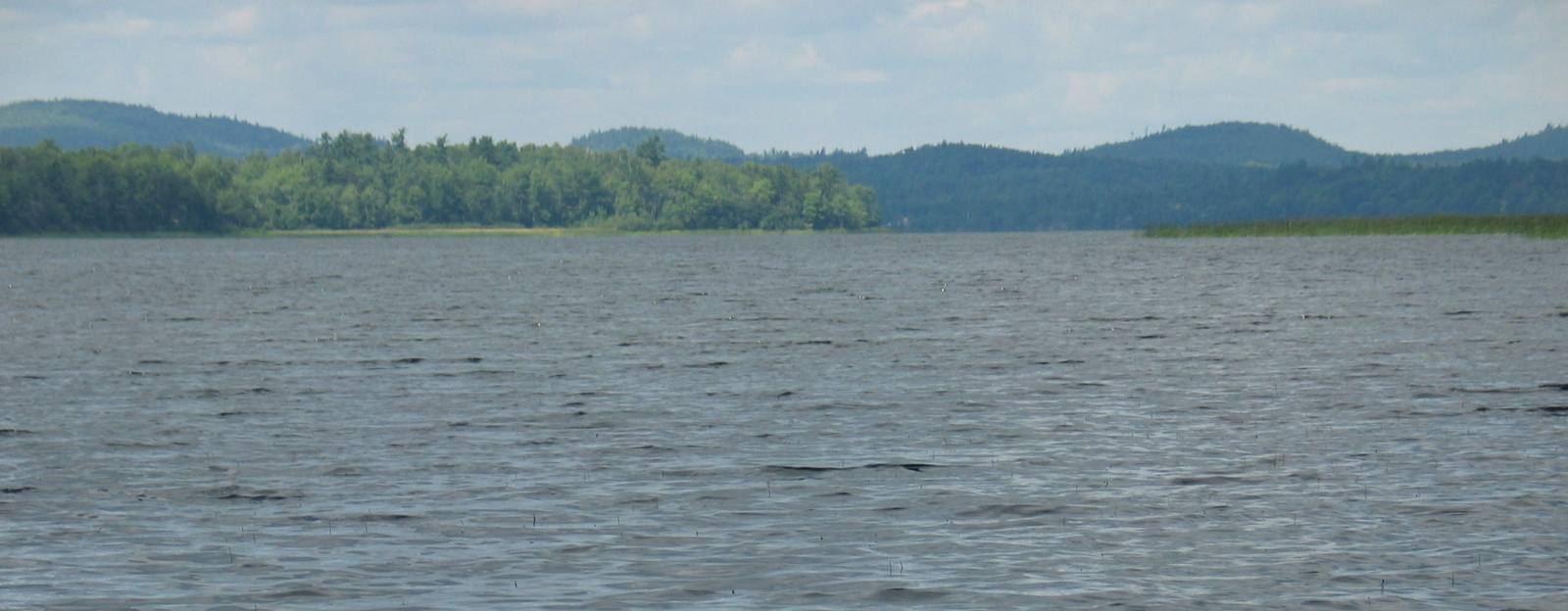
Alewife life history
Freshwater
(natal) spawning adults
young of year
eggs
Spring
Fall
juveniles
3-5 years
at sea
adults
Ocean

Slide 8
restoration timeline
1987 – DMR constructed fishway at Highland Lake outlet dam, stocked lake with alewives for many years
1990 – Fishway constructed at Smelt Hill Dam
2000 – Renewed efforts to stock Highland & improve passage
2002 – Smelt Hill Dam removed
2004 to 2006 – Multi-partner collaboration to improve passage into Highland Lake
Channel restoration
Fishway improvements at upper and lower ends
Entrance guidance weir installed
Baffle replacement, additions, and reconfigurations
New trashrack at fishway exit
2011 – DOT replaced two culverts on Mill Brook
Source: C. Enterline, MeDMR

Slide 9
Alewife stocking & return history
60,000
50,000
40,000
Spawning Adults
30,000
20,000
10,000
0
2000
2002
2004
2006
2008
2010
2012
2014
2016
Year
Stocked Adults
Wild Returns

Slide 10
Presumpscot River Watch (PRW)
Mission: preserve and improve health of the Presumpscot River watershed by scientific monitoring of water quality and sharing data to increase awareness of river conditions (1989)
Monitors: dissolved oxygen, temperature and E. coli bacteria in Presumpscot River & tributaries
Methods: May - Aug sampling early every other weekend at 22+ sites by volunteers
Contact: Fred Dillon, prw@maine.rr.com, 774-6476
Notes:
Dillon, Frederick <fdillon@southportland.org>
12:43 PM (19 hours ago)
to me
Hi Karen,
Sorry for the late reply…I was in Boston yesterday and tied up with other stuff this morning. See my responses to your questions below in red.
Thanks and see you tomorrow!
Fred
From: Karen Wilson [mailto:karen.wilson@maine.edu] Sent: Sunday, October 11, 2015 10:10 PM To: Dillon, Frederick; Dillon, Fred Subject: Thoughts on Monitoring Presumpscot for CBEP talk on Tuesday
Hi Fred,
sorry about the lateness of this email - it may get to you way to late for you to comment. In any case, I'm part of a panel discussing monitoring in Casco Bay at Tuesday's CBEP's meeting, and I want to cover things with a more freshwater emphasis. I'm going to talk about the work I've done with folks on the Highland Lake alewife run, but also I'd like to do a shout out to PRW. I don't know if you'll be talking about what PRW does during the day, but I'd love to put a slide or two into the talk about the PRW: something like:
I won’t be saying anything about PRW tomorrow and instead will be focusing on my work with SoPo. Therefore, it would be great if you could say a few words in support of the work that PRW does – THANKS!
•Since 1989 has been monitoring the Presumpscot River for dissolved oxygen, temperature, and E. coli bacteria (in the early years I believe there was also some nutrient / TSS and macroinvertebrate monitoring) •Mission: preserve and improve the health of the Presumpscot River watershed by scientific monitoring of water quality and sharing data to increase awareness of the condition of the river (from a 2011 Report to DEP) •Methods: volunteers sample ~8x early morning every other weekend at 22+ sites (mainstem & tributaries) – sampling season generally runs from late May until late August •Contact: you can list me as the contact as follows – Fred Dillon / prw@maine.rr.com / 774-6476
And a few questions: Who would be a contact?/credit? I’m fine being the primary point of contact
Is there a take home slide for results that I could show? Since PRW began participating in DEP’s VRMP program several years ago they’ve been doing all of our data summarization. Unfortunately, I haven’t compiled their annual summaries into a larger data set for the purposes of observing longer term WQ trends. I’ve attached DEP’s reports for 2011-2014.
I noticed the CSWCD is listed as the contact for PRW - should I be sure to mention them in any PRW slide? You can credit CCSWCD for providing ongoing admin support in the form of a mailing address and meeting place. In years past they’ve also helped with basic liability insurance coverage for our volunteers through the NRCS’s Earth Team program.
And what other monitoring efforts (on the Presumpscot or other rivers) should/could I mention? Besides the work that DEP, ME DIFW, you and Theo have done, I’m not aware of other monitoring efforts on the Presumpscot. For other volunteer-based monitoring efforts the DEP’s VRMP website identifies 8 groups that have been participating in their program for the past several years. In addition to PRW they are: Androscoggin River Watershed Council, Friend of Merrymeeting Bay, Skowhegan Conservation Commission, City of Lewiston, Mousam and Kennebunk Rivers Alliance, and Rockport Conservation Commission.
Thank Fred... see you on Tuesday (?), Hope this helps and see you tomorrow!
Karen

Slide 11
Other information
Work on Presumpscot and Casco Bay tributaries by Cumberland County Soil and Water Conservation District (watershed plans, etc)
Sebago Lake watershed lakes [PWD, LEA, MFS, CCSWCD, Oxford CSWCD, DEP lakes]

Slide 12
Other information (intermittent)
USM Water Quality class: January - April 2015

