Slide 1
Building Resilience: connecting systems and communities
State of the Bay Conference 2015
Jed Wright, Gulf of Maine Coastal Program, USFWS
Madeline Kinsey, University of California Davis
Notes:
Resilience principles and attributes
Strategies for building resilience socio-ecological systems (SES)
Start the conversation by outlining two areas where we are intervening to increase resilience in Casco Bay

Slide 2
Resilience
The capacity of a system to absorb disturbance and reorganize while undergoing change so as to retain essentially the same function, structure, identity, and feedbacks
Notes:
The goal of a resilience-based approach is not equilibrium, nor is it optimum yield of ecosystem services and products. Rather, the goals are learning, flexibility, and diversity. Connectedness and stability increase while the ecological capital of nutrients and biomass (or, in social systems, institutional networks and mutual trust) accumulate (Zellmer 2008)
How much disturbance can the system—people, infrastructure, resources, and environment—accommodate while still maintaining its basic structure, capabilities, and capacity to function? How far can it bend and adapt without breaking? (Kerner & Thomas 2014)
At the heart of resilience thinking is a very simple notion - Things change - Walker and Scott 2006

Slide 3
Regime shifts
Semi-arid rangelands that are overgrazed suddenly flip from a grass dominated regime to one with shrubs- undergrazed become deserts
Notes:
Results in regime shifts
Ecosystem services change
Carp in lakes - change water clarity, population structure and ecosystem services

Slide 4
Restoration
“returning an ecosystem to a close approximation of its condition prior to disturbance”
National Research Council 1992
Notes:
Planning for risk and uncertainty, rather than planning for current conditions or a known future

Slide 5
Developing strengths, acquire skills to cope, recover from hardships, and be prepared for future challenges
Connectivity
Social Capital
Modularity
Feedback
Institutions
Notes:
Mirrors
Build friendships, networks, reach out to others
Help your child by having him or her help others - create trust
When there is a situation outside of the home that is frightening, limit the amount of news your children watch or listen to
Tough times are often the times when children learn the most about themselves
Institutions - family, school, clubs, etc.

Slide 6
Nine Resilience Properties
Diversity
Ecological variability
Modularity
Acknowledgement of slow variables
Tight feedbacks
Social capital
Innovation
Overlap in governance
Ecosystem services
Walker & Salt 2006
Notes:
What attributes reflect whether a system will be able to continue to function and
retain its identity in the face of existential challenges? (Kerner and Thomas 2014)

Slide 7
Social
Ecological
Social Capital
Innovation
Overlap in Governance
Ecosystem Services
Diversity
Modularity
Tight Feedbacks
Ecological Variability
Acknowledging Slow Variables
Notes:
Resilience is both a characteristic of social and ecological systems - we exist in social systems that are linked with ecological systems.
Entrenched stakeholders and institutions can present challenges

Slide 8
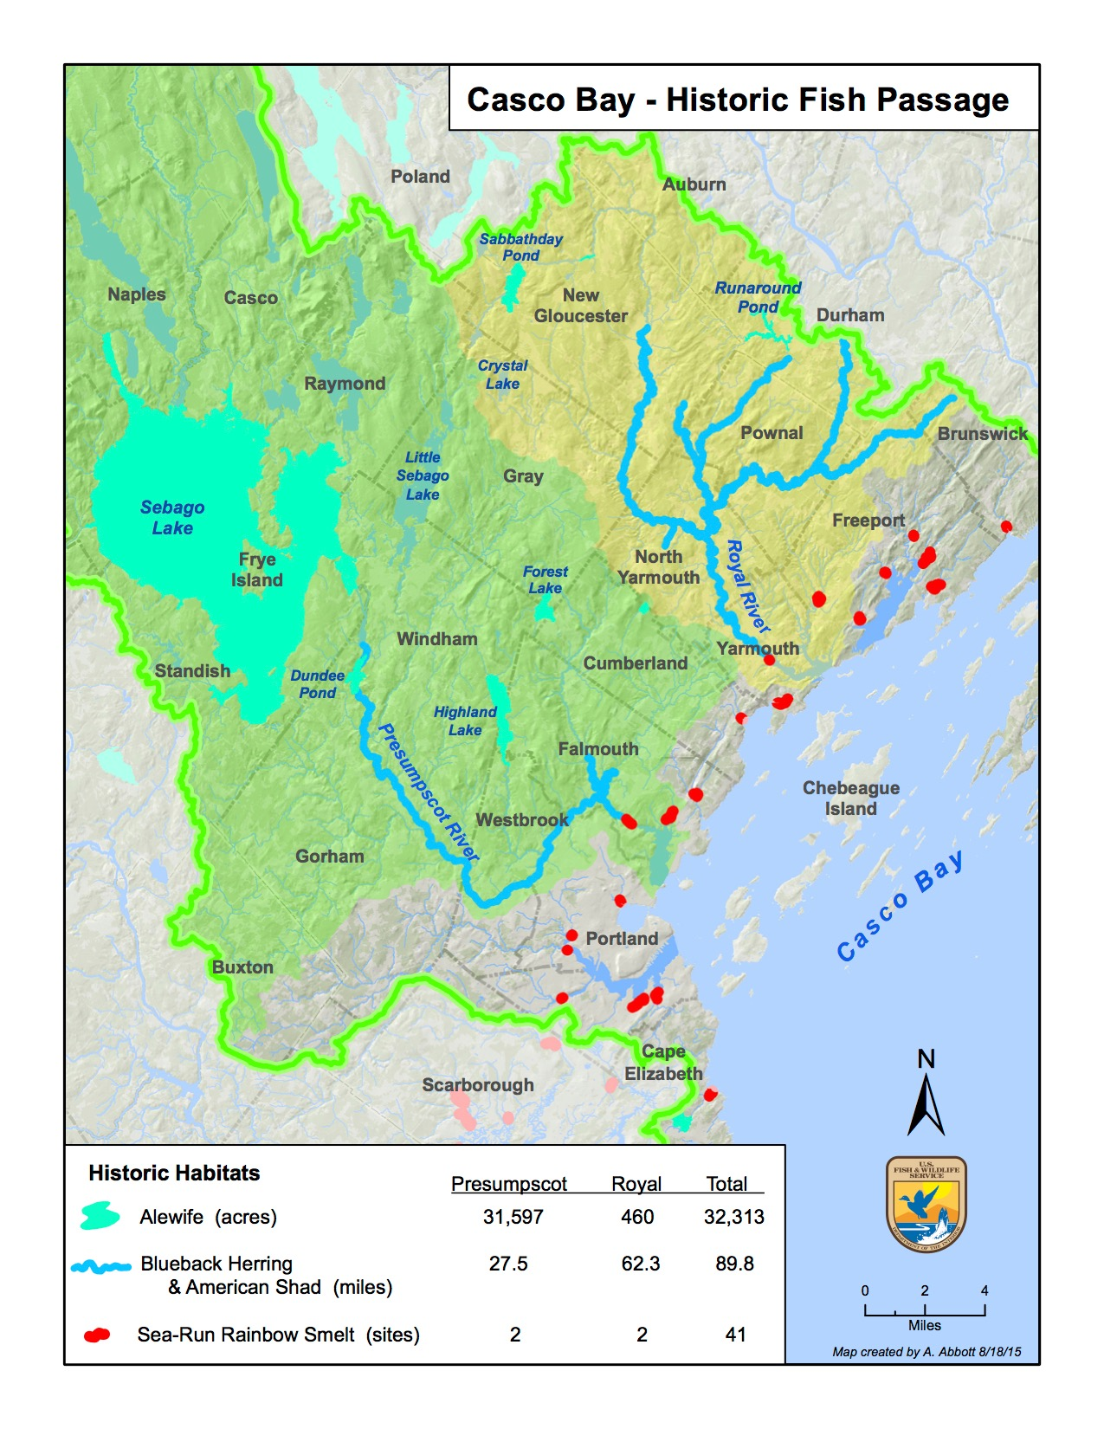

Slide 9
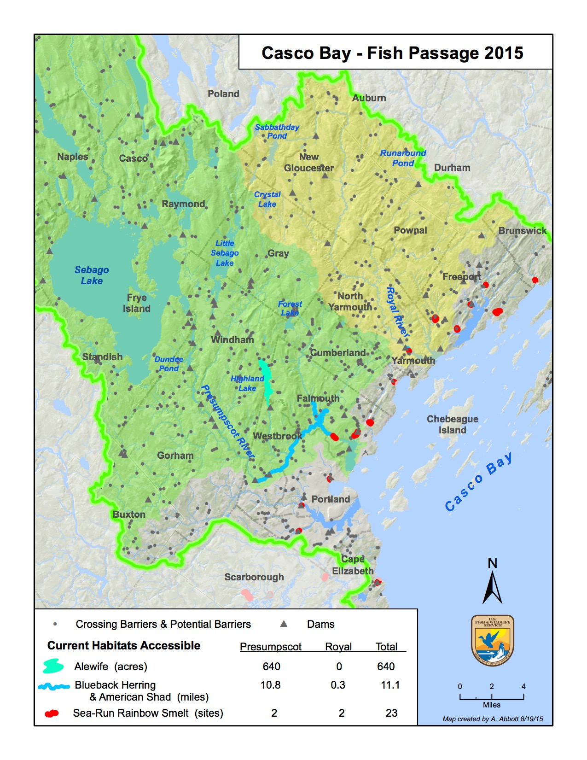
Notes:
Impacted both social and ecological systems

Slide 10
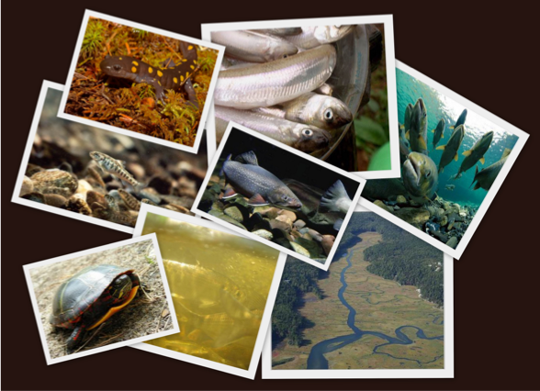
Diversity
Notes:
Diversity - source of future options
Diversity - when we limit diversity limit options - monocultures
Fragmentation results in lower habitat diversity
Balance diversity with function - invasive species might outcompete native riparian vegetation

Slide 11
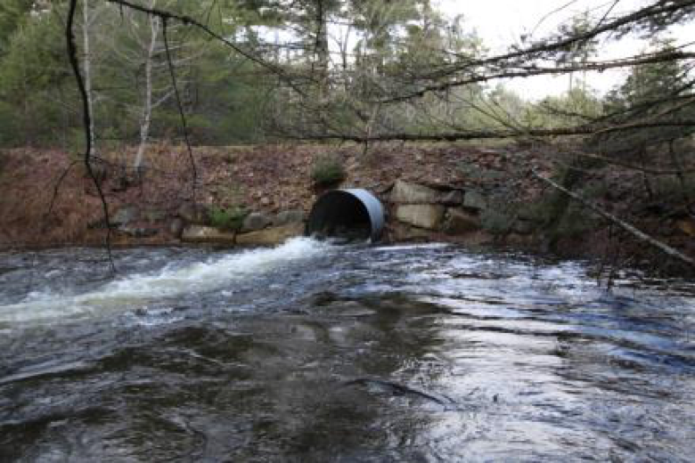
Ecological variability
Notes:
Ecological variability - allow for disturbance and change
Ecological variability - when we dampen and control ecological variability we cause problems (dams tamper flows)
Undersized structures reduce sediment and wood transport, create thermal impacts, regulate flow

Slide 12
Slow variables
Notes:
May degrade resilience of system to shock.s We are currently creating a stream temperature network to identify areas that may retain cool water inputs.

Slide 13
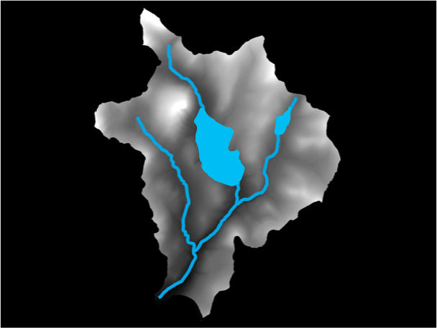
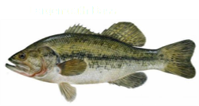
Modularity
Notes:
Modularity - Need connectivity, but also need to control for shocks that may travel through system
Modularity - protect against spread of invasive species
Managers should try to avoid opening habitat for fish that may be unsuitable, which could include waters that are too warm for the fish or have invasive
species that outcompete the brook trout

Slide 14
Overlap in governance
Notes:
Overlap in governance - Is there redundancy in institutions?
Diverse governance groups managing the ecosystem means there
are multiple groups involved including local, state, and federal governmental agencies as well as relevant non-governmental groups. With multiple stakeholders managing conservation, the hope is that different interests and perspectives are brought to the table to enhance planning

Slide 15
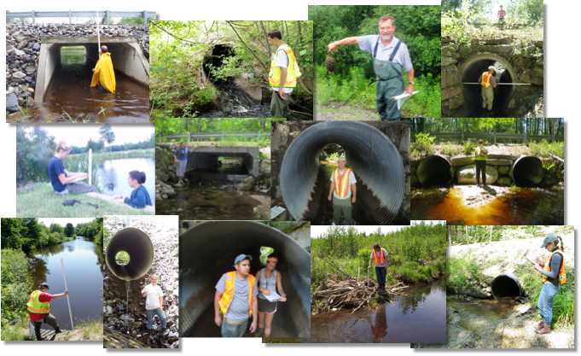
Social capital
Notes:
Social capital - Is there a high level of trust, strong networks, leadership, networks? How do institutions respond in a time of crises?

Slide 16
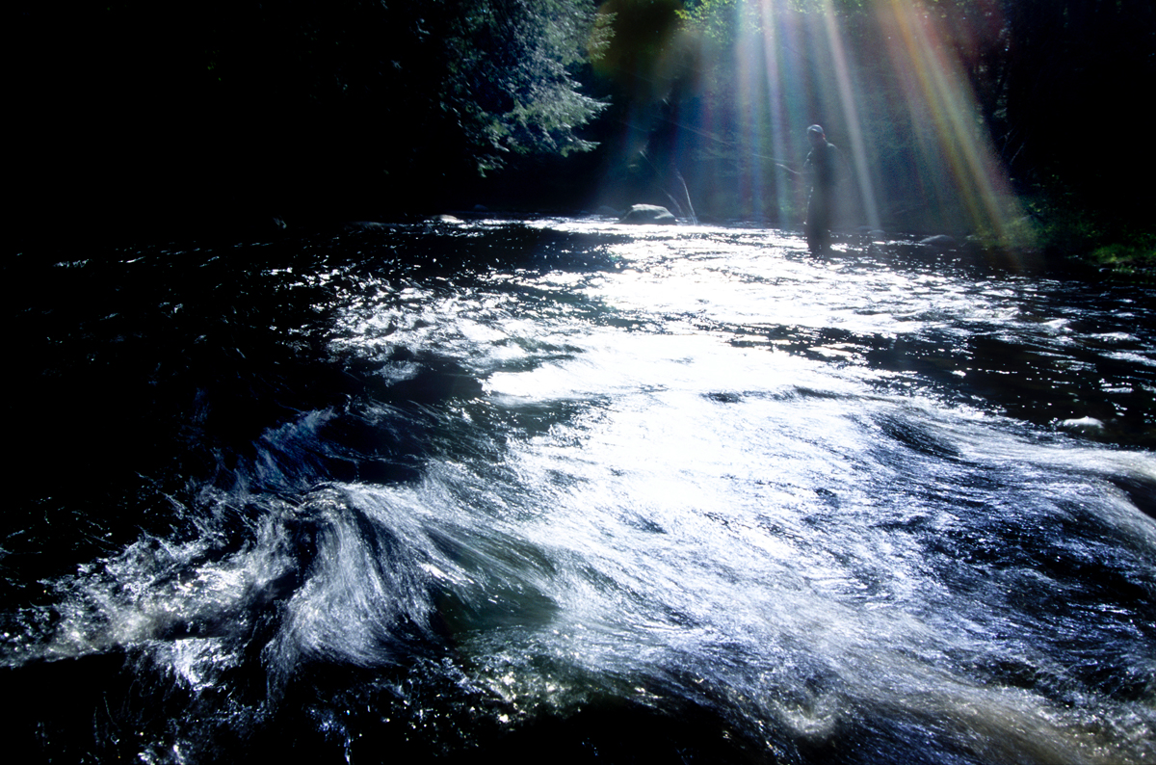
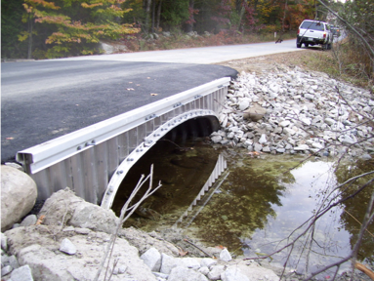
Ecosystem Services
Notes:
Ecosystem services - Have we recognized “free”benefits that society gets from ecosystems (e.g pollination, water quality, etc.)?
Ecosystem services are all of the benefits that humans obtain from ecosystems
Supporting, provisioning, regulating, and cultural

Slide 17
Innovation
Notes:
Innovation - Is there an environment that encourages learning, experimentation, embracing change?
Institutional factors (permitting, etc.) can restrict innovation

Slide 18
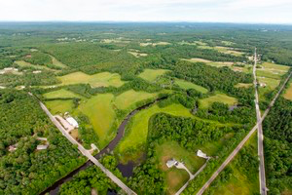
River corridor management
Identify, protect and restore, river processes that promote long term river equilibrium (stability) and sustain quality habitat
Stream geomorphic assessments

Slide 19
How do you building resiliency in a landscape where linkages between social and ecological systems are weak?

