Slide 1
1
2
3
4
5
6
7
Figure 1. Tree map of relative abundance of 43 species encountered in seine sampling for CBASS. The top 7 species (in box) make up 98.6% of all fish caught. The other species are listed in order of declining abundance. The smaller boxes in figure (10-43) are intentionally not discernable to highlight the relative rarity of these species.

Slide 2
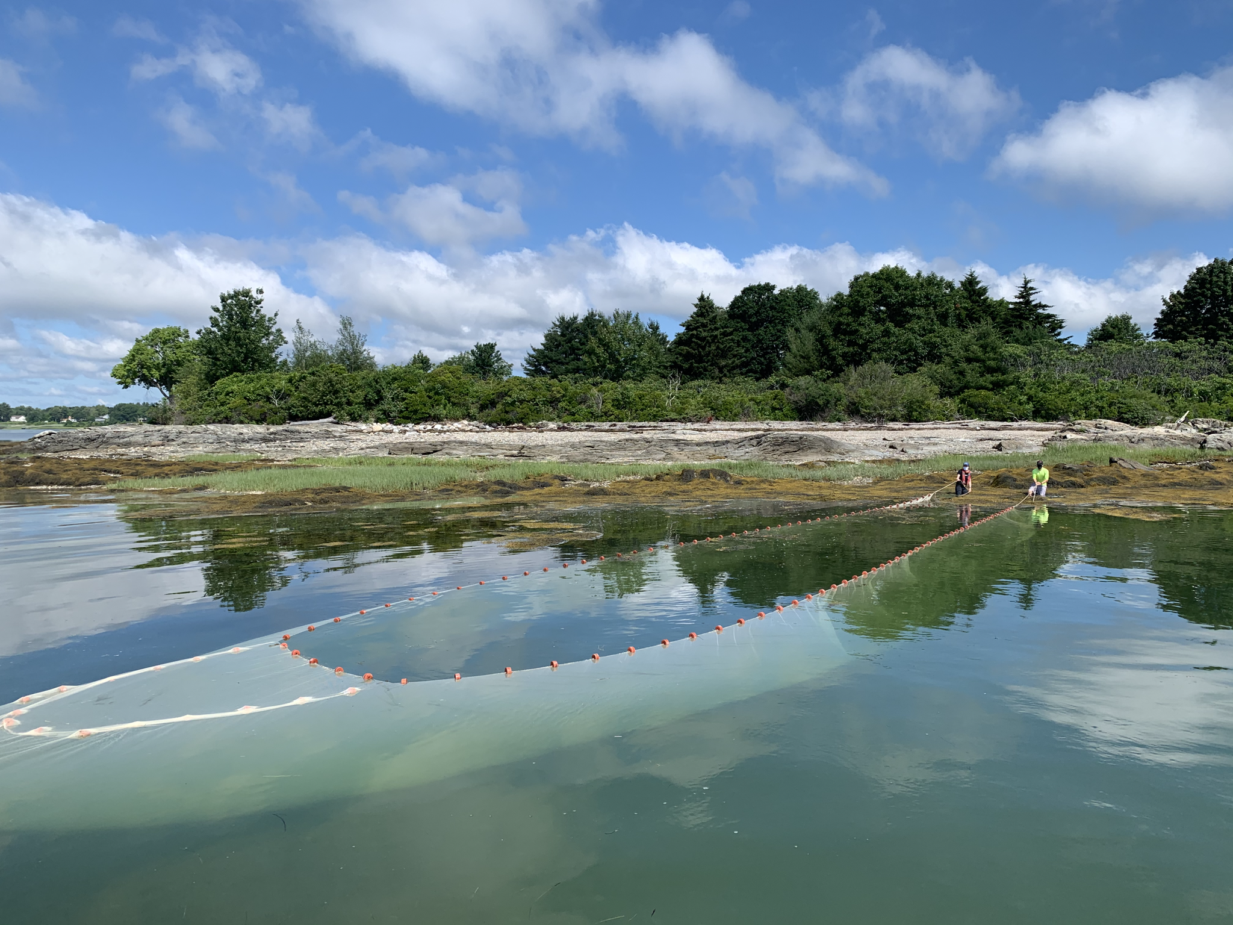
Figure 2. Seining at The Brothers (off Falmouth) in Casco Bay (Photo: G. Sherwood).

Slide 3
Figure 3. Map of western Casco Bay showing location of 12 seine sites further classified as Presumpscot River, Inner Bay and Outer Bay sites (separated by dotted lines). Tree maps on left show relative abundance of the top 7 species at these sites (see figure 1 for species’ color legend).

Slide 4
Figure 4. Abundance trends for the top 7 species from seine sampling (2014-2018). See inset for how to read this figure.

Slide 5
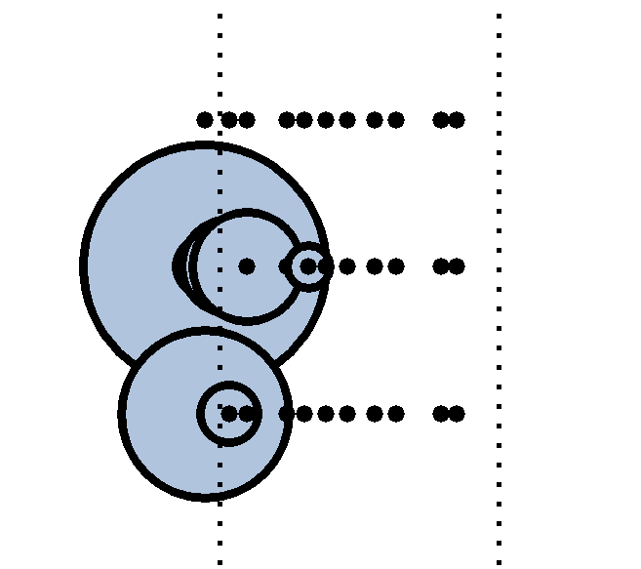
Figure 4 inset: How to read this figure: This box (a blowup of grey box in full figure) shows results for Atlantic herring in 2016. The top row of points is for outer Casco Bay seine sites (no herring were caught as shown by small black dots), the middle row is for inner Casco Bay seine sites, and the bottom row of points is for Presumpscot River seine sites. The size of the circle represents the relative number of herring caught; more herring were caught at beginning of summer than end of summer. The dotted vertical lines are first day of summer (left) and last day of summer (right).
Size of circle represents relative number of fish caught
Outer Casco Bay
Inner Casco Bay
Lower Presumpscot River
June 21st
Sept 21st

