Slide 1
Maine Seagrass Summit, Fall 2025: Seagrass Status Update
Angela Brewer
Section Leader, Marine Unit
Division of Environmental Assessment
Bureau of Water Quality

Slide 2
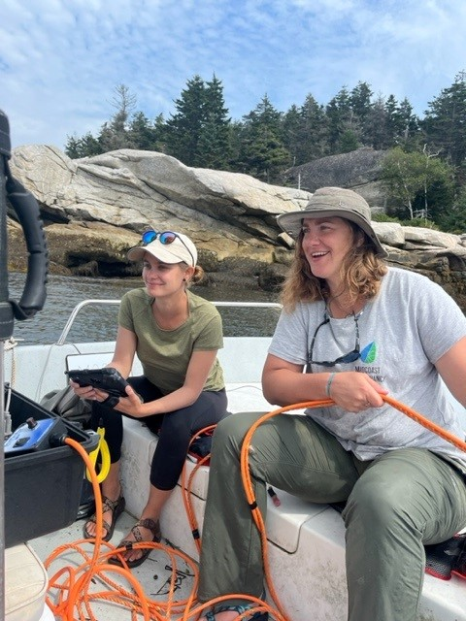
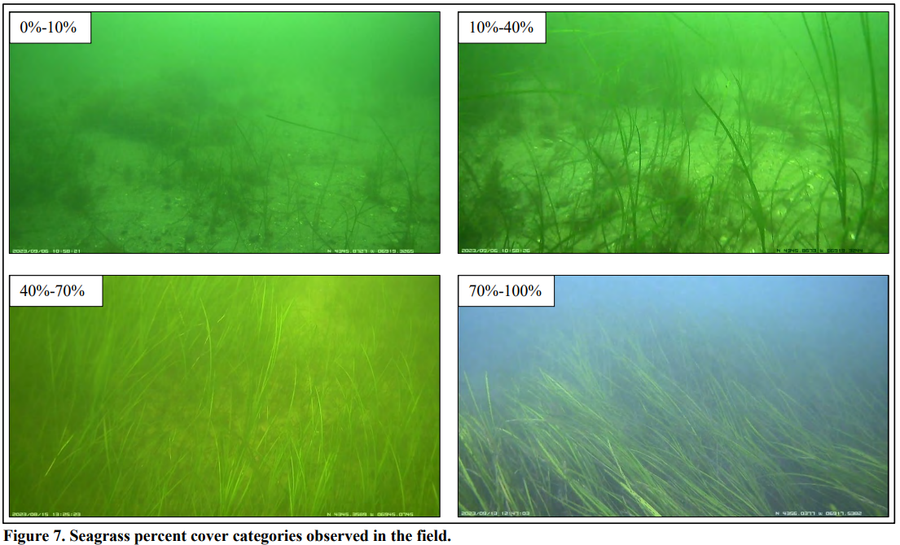
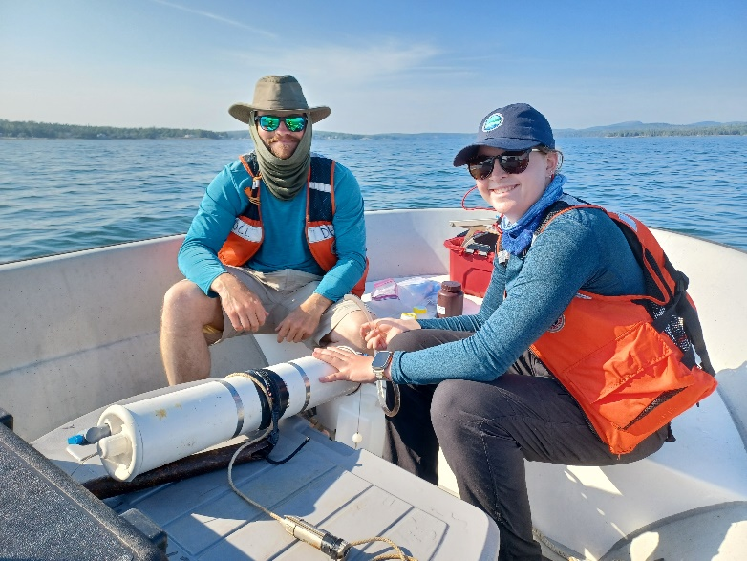
Marine Environmental Monitoring Program
Lead: Angela Brewer (angela.d.brewer@maine.gov)
state funded as of 2023
regional rotation with anthropogenic gradient
3 estuaries/embayments, 3-6 sites each
May-Oct. water quality, sediment sampling, every three weeks on alternating ebb and flood tides
Marine Vegetation Mapping Program
Lead: Cheyenne Adams (cheyenne.adams@maine.gov)
state funded as of 2023
regional rotation of supratidal to shallow subtidal zone, from Head of Tide to 3 nm
June-Aug. low tide imagery followed by field verification

Slide 3
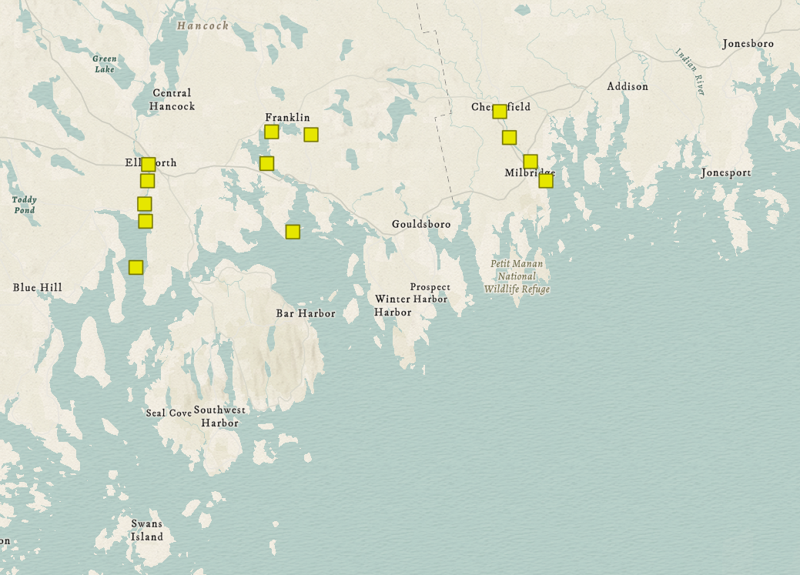
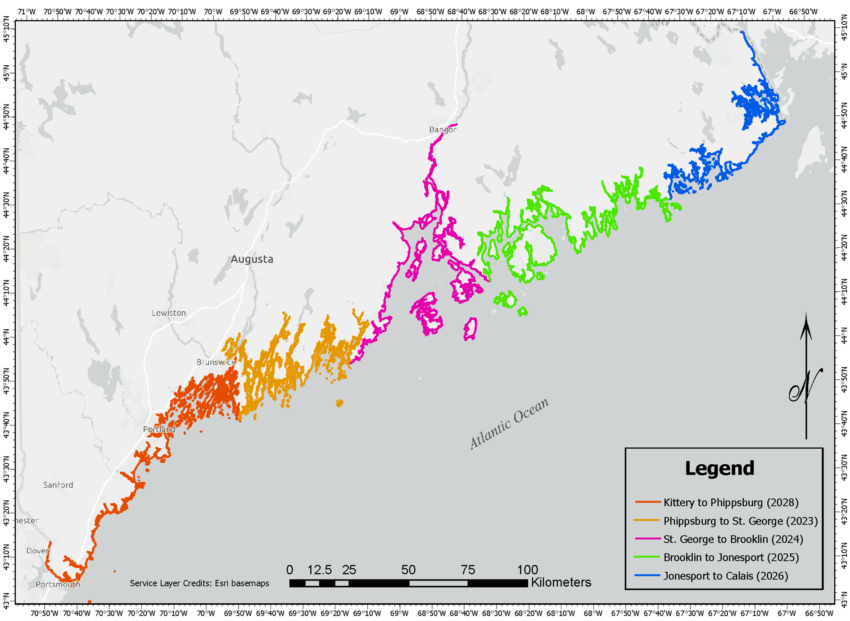

2025 water quality sites
Marine Veg. Mapping Program biennial reports, annual imagery & GIS layers published on ME Geolibrary
(2027)

Slide 4
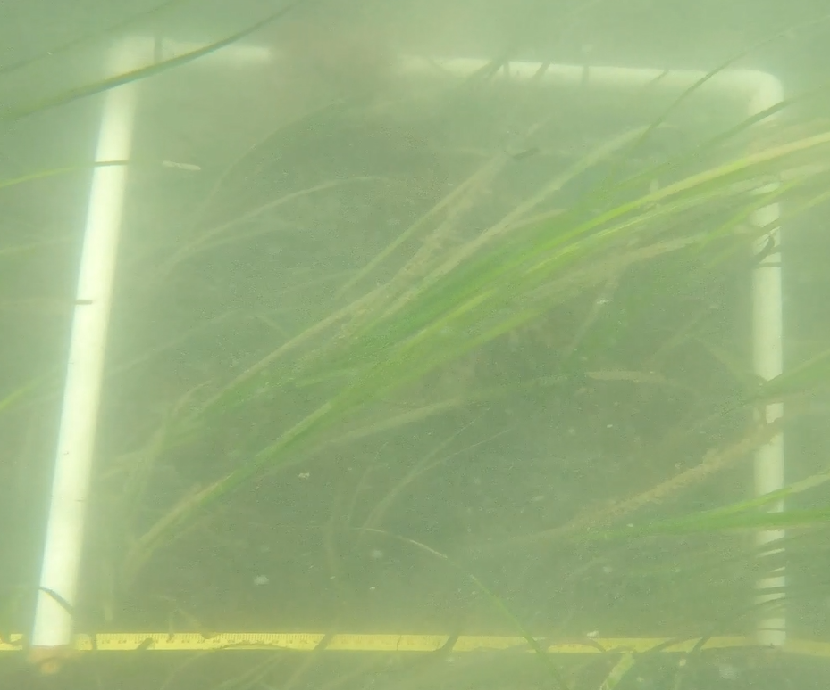
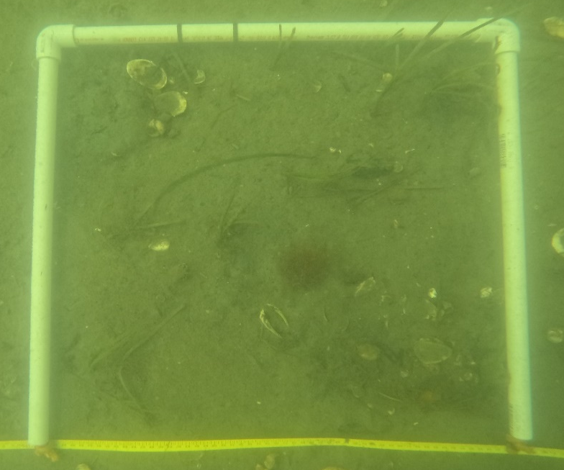
Why eelgrass?
Docks, piers, bulkheads
Boat props, moorings
Wild harvest, aquaculture
Sept. 2022: quad. S7
Sept. 2023: quad. S7
Invasive species
Erosion (ice, swell)
Disease
Sea level rise
High nitrogen levels
Lowering salinity
Warming temperature
Light attenuation

Slide 5
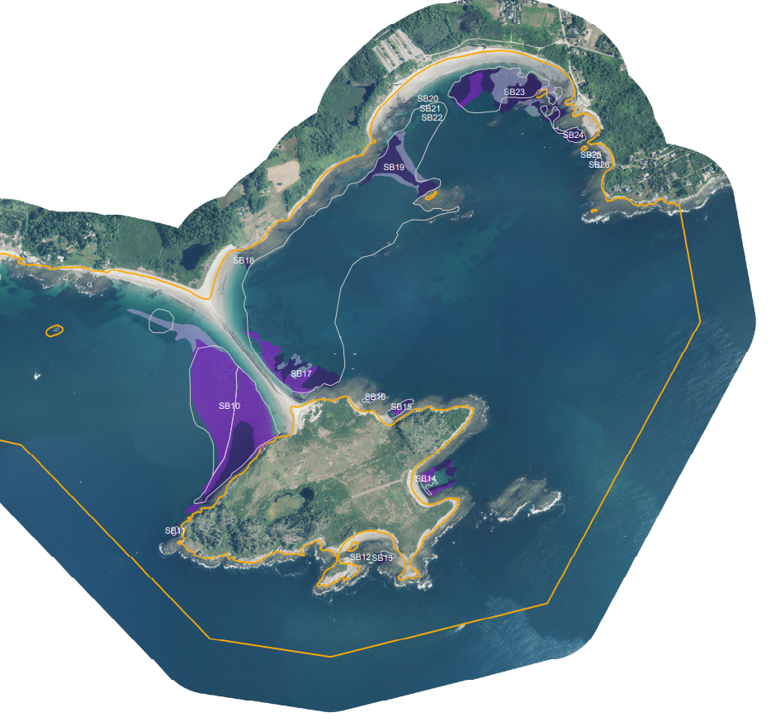
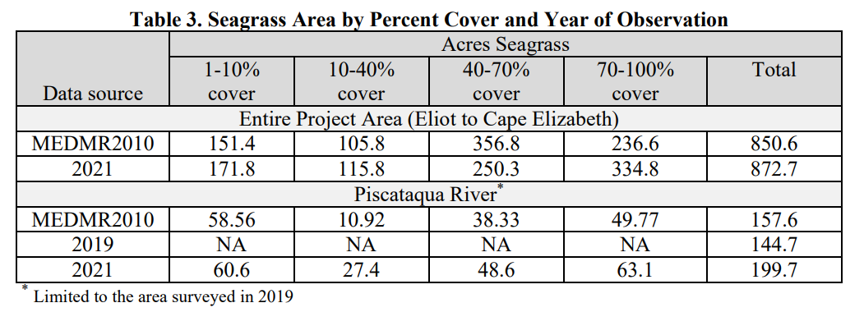
Southern Maine (1993/95, 2010, 2021)
Adds data richness to Great Bay estuary eelgrass mapping
Region without substantial suitable habitat
Largest increases: Portsmouth Harbor, S of Vaughan Island (Kennebunkport), N of Biddeford Pool, NW of Richmond Island (Cape Elizabeth)
Largest decrease: NE of Richmond Island

Slide 6
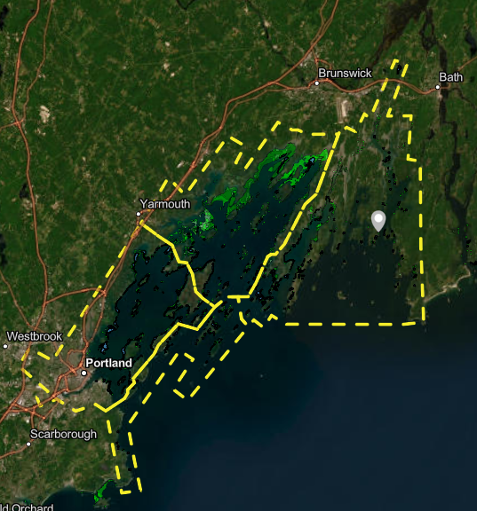
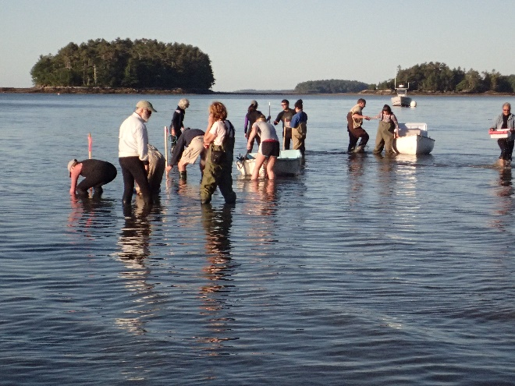
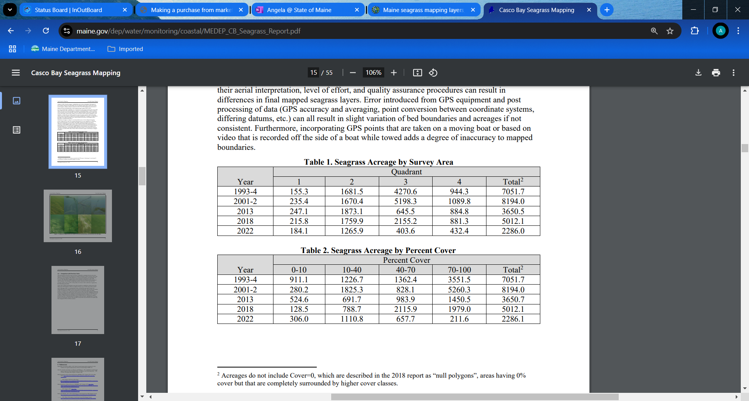
Casco Bay (1993/94, 2001/02, 2013, 2018, 2022)
3
4
2
1

Slide 7
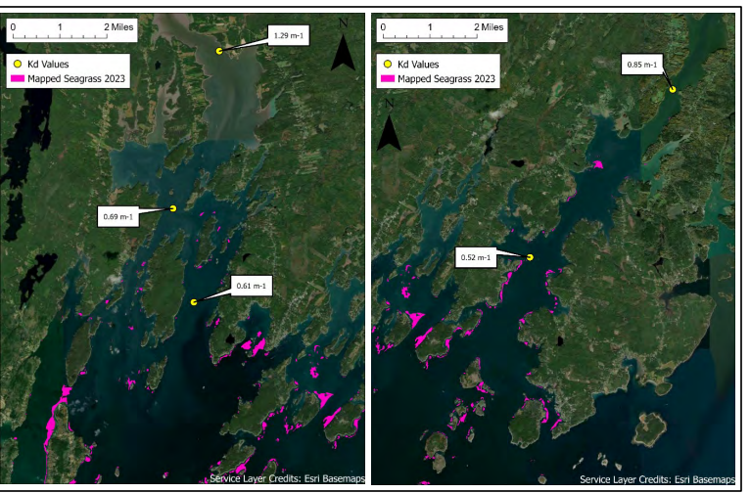
Midcoast (1994/95, 2004/05, 2023)
Many small, patchy beds
60% decline from 2005-2023
Most declines of large beds in upper estuaries: Great Salt Bay (Damariscotta, etc.), Medomak River (Waldoboro), W of Westport Isl.
Eelgrass mapped in Monhegan!

Slide 8
Regional mapping summary since 1990s
So. Maine: 5%
Casco Bay: 67%
Midcoast: 67%

Slide 9
Portland area focus
% cover declined before density – many observations of seedlings not reaching maturity
2025 temperature cooler overall than 2024, reappearance of patchy eelgrass

Slide 10
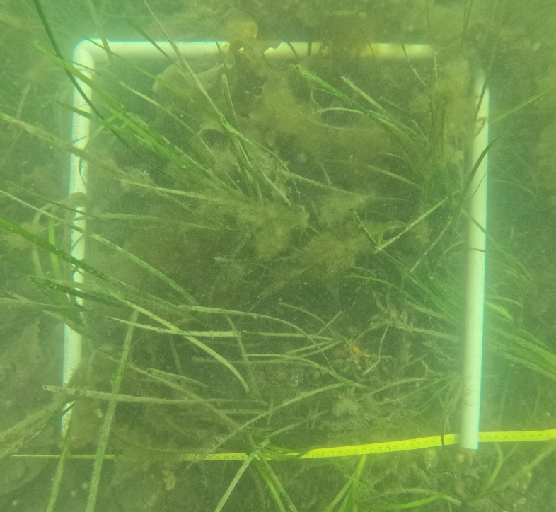
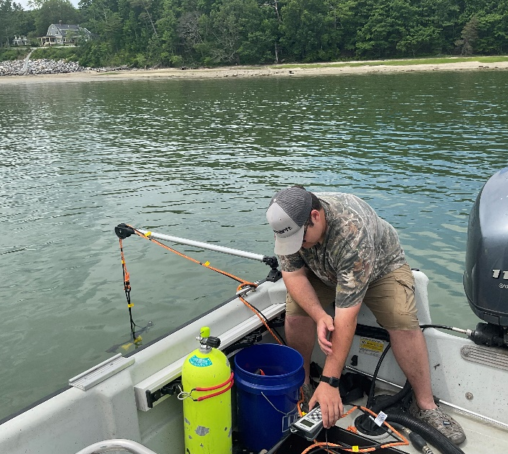
Fort Gorges, 9/2025
Major eelgrass losses by 2022 not explained by irradiance data
2025: warmest site has greatest light availability & vice versa

Slide 11
Summary
Consistent loss in eelgrass area in the Casco Bay and Midcoast regions since 1990s—more to come on Penobscot Bay and Acadia in March 2026 report
In Portland area, losses seem correlated to temperature more so than irradiance, but many confounding factors
Restoration potential needs to carefully consider multitude of stressors
ME Climate Action Plan + Marine Vegetation Mapping Program + ME Seagrass Consortium + grant opportunities + amazing partners = vast increase in ME seagrass knowledge & ability to leverage funding for monitoring, research & restoration, where feasible

Slide 12
DEP Marine Unit webpage
Angela Brewer, 207-592-2352 angela.d.brewer@maine.gov

